Slide 1
Environmental toxicity evaluation
Jouni Tuomisto, THL, Kuopio

Slide 2
Outline
Diclofenac and vulture crisis
Glyphosate and putative human health risk
Neonicotinoids and ecological risks on bees
Lessons learned

Slide 3
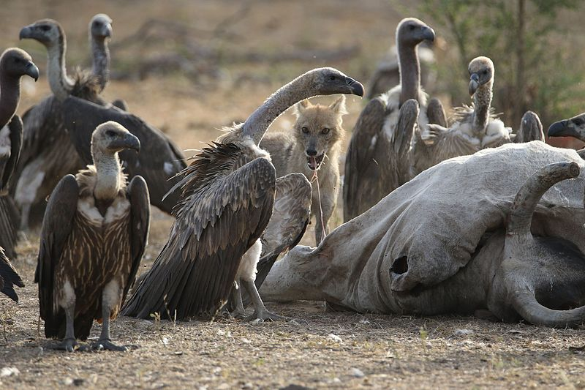
Notes:
https://en.wikipedia.org/wiki/File:Vulture_and_Jackal_eating_together.jpg
https://en.wikipedia.org/wiki/White-rumped_vulture

Slide 4
Vultures in India
In 1980’s, 80 million white-rumped vultures (Gyps bengalensis, OWBV)
500 million cattle in India, 4 % used for human food. Most are carried to carcass depositories after death.
In 1990’s a rapid and major decline observed (20-50%/a)
First suspects: pathogenic microbes
Breakthrough in 2003: diclofenac (Voltaren®) fed to cattle as analgesic
Notes:
https://en.wikipedia.org/wiki/Indian_vulture_crisis
Oaks et al. 2004 Nature volume 427, pages 630–633 (12 February 2004) http://dx.doi.org/10.1038/nature02317
GREEN, R. E., NEWTON, I., SHULTZ, S., CUNNINGHAM, A. A., GILBERT, M., PAIN, D. J. and PRAKASH, V. (2004), Diclofenac poisoning as a cause of vulture population declines across the Indian subcontinent. Journal of Applied Ecology, 41: 793–800. http://dx.doi.org/10.1111/j.0021-8901.2004.00954.x

Slide 5
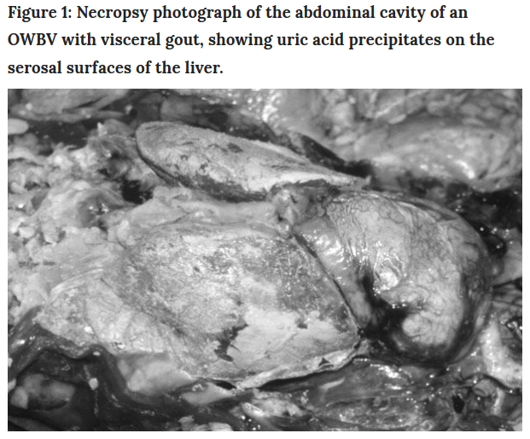
Notes:
Oaks et al. 2004 Nature volume 427, pages 630–633 (12 February 2004) http://dx.doi.org/10.1038/nature02317
https://www.nature.com/articles/nature02317#f1

Slide 6
Diclofenac studies
Diclofenac leads to renal failure in vultures damaging their excretory system [direct inhibition of uric acid secretion in vultures].
In buffalos: 2.5 mg/kg/d → 5.7, 1.5 and 0.76 µg/g in kidney, liver, and muscle, respectively.
Meat with 6.4 µg/g diclofenac → doses 0.005 - 0.3 mg/kg in vultures.
2/8 died of renal failure; concentrations 0.07 and 0.38 µg/g in kidney.
Notes:
Oaks et al. 2004 Nature volume 427, pages 630–633 (12 February 2004) http://dx.doi.org/10.1038/nature02317
https://www.nature.com/articles/nature02317#f1
https://www.pmfias.com/diclofenac-indian-vulture-crisis/

Slide 7
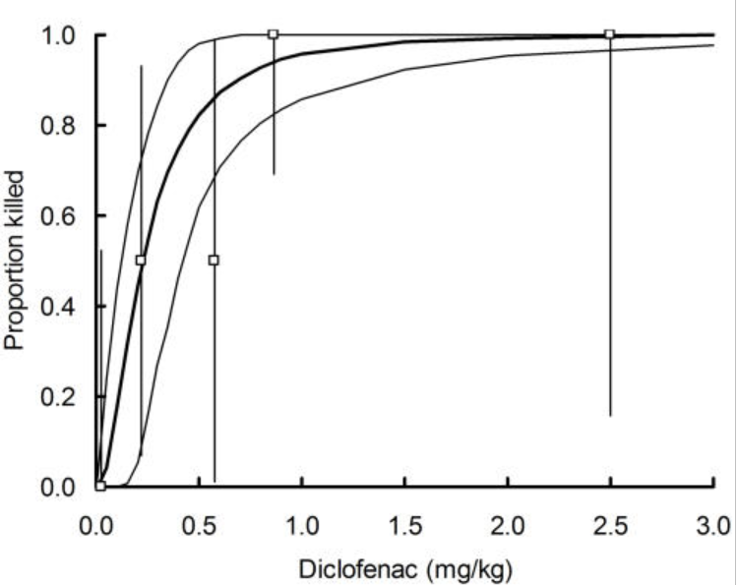
Acute toxicity of diclofenac in vultures (OWBV)
Notes:
https://www.ncbi.nlm.nih.gov/pmc/articles/PMC1930156/
PLoS ONE. 2007; 2(8): e686.
Published online 2007 Aug 1. doi: 10.1371/journal.pone.0000686
PMCID: PMC1930156
Rate of Decline of the Oriental White-Backed Vulture Population in India Estimated from a Survey of Diclofenac Residues in Carcasses of Ungulates
Rhys E. Green,1,2,* Mark A. Taggart,3,4 Kalu Ram Senacha,5 Bindu Raghavan,5 Deborah J. Pain,2 Yadvendradev Jhala,6 and Richard Cuthbert2

Slide 8
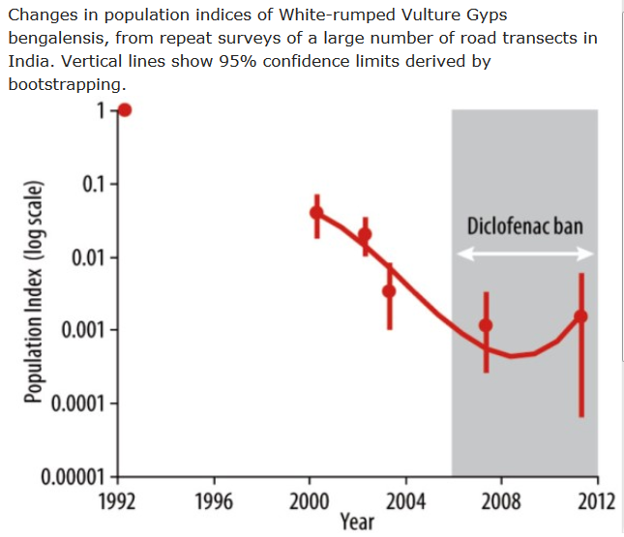
Notes:
Source: Cuthbert et al . (2011) PLoS ONE 6(5): e19069, Jamshed et al . (2012) Bird Conservation International 22: 389–397, Prakash et al . (2012) PLoS ONE 7(11): e49118.
http://datazone.birdlife.org/sowb/casestudy/vultures-are-under-threat-from-the-veterinary-drug-diclofenac

Slide 9
Vultures had an important sanitation role in India
Disappearance → explosion of rats and wild dogs and the spread of diseases (costs of up to US$25 billion) (as of 2015).
The carcasses rot in village fields → contaminated drinking water.
A vulture’s metabolism is a true “dead-end” for pathogens, but dogs and rats become carriers of the pathogens.
The mammals also carry diseases from rotting carcasses such as rabies, anthrax, plague etc. and are indirectly responsible for thousands of human deaths.
Notes:
https://www.pmfias.com/diclofenac-indian-vulture-crisis/
https://blogs.scientificamerican.com/extinction-countdown/indian-vultures-are-dying-for-some-good-news/

Slide 10
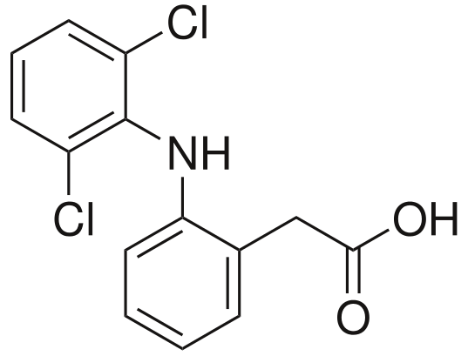
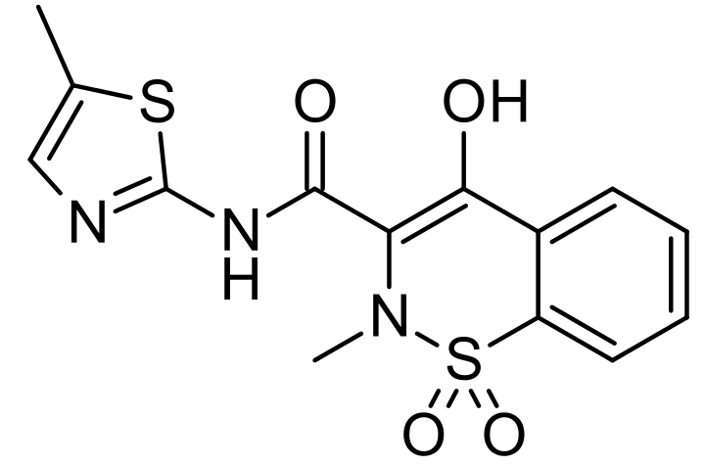
Diclofenac and alternative meloxicam

Slide 11
Diclofenac alternative
The drug was banned for veterinary use in India in March, 2006; Nepal and Pakistan followed suit shortly thereafter.
A replacement drug was quickly developed and proposed after tests on vultures in captivity: meloxicam.
Meloxicam affects cattle the same way as diclofenac, but is harmless for vultures.
Diclofenac for humans is in veterinary uses through black markets in certain parts of India.
Discussion ongoing about griffon vulture in Spain (no bans to veterinary use in the EU).
Notes:
https://www.pmfias.com/diclofenac-indian-vulture-crisis/
https://blogs.scientificamerican.com/extinction-countdown/indian-vultures-are-dying-for-some-good-news/
https://www.nature.com/news/cattle-drug-threatens-thousands-of-vultures-1.19839

Slide 12
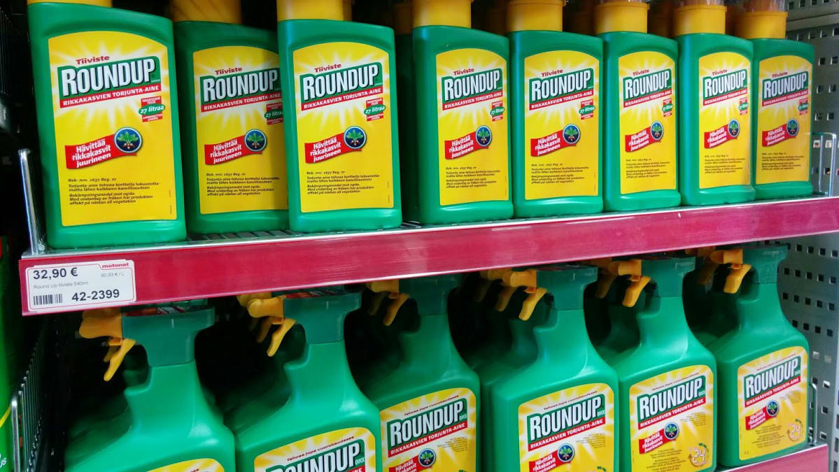
Glyphosate regulation in the EU

Slide 13
Glyphosate
One of the most popular herbicides in the world.
Widely used to kill weed on fields after harvesting.
In some countries, also used to accelerate ripening before harvesting (not allowed in Finland).
Commonly used in gardens.
Consumption at top year 2010 was 900 tons in Finland.
Mode of action: prevents a crucial enzyme in plant amino acid production: 5-enol-pyruvyl-sikimate-3-phosphate synthase. This enzyme does not exist in animals.

Slide 14
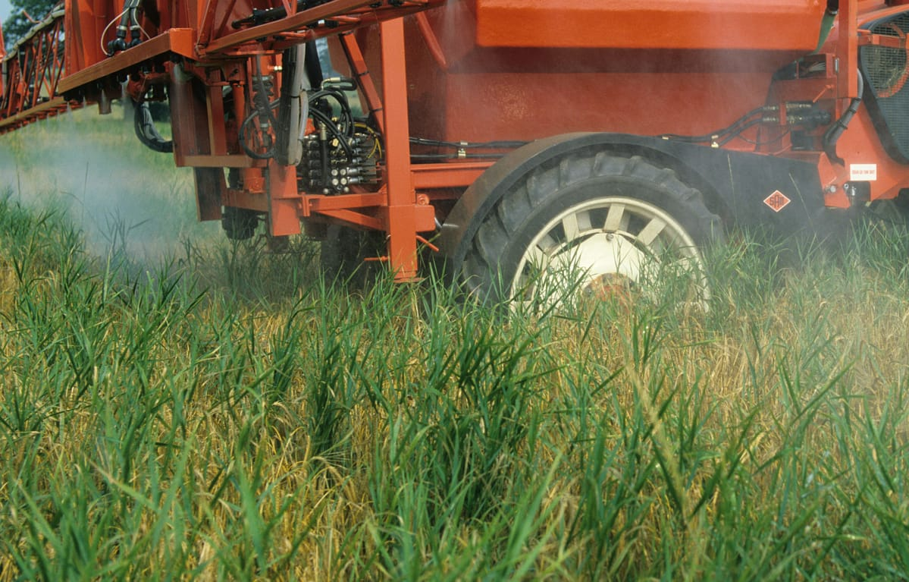
Glyphosate used to ripen the crop

Slide 15
Political controversy
Glyphosate was developed by Monsanto in 1970’s.
Monsanto also developed GMO crops (corn, cotton) with glyphosate resistance → weed could be sprayed during season.
Glyphosate became the model compound for Big Agri and “non-organic farming”.
Strong lobby to get glyphosate banned in EU.
EU Parliament Oct 2017: ban by 2022
EU MC Dec 2017: give extension to permit until 2022

Slide 16
Scientific “controversy”
The acute and chronic toxicity of glyphosate is low in rodents and humans.
This enables carcinogenicity studies with extremely high doses.
IARC classified glyphosate as 2A (probable human carcinogen) in March 2015.
EFSA risk assessment concluded “unlikely to be carcinogenic to humans” in October 2015.
ECHA March 2017: “Not carcinogenic”.
Notes:
http://fi.opasnet.org/fi/Glyfosaatti
Jouko Tuomisto. 2016. Kiistelty glyfosaatti. Skeptikko 3/2016. [11]

Slide 17
Interpretations
IARC evaluates carcinogenic hazard but NOT potency.
Potential carcinogenicity requires very large doses.
EFSA evaluates risk at the current (low) levels of exposure.
→ Their conclusions are not contradictory but about different issues.
However, each political agenda can now pick the message they want and get apparent scientific support.
Actually, the discussion does not hold against scientific criticism.

Slide 18
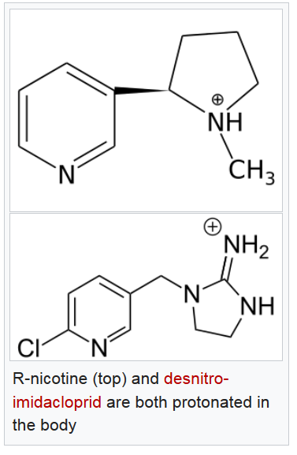
Neonicotinoids
nAChR-acetylcholine receptor agonists, like nicotine.
Very toxic to insects (IC50 2 - 20 nM).
Only moderately toxic to mammals (IC50 700 - 50 000 nM).
Toxicity is fairly low also to birds.
Not mutagenic, carcinogenic, nor teratogenic.
Several uses:
Kill insects on green leaves by spraying.
Protect seeds by staining with neonicotinoids.
Kill fleas from the animal fur.
Notes:
http://fi.opasnet.org/fi/Neonikotinoidit
https://en.wikipedia.org/wiki/Neonicotinoid

Slide 19
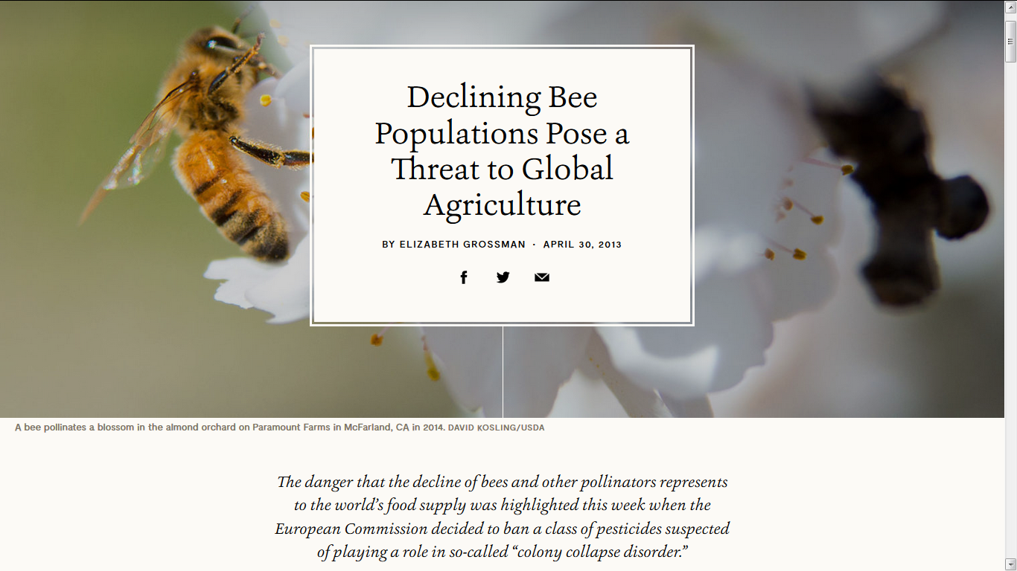
Notes:
http://e360.yale.edu/features/declining_bee_populations_pose_a_threat_to_global_agriculture

Slide 20
Problems with neonicotinoids
Harmful to other insects, especially bees.
However, not clear which practices cause how much problems.
Links to mass destruction of bees suspected but not proven.
Causes changes in ecology of insect-eating birds.
Compounds are persistent in the environment.
Very wide use (global market > US$ 1B)

Slide 21
Lessons learned
All examples were about compounds accepted to market.
Human toxicity was minimal (glyphosate) or low (diclofenac, neonicotinoids).
Still, very severe ecological or political problems arose even after decades of use of the chemical.
How could these problems have been avoided?
Continuous environmental and health monitoring to identify unexpected problems and investigate causes.
Avoid reckless use of any chemical.
Pay attention to changes in use practices.
Ensure open, continuous scientific and political discussion.

