Slide 1
Structured Discussion
Michael
Mari
Anni
www.resolute-image.com

Slide 2
Objectives
To organise written material into a structured discussion with main statement and related arguments.
Initiate and participate in structured discussion
Build content of discussion based on various materials in relation to the statement.
Act as facilitator of a discussion with different roles in contribution to the statement

Slide 3
Substantive Content
The main task was to participate in the discussion on the page:
Talk: Climate change policies in Helsinki.
The content would be built from existing data from Homework 5 and outside sources

Slide 4
Substantive Content

Slide 5
Structure
Discussion has three parts:
A statement or list of conflicting statements
Argumentation containing the actual discussion (hierarchical)
Resolution of the discussion
(statement can be accepted, accepted with modification or two or more remain valid without resolution)

Slide 6
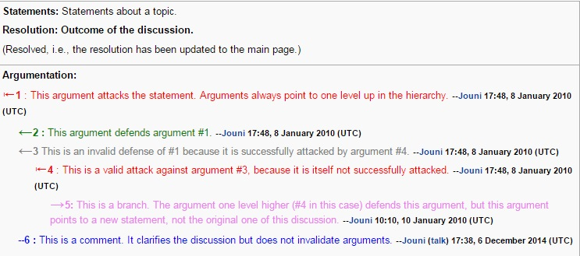
Structure

Slide 7
Structure
Attack
Comment
Defend

Slide 8
Lessons
Gives an idea of how to organise a discussion
Treating statements as weighted since it has to be backed with facts
Freedom of expression
Analyse the data to make conclusions
Compare obtained data with others for resolution

Slide 9
Incorporation into bigger picture
Increase understanding on decision making process
Facilitating gave opportunity to assess other point of view of various experts
Have to see decision making process as complex
Consequences arising from resolutions that are made

Slide 10
Wider perspective of content
Comparison with other discussions are needed
Important to include various field experts in decision making
Climate change is very sensitive topic and more analysis needs to be done in terms of assessment
Case studies from other cities can aid in forming arguments in reaching a resolution

Slide 11
KIITOS!!

