Slide 1
URGENCHE – Investigating health impacts of climate change reduction policies in Cities
Prof Clive Sabel
Project Coordinator
University of Exeter / University of Bristol
Project Meeting, Kuopio, Finland. Feb 2014.

Slide 2
Project Overview
FP7 Project: 2011-2014
€ 3.5 Million
17 Partners, in Europe and China. University of Exeter is the PI.
Interdisciplinary team: health risk assessment, urban energy demand and supply scenarios, urban planning, geography, environmental science and epidemiology.
Practical city-based policy focus. Cities at the core of the project. Strategic partnership between academic partners and cities.
Aim to investigate the impact on human health and well-being of Greenhouse Gas (GHG) reduction policies in domains of housing, transport and energy. Distribution of the impacts across different socio-economic groups are being addressed.

Slide 3
The Partnership
Participant no. * | Participant organisation name | Participant abbreviation | Country
1 coordinator | University of Exeter | UExeter | United Kingdom
2 | City of Suzhou | CSuzhou | China
3 | City of Xi'an | CXi'an | China
4 | City of Basel | CBasle | Switzerland
5 | City of Kuopio | CKuopio | Finland
6 | City of Rotterdam | CRott | The Netherlands
7 | City of Stuttgart | CStutt | Germany
8 | Peking University | UPek | China
9 | Nanjing University | UNanj | China
10 | Centre for Research and Technology Hellas | CERTH | Greece
11 | Institute of Occupational Medicine | IOM | United Kingdom
12 | Suomen Ymparistokeskus | SYKE | Finland
13 | Terveyden ja Hyvinvoinnin Laitos | THL | Finland
14 | Nederlandse Organisatie voor Toegepast Natuurwetenschappelijk | TNO | The Netherlands
15 | Universitaet Stuttgart | UStutt | Germany
16 | Swiss Tropical & Public Health Institute | SwissTPH | Switzerland
17 | World Health Organization Regional Office for Europe | WHO | Germany

Slide 4
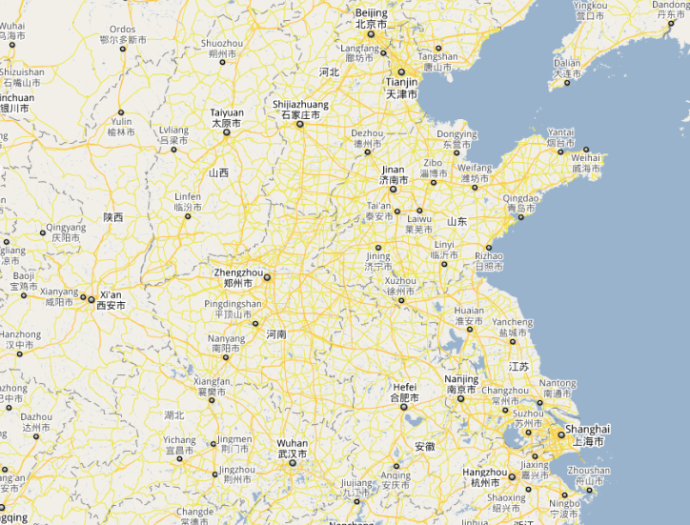
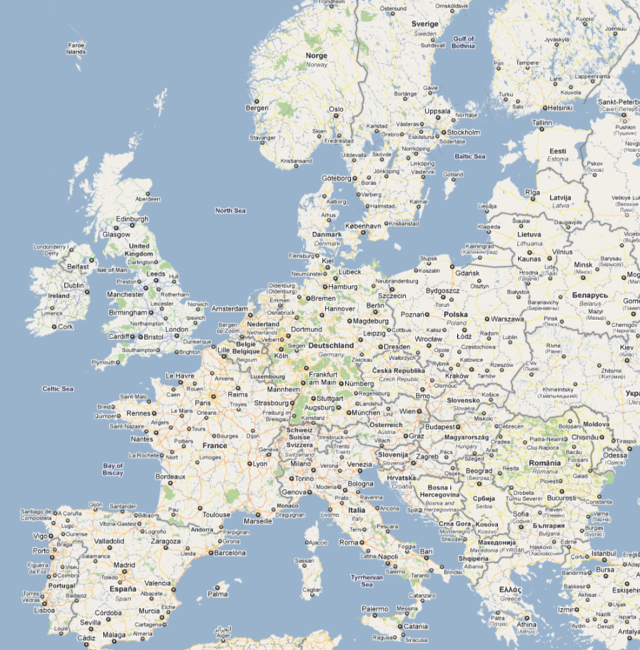
Partners

Slide 5
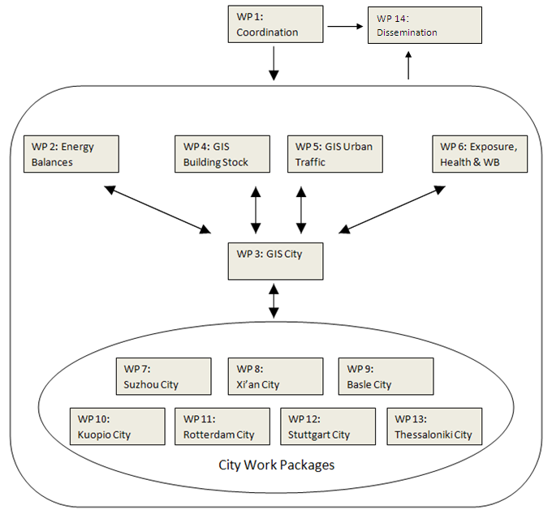
Project Structure

Slide 6
Health & Wellbeing
Inclusive definition of health:
more than simply the absence of disease, but rather ‘… a state of complete physical, mental and social well-being’
WHO (1946)

Slide 7
Objectives – Project Level
Evaluate real-world City-based climate change reduction policies.
Identify WIN-WIN policies? Policies that reduce CC whilst also improving citizen’s health.
Develop a network of cities in Europe and China evaluating city policies.
Develop a web based knowledge exchange workspace for cities and academic partners.

Slide 8
Challenges
Team of largely physical scientists
Rise in prominence of social-science as project progresses
Data availability Europe v China
Spatial data
Health data
Environmental data
Cultural values
What does eg. ‘wellbeing’ mean in different cultures, and how do we measure it consistently?

Slide 9
Following Presentations
Policy Briefing – Traffic case-studies
Menno Keuken, TNO, Netherlands
Policy Briefing – Energy case-studies
Sandra Torras, Uni Stuttgart, Germany
Policy Briefing – Building case-studies
Jouni Tuomisto, THL, Finland

