Slide 1
Homework 4: Draft of an assessment
Climate Strategy for Helsinki Metropolitan Area
DARM 2015

Slide 2
Scope
Question
Intended use and users
Participants
Boundaries
Decisions and scenarios
Timing

Slide 3
Question
What are the research questions?
What is the purpose of the assessment?
What measures should be taken in Helsinki Metropolitan area to control climate change by reducing greenhouse gas emissions?
How to reduce the per capita carbon dioxide emissions of the Helsinki Metropolitan Area by 39 per cent of the 1990 level by the year 2030?

Slide 4
Intended use and users
Who is the assessment made for?
What is the expected use?
To be used by Helsinki Metropolitan area city authorities in decision making towards less GHG emissions.

Slide 5
Participants
Who is needed to participate?
Who is not allowed to participate?
Cities of Helsinki, Espoo, Vantaa and Kauniainen
Set boundaries for assessment
A broad range of environmental protection, planning, traffic and public transport specialists from the cities
Field-specific information
HSY specialists in traffic, solid waste management and regional development
Field-specific information

Slide 6
Boundaries
Which factors are noted and which are left outside?
Spatial, temporal and subgroup boundaries
Area: Helsinki Metropolitan area (Helsinki, Espoo, Vantaa and Kauniainen)
Time: Based on years 1990, 2000 and 2004. Estimations made for year 2030.
Considered sources of GHG emissions:
Electric heating
consumption electric power
transport, district heating
separate heating
industry and machinery
treatment of solid waste and waste water

Slide 7
Decisions and scenarios
Which are the possible decision options?
If scenarios are used: which and why?
There are many possible decision options to reduce emissions considering different sectors
- Transportation: public transport, taxation
- Land use: location of services, workplaces
- Electricity consumption: Improving awareness, energy efficiency
- Heating of buildings: district heating, maintenance
- Procurement, consumption and waste: promoting energy efficiency, preventing waste formation
- Energy generation and distribution: centralization, eco-efficiency

Slide 8
Timing
When does the assessment take place?
The assessment should be made as soon as possible to reach a decision to achieve the best GHG emission reduction

Slide 9
Answer
Results
Conclusions

Slide 10
Results
Answers to all the research questions
Since it is a draft of assessment, we can only give possible results
E.g. Transportation
Lowering of ticket prices would increase the cost for the transportation company
Taxation policy would take money from individuals
Heating of buildings
wide use of district heating would make it more affordable to users
need to improve infrastructure

Slide 11
Conclusions
What are the conclusions based on the results?
With the proposed improvements it might be possible to reduce GHG emissions significantly
The measures will be a drain on resources but doing nothing would be even more costly

Slide 12
Rationale
Stakeholders
Dependencies
Analyses
Indices
Calculations

Slide 13
Stakeholders
Who have an interest in the assessment?
What are their interests and goals?
Who are influenced by the result?
Cities of Helsinki, Vantaa, Espoo and Kauniainen
Citizens of Helsinki, Vantaa, Espoo and Kauniainen
Enterprises e.g. energy producers, building companies, waste management
Responsible city agencies e.g. environmental agencies, premises center, building supervision, Helsinki City Transport
State government
NGOs

Slide 14
Dependencies
What issues must be studied?
Current emissions from all sources
Amount of reductions (as CO2-equivalents) needed to reach the target
Estimation of possibilities and their
GHG reducing potential
cost (money, time, work force)
risk
health impacts
environmental impacts

Slide 15
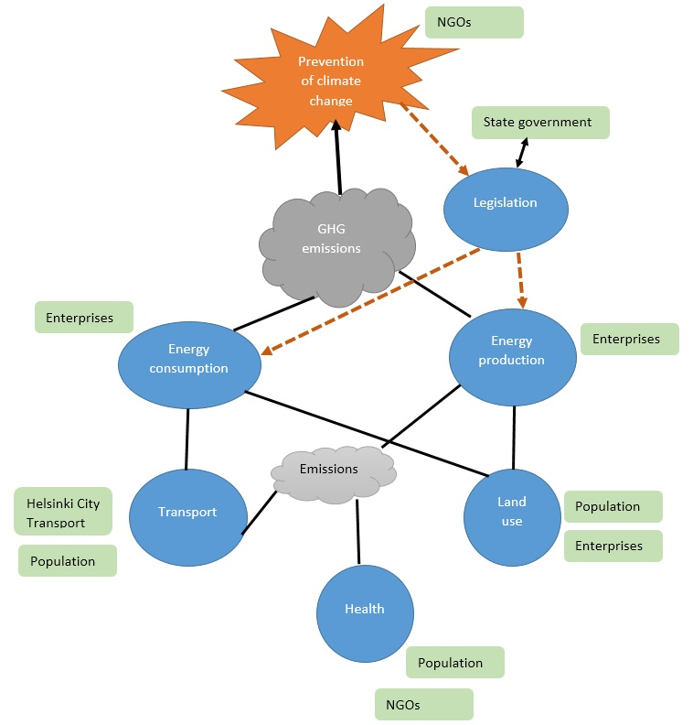
What are the causal connections between decision actions and endpoints of interest?

Slide 16
Analyses
What statistical or other analyses are needed?
Indices
What indices are used?
Index explains results stored in the database
E.g. age, time
Calculations
What are the actual calculations used to produce the result? (r-code)

