Slide 1
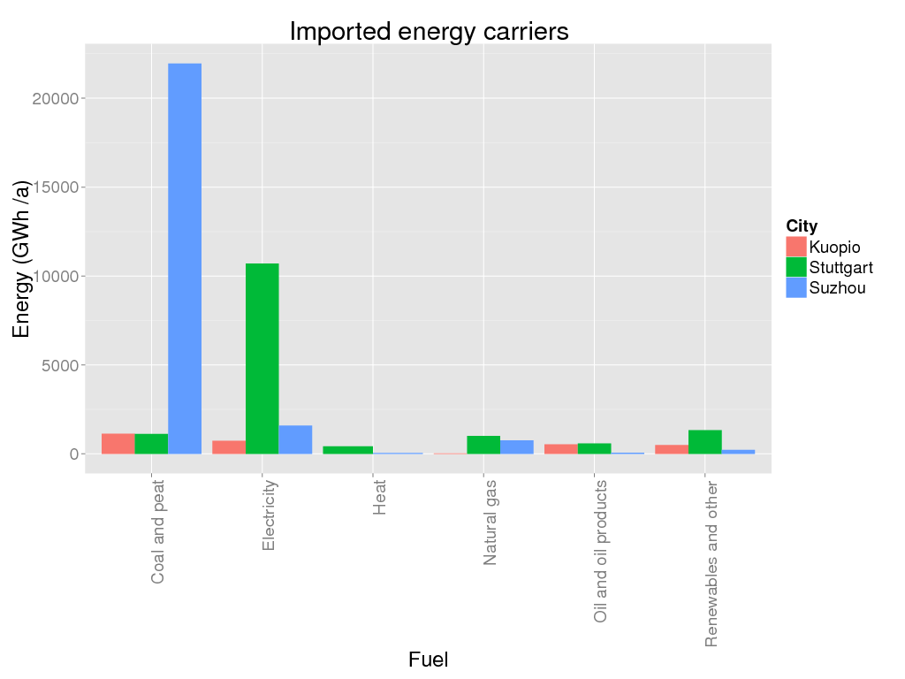
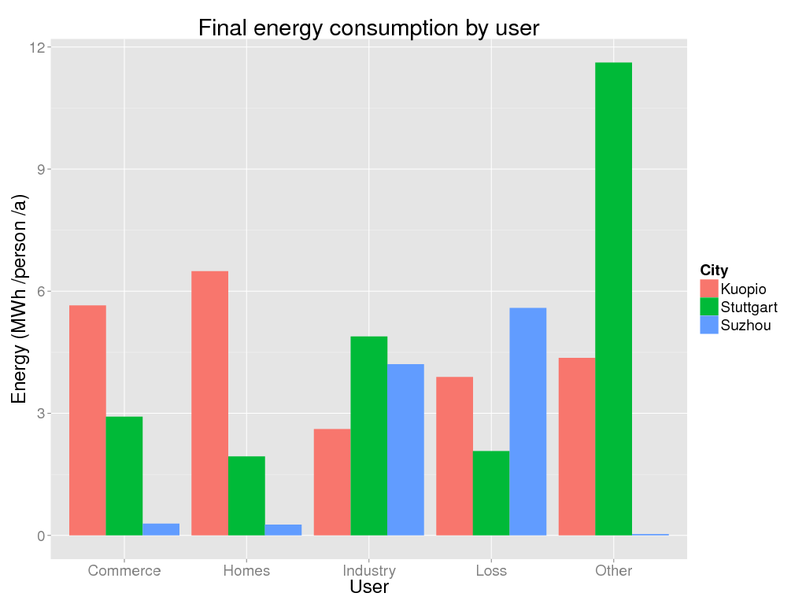
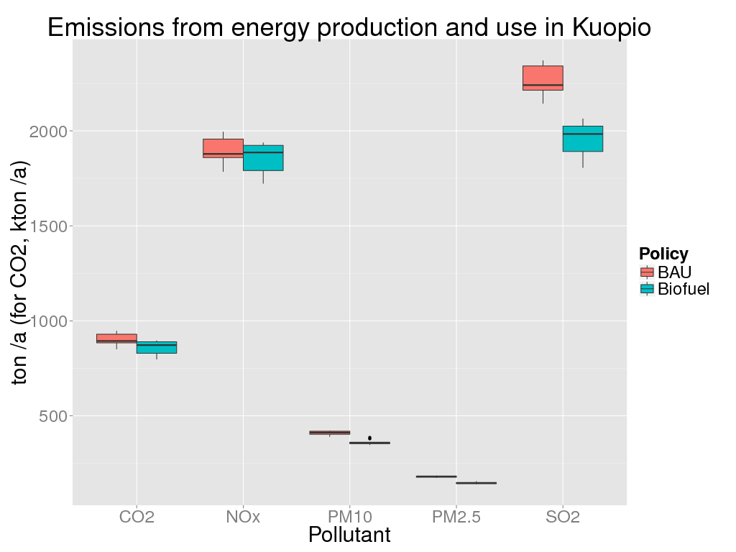
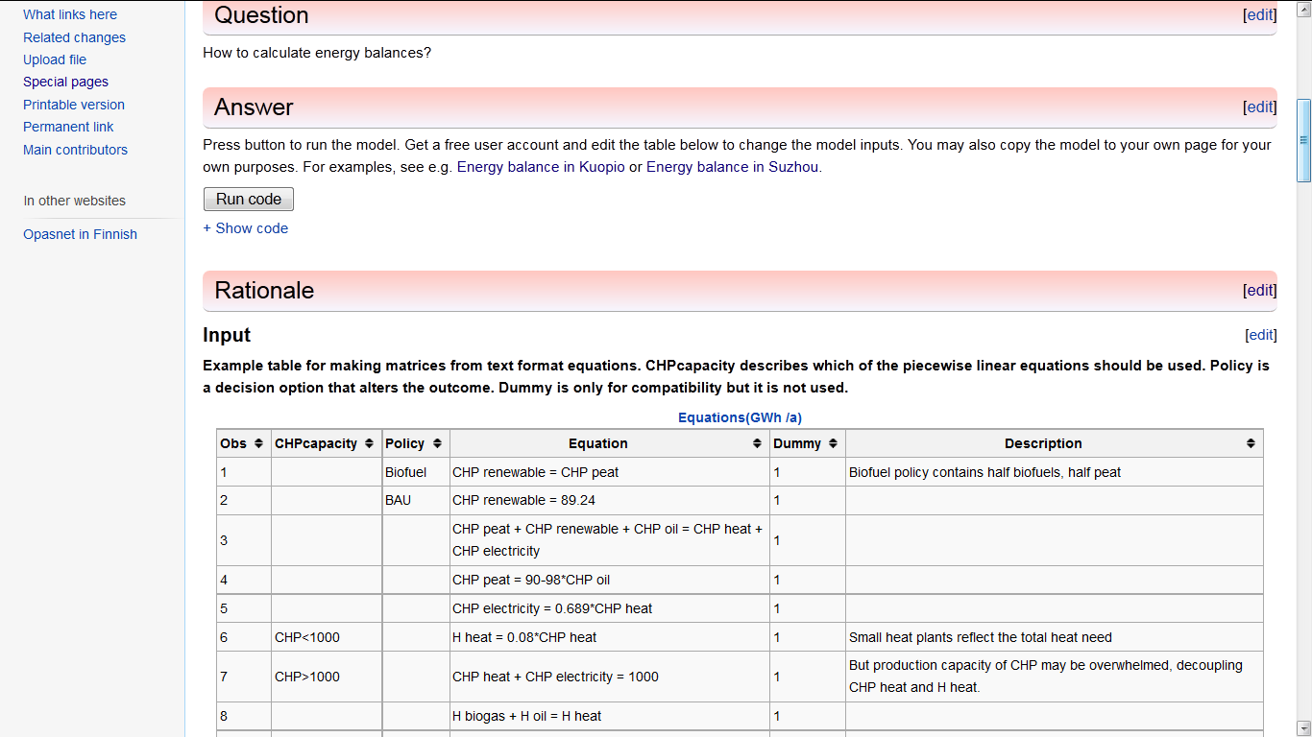
Online energy tool for health assessments Online energy balance tool to assess health impacts of climate policies in cities - case EU (Kuopio, Stuttgart) and China (Suzhou) ¹National Institute for Health and Welfare, Kuopio, Finland. ²University of Stuttgart, Germany
Background
Climate mitigation policies in municipalities have global impacts on climate change, but the actual impacts on the municipalities themselves are other than climate. Typically, energy policies may add or reduce fine particle emissions and thus cardiopulmonary effects; traffic policies affect e.g. urban sprawl, accidents, and well-being. As a part of climate policy support, there is a need for simple online impact models including energy and health.
Aims. We developed an online computational model for estimating energy balance (inputs and outputs of energy on municipality level) and related emissions. The model was designed to be both a modelling and dissemination tool, and able to be updated and run by municipality authorities or even by interested citizens.
Methods. We decided to use matrix calculation as the core of the tool, as we need a straightforward way to calculate a new solution when some inputs or outputs are changed by a user. The model was implemented in an open web workspace Opasnet http://en.opasnet.org/w/Energy_balance with R software. The structure of the balance table was taken from the OECD energy balance sheets, with city-specific modifications when needed.
Results
Data was collected and model adjusted for two European cities: Kuopio (100,000 inhabitants, in Finland) and Stuttgart (600,000 inhabitants, in Germany) and one Chinese city Suzhou (2.38 million inhabitants).
Two major functionalities were added based on user feedback: inclusion of uncertainties (using Monte Carlo) and nonlinear functions (using piecewise linear equations).
The core model solves one set of linear equations. However, the user can easily define a large bunch of sets that are solved one at a time. This is useful when comparing e.g. different decision options, timepoints, seasons, etc.
Conclusions
The energy balance model works as intended and is able to calculate input/output balances for different scenarios. Object-oriented structure makes it possible to attach the model to emission and dispersion models that already exist in Opasnet.
The major problem is the lack of awareness among potential users and developers.
Figure 2. Energy carriers in the three cities. Both absolute and relative differences are large. E.g. Suzhou is heavily dependent on coal.
Figure 3. Final energy consumption by user group. Values are shown per inhabitant. The difference between personal vs. industrial use of energy in EU and China is remarkable.
Figure 4. Emssions from energy production and use in Kuopio. The result contains two alternative policies, uncertainties about the activities, and nonlinearities related to the maximum capacity of a major power plant.
Correspondence: Jouni Tuomisto, THL. Firstname.lastname@thl.fi.
Figure 1. A screenshot of the model page in Opasnet http://en.opasnet.org/w/Energy_balance . The model can be adjusted for new situations. New columns can be added for additional determinants such as time or a new policy.

