Slide 1
Collaboration in climate policy assessment
Case study : Danish strategy for adaptation to a changing climate (2008)
Ayelotan Aishat Bukola, Badejo Oluwatobi Abayomi, Effah Evans

Slide 2
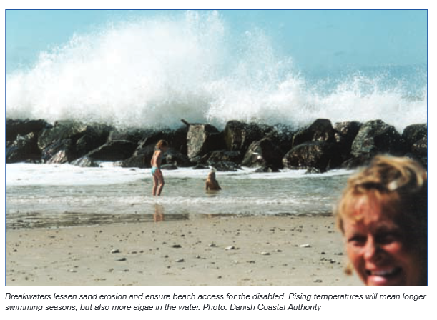
Background Information
Climate change is a reality, and an important part of global warming is due to human activity.
Climate change will take place gradually over an extended time horizon and the societal consequences will depend upon how society adapts.
This strategy will provide a basis describing how the expected climatic changes could affect a number of areas in Denmark.
The strategy will need to be continuously adjusted owing to the unpredictable nature of climate change.

Slide 3
Collaborators in Strategy Design.
Danish government as represented by sectorial ministries.
European Union.
International Organization.
Danish Meteorological Institute (DMI) .

Slide 4
Roles of Collaborators
EU and international organizations will ensure that international protocols as well as regional climate change policies are incorporated into Danish adaptation strategy.
Sectoral ministries will enforce standards to be met in fisheries and coastal management, agriculture and forestry, water and energy supply, building and nature management as well as health adaptation programmes for public health emergency management.
Danish government will provide an enabling environment as well as financial facility for the assessment and adaptation process.
Danish Meteorological Institute will provide up to date information in global, regional and local climate change to aid in the design of the adaptation strategy.

Slide 5
Aims and Objectives of Strategy
The specific objective of the strategy is to incorporate climate change adaptation policies into Danish national planning and development. The goals are designed to be attainable within 10years from 2008.
The strategy is expected to benefit individual citizens, business owners and the government.
The strategy aims to meet Denmark's reduction commitment of 21% of 1990 emissions of greenhouse gases.
Reduction in economic and environmental cost to authorities in situations of natural disaster
Benefits
Individuals and business owners are protected from consequences of climate change

Slide 6
Decisions for Adaptation Strategy
The establishment of a coordinating unit for research in climate change adaptation.
Creation of web portal for climate change adaptation by the government to provide relevant knowledge to all stakeholders.
Goal-oriented information campaign to inspire the stakeholders and individuals to change their behavior.
The development of modelling tools for socio-economic evaluation of measures in the climate change adaptation area.

