Slide 1

How to prevent
Environmental Burden of Disease in Finland?
Tuesday seminar
in the Environmental Burden of Disease –series
http://fi.opasnet.org/fi/Tautitaakka-seminaarisarja_2014
2014-01-28 at 14:30-15:30
Miten torjumaan (ympäristö)terveysriskejä?
Otto Hänninen
National Institute for Health and Welfare (THL) »
Kuopio, Finland

Slide 2
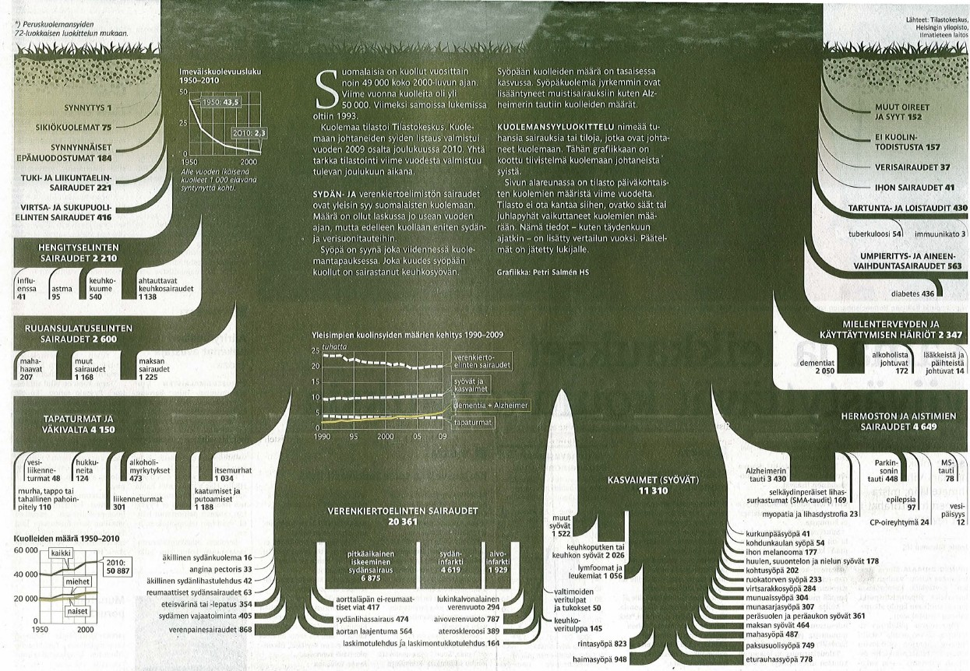
Finnish Death
49 904 registered deaths in 2009
Helsingin Sanomat 2011-11-05

Slide 3
Kansanterveyslaitos, Ympäristöterveyden osasto
Motto:
"Ihmisen on voitava hengittää, juoda ja syödä, käyttää kuluttajille myytäviä tuotteita ja liikkua ympäristössään luottaen siihen, ettei hänen terveytensä ole uhattuna."
People must be able to breath, drink, eat, use consumer products and move in the environment trusting on that her health is not endangered.

Slide 4
However,
600 000 people are exposed to dampness and mould problems; few thousand of them loose their health
1000-2000 people are estimated to die due to outdoor air pollution every year
200-300 persons get a lung cancer due to indoor radon; up to 90% of them die
ca. 100 persons have a myocardial infarction due to traffic noise; 30-40 of them die
10 persons die due to carbon monoxide poisonings annually

Slide 5
Thus…
It is clear that the ideal goal presented in the KTL motto has not yet been quite achieved
  work remains to be done!
  it is likely that it is not achieved in the near future, and perhaps never
and meanwhile we may consider looking at the problem from an alternative angle:
Public health impact

Slide 6
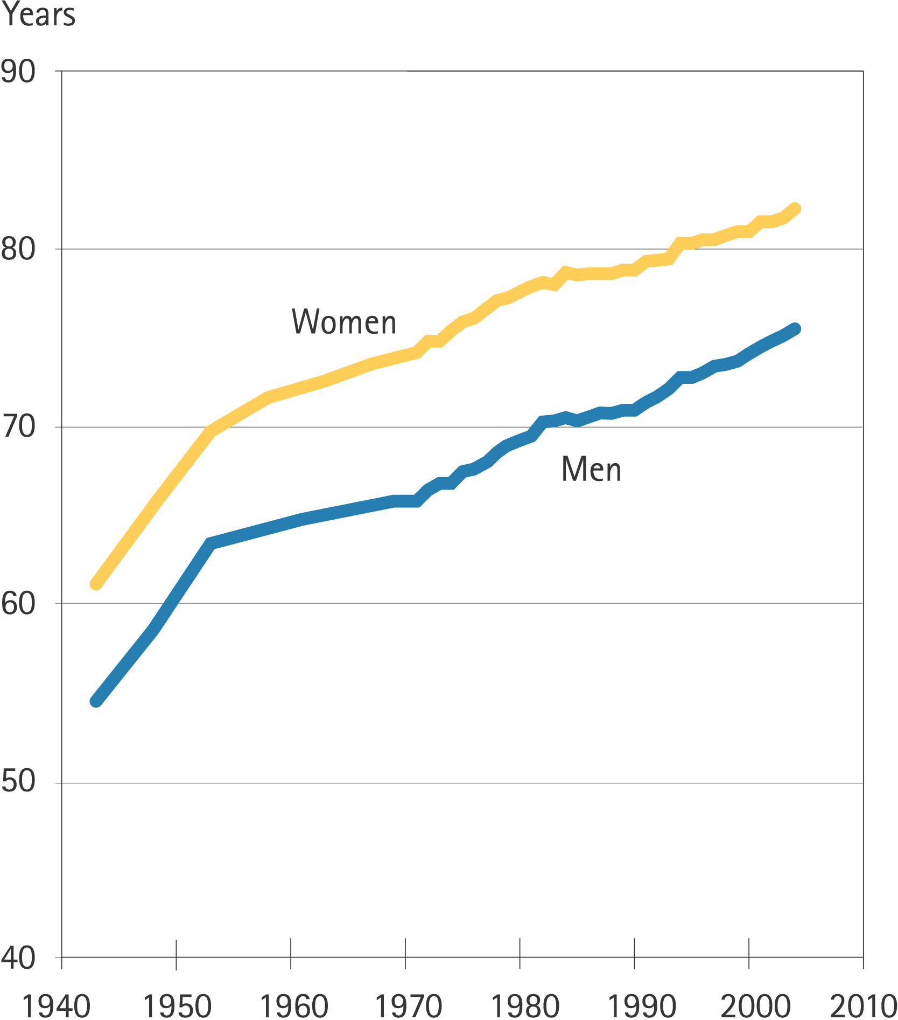

Life expectancy in Finland (2006)
http://www.ktl.fi/hif/
Koskinen S, Aromaa A, Huttunen J, Teperi J. (eds.) Health in Finland. Helsinki 2006.

Slide 7
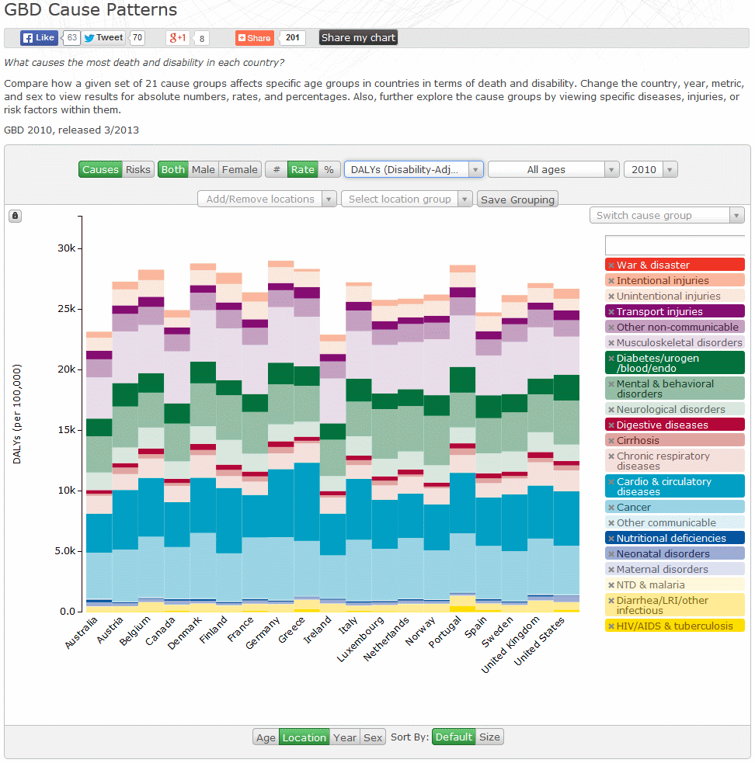
GBD 2010
Causes
Finland has the 6th worst health out of 18 West European countries
6
5
2
1
4
3

Slide 8
Few theses for today:
Health and functioning
We should hunt health, even if it can not be caught!
  public health is one* of the relevant metrics
  (*but not the only one)
Health equality: Health is health is health
  i.e. different ways of obtaining health are equal
    curing disease = preventing disease = wellbeing = functioning
  Looking for ways to improve health where it is feasible and affordable!
Costs, cost effectiveness, cost-benefit
Public acceptance: values
=> Discussion on priorities!

Slide 9
Outline for today’s introduction
Background
  Few words on this EBD seminar series
  Few slides on previous studies
    SETURI, SETURI DALY update,
    EBoDE, HEALTHVENT, …
Global Burden of Disease (GBD) 2002, 2004, 2010
  attributable risks, overlapping risk factors
Ultimate objective: Estimating Preventable Risks
Discussion
Case studies will be presented in
this series over the next months
Multidiciplinary approach,
involving re-defining ’environment’

Slide 10
Tuesday Seminars on
Environmental Burden of Disease
2014-01-14 | Priorisointi on pakko ympäristöterveydessä | Jouko Tuomisto
2014-01-28 | Miten torjumaan (ympäristö)terveysriskejä? How to prevent (environmental) health risks? | Otto Hänninen
2014-02-11 | Ympäristötautitaakan alentamisen arvotehokkuus | Juho Kutvonen
2014-04-29 | Tautitaakan synergia: radon vai tupakka? | Jouni Tuomisto
2014-05-20 | Reduction potential of asthma burden of disease (lifetable estimates for prevalence and incidence) | Isabell Rumrich

Slide 11
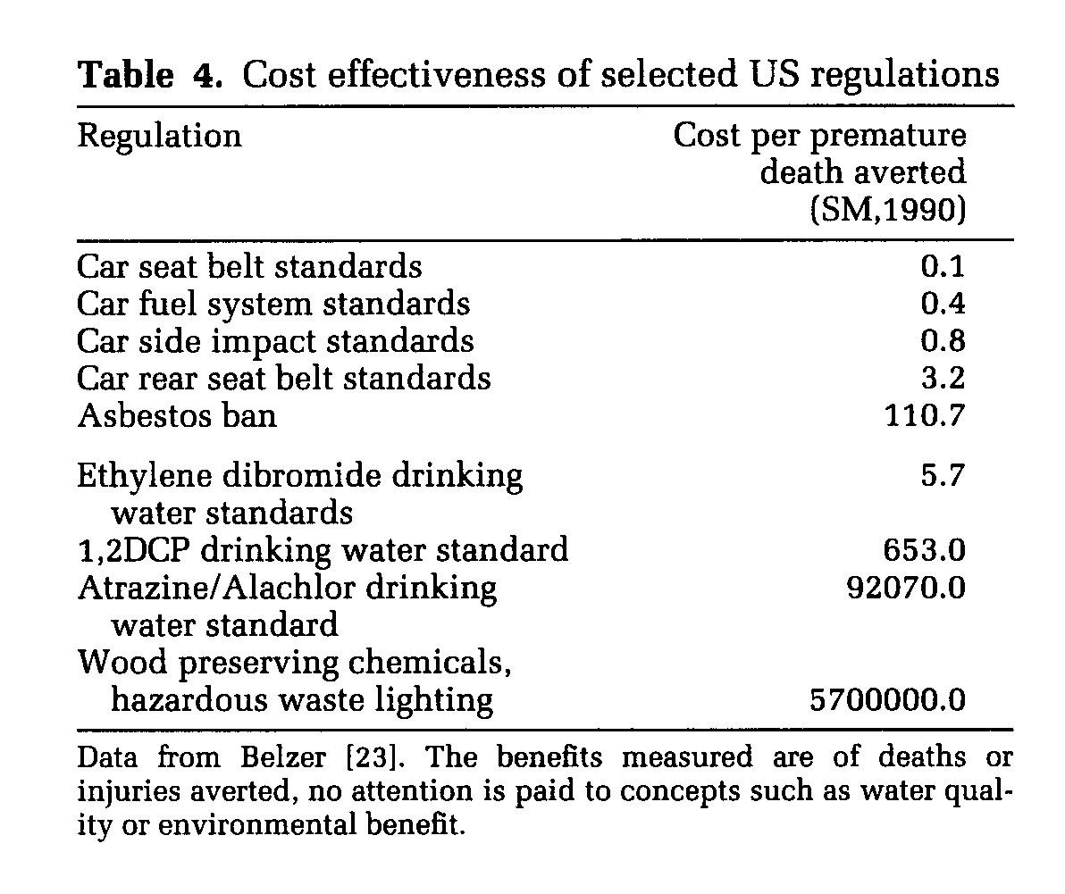
Jouko Tuomisto 2014-01-11
Prioritization is a must
6×10⁷
Levels of risk vary greatly
Prioritization is a must, but very hard to sell to the public
We easily accept measures causing a burden to somebody else
Resistance to change our own behaviour to reduce risks is great
Colin Berry: Risks, costs, choice and rationality

Slide 12

Juho Kutvonen 2014-02-11
Value effectiveness
Master’s Programme on
Environmental Sciences
Reduction scenarios for the top EBD exposures
  PM2.5, radon, second hand smoke (&smoking)
Cost effectiveness => Value-effectiveness
Tobacco smoke

Slide 13
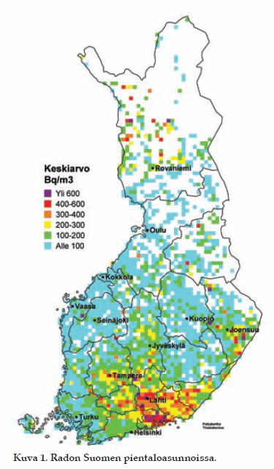
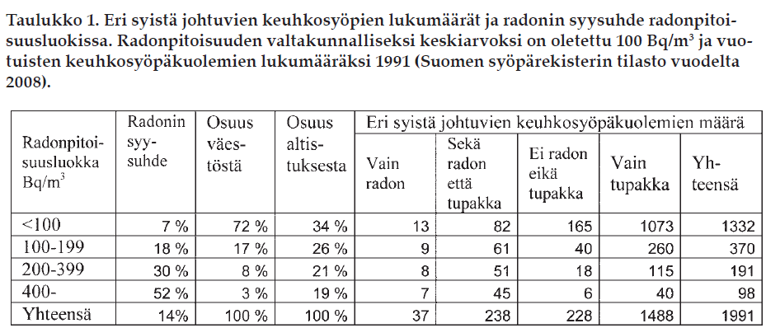
Jouni Tuomisto 2014-04-29
Radon and smoking
74.7% of lung cancer caused by smoking without radon
11.9% by smoking and radon
1.9% by radon without smoking
Mäkeläinen, 2010

Slide 14
Isabell Rumrich (2014-05-20)
Reducing asthma
International EnvTox Programme
life-table model
comparison of incidence vs prevalence based approaches
7 risk/protective factors, 15 scenarios
Attributable YLD at Baseline (2011)
NO2
7 %
Unexplained
Explained
PM2.5
Dampness and mould
63 %
37 %
8 %
7 %
SHS
Allergen
3 %
10 %
Underweight
Formald.
Cat
Dog
Smoking

Slide 15




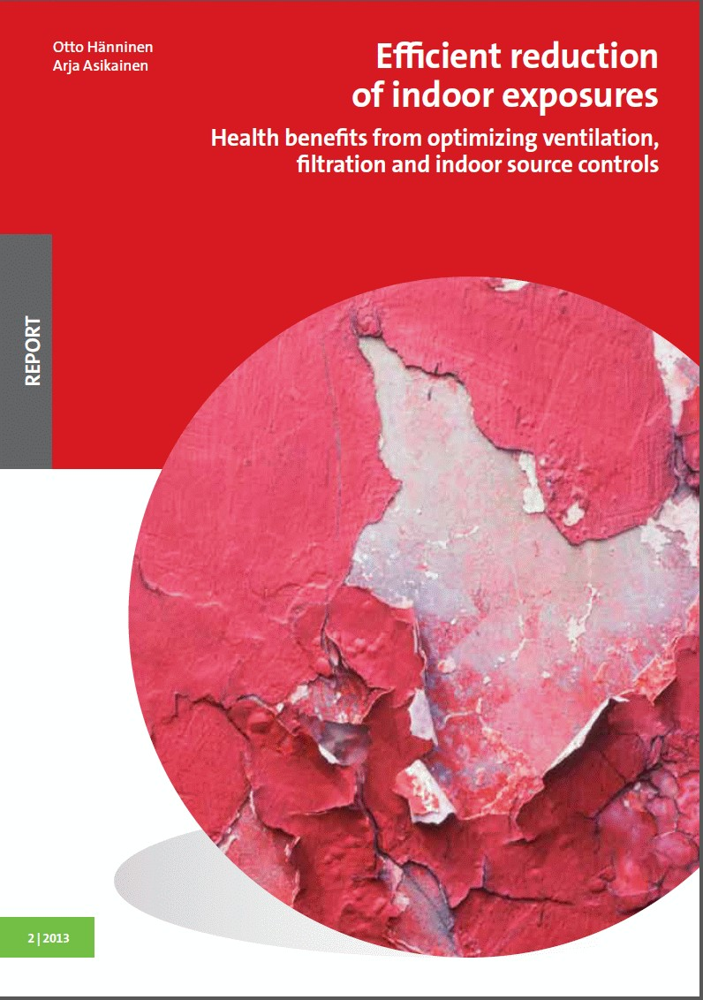
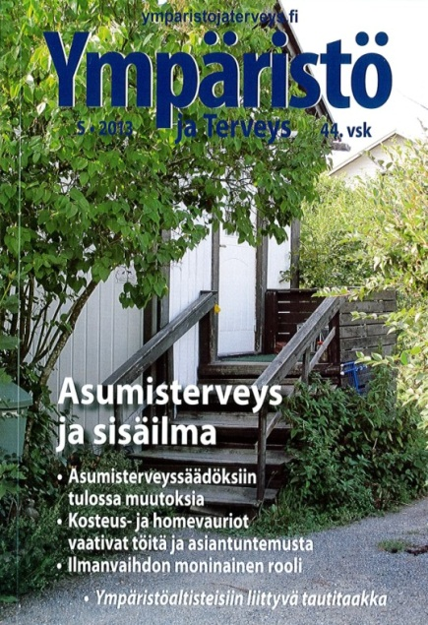

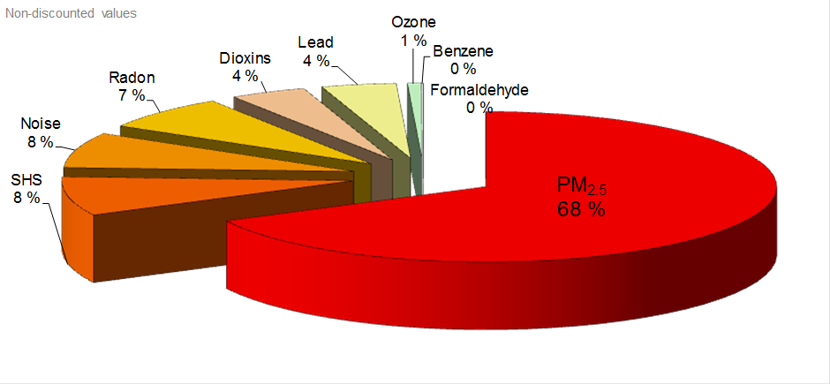
Background:
Previous projects
SETURI
Healthvent
EBoDE
DALY update
Pekkanen, 2010
Hänninen et al, 2010ab
Hänninen & Asikainen, 2013
Asikainen ym., 2013,
Hänninen & Knol, 2011

Slide 16
1. Public health view
Cases/year (deaths, cancers)
Occupational causes
Environmental causes

Slide 17
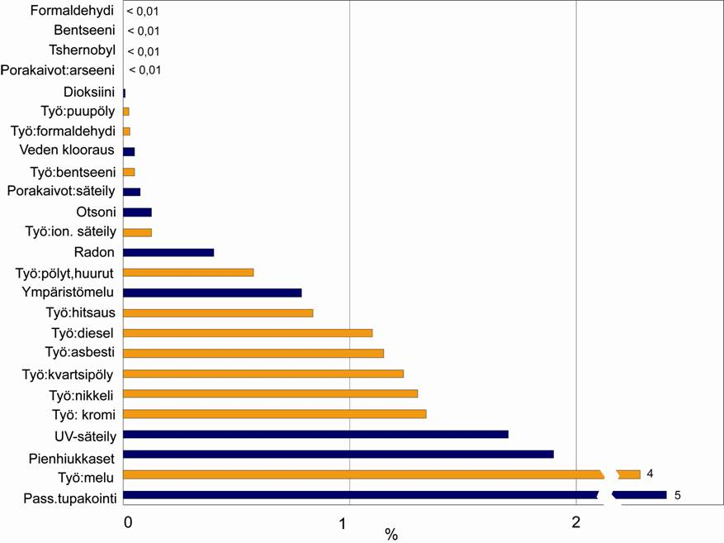
2. Individual health view
Lifelong risk (%)
-mean risk of the exposed
-deaths, cancers

Slide 18
SETURI DALY Update 2013
SETURI-hanke
Ympäristöaltisteet
Lähde: Asikainen ym., 2013,
Ympäristö ja Terveys Nr 5
Aiemmin:
Pekkanen, 2010
Hänninen ym., 2010

Slide 19

TOP 12 Risks
New causes on the list
Source: Asikainen ym., 2013, Ympäristö ja Terveys nr. 5

Slide 20
Uncerstanding causes of disease
Burden of disease
1
What are these
unknown causes?
2
Attributable
burden of disease
= risk factors
What actually is
environment?
Environmental factors

Slide 21

GBD 2010 Study
Institute of Health Metrics and Evaluation (IHME)
  Seattle, USA
Funding Bill and Melinda Gates Foundation
Lancet 15.Dec 2012 dedicated issue
  seven articles
  eight commentaries
  a special report
http://www.thelancet.com

Slide 22
GBD 2010 Study in a nutshell
187 countries, 21 regions
Target years 1990-2005-2010
291 diseases and injuries, 1160 sequelae (non-fatal health consequences)
67 risk factors
20 age groups
discounting and age-weighting dropped

Slide 23
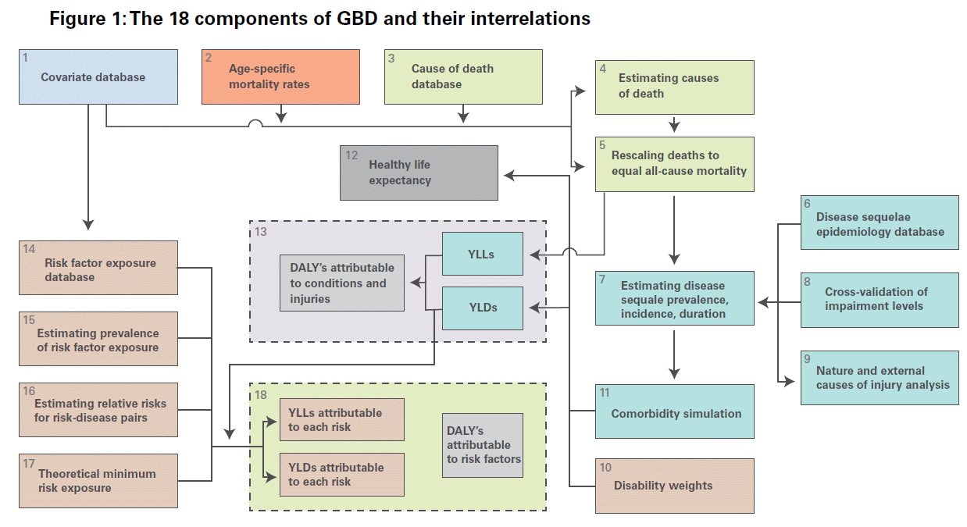
GBD 2010

Slide 24

Institute for Health Metrics and Evaluation (IHME)
GBD 2010 Visualization tools

Slide 25
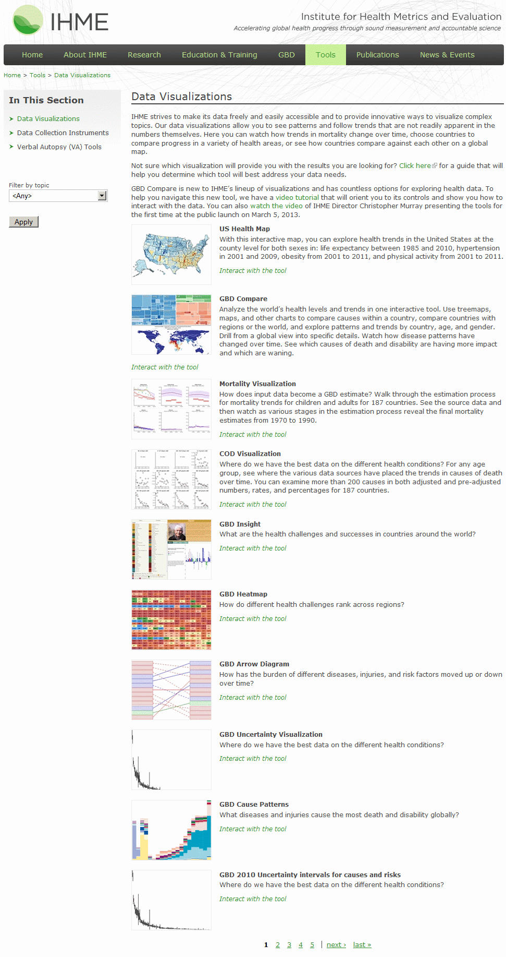
Institute for Health Metrics and Evaluation (IHME)
GBD 2010 Visualization tools
roughly 50 graphical online tools are provided
many of them with developing country focus
some only for USA
many interesting views to issues relevant also in Finland

Slide 26
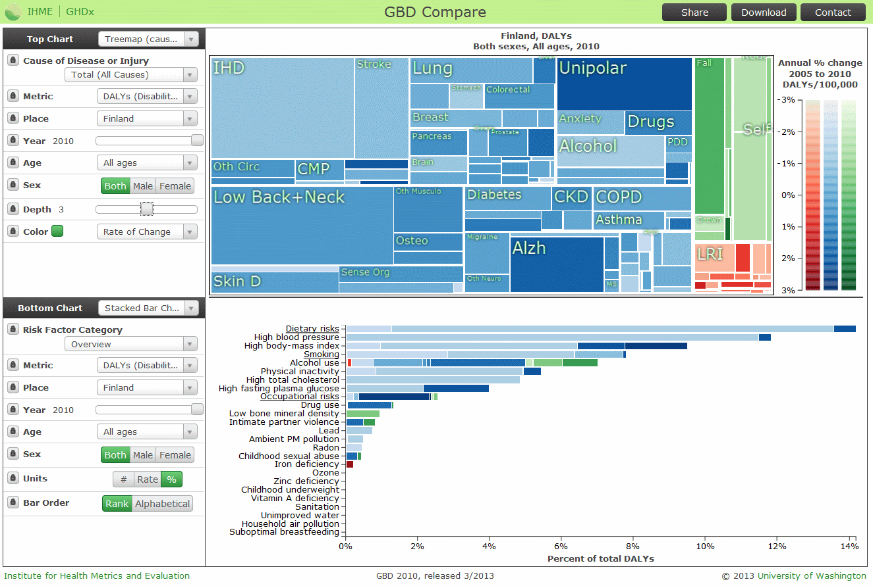

Slide 27
GBD 2010 as a tool for national analyses
Results should be evaluated against national data!
Suggested risk factors explored for control potential
  control policy options development
  cost-effectiveness and cost-benefit analyses
Some initial introductory views to the data currently available:

Slide 28
GBD 2010
Burden of disease in Finland
A Communicable
B Non-comm.
C Injuries
Communicable
Injuries
-
Total burden
1.4 MDALY in 2010
Non-communicable
1 286 900; 86%
Total burden of disease in Finland in 2010 was 1 498 722 DALY (nd)

Slide 29
A-C Splitdown
GBD 2010
Burden of disease in Finland

Slide 30
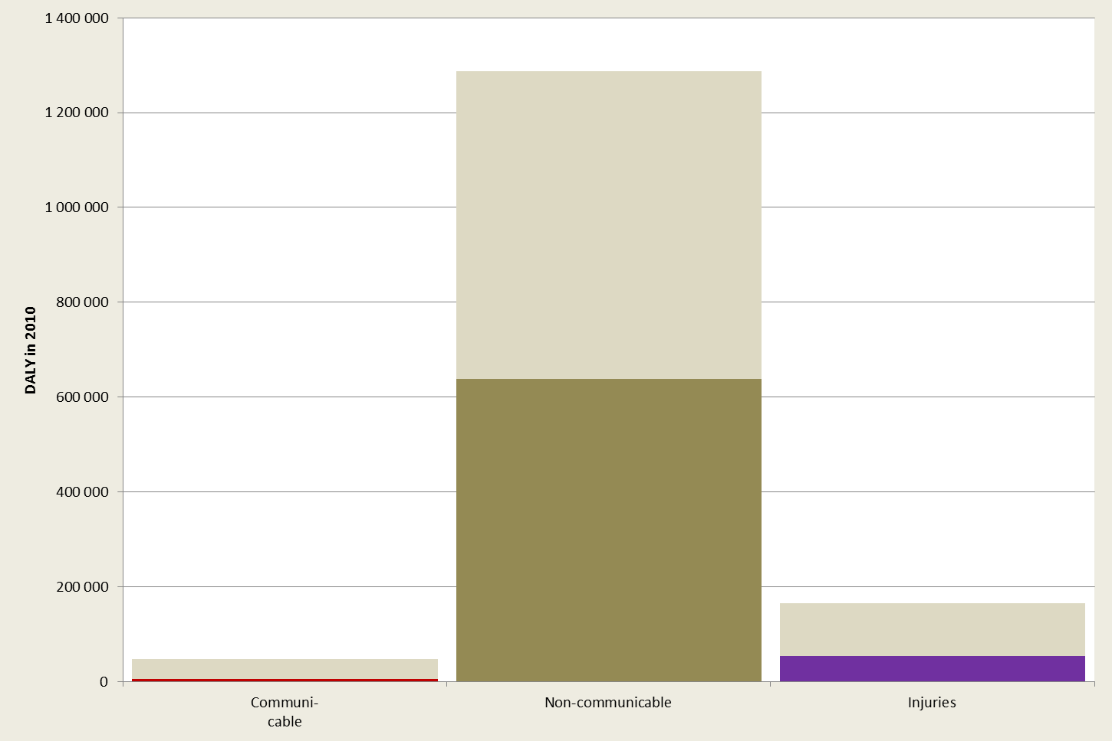
GBD 2010
23 Risk factors investigated
Assocaited with risk factor(s)
These gray parts are potentially available for risk management
- of the rest we do not know what to do (in this data)

Slide 31
GBD 2010
Risk factor grouping (suggested)
Behavioral interventions

Slide 32
GBD 2010
Attributable risks
Occ.-PM-Pb-Rn
Behavioral
Indicators
E
Unknown causes
assuming here (as a first shot) all risk factors independent and additive!!!
Behavioral and bioindicator factors dominate
and are of same order of magnitude as the residual risks
however, here the cardiovascular risks have been attributed more than twice

Slide 33
GBD 2010
Attributable risks
relative risk model leads to the fact that e.g. two necessary causes of a disease both are assigned 100% attribution; thus total of 200%
Only cardiovascular diseases are overattributed
(total PAF=2.3 or 230%)

Slide 34
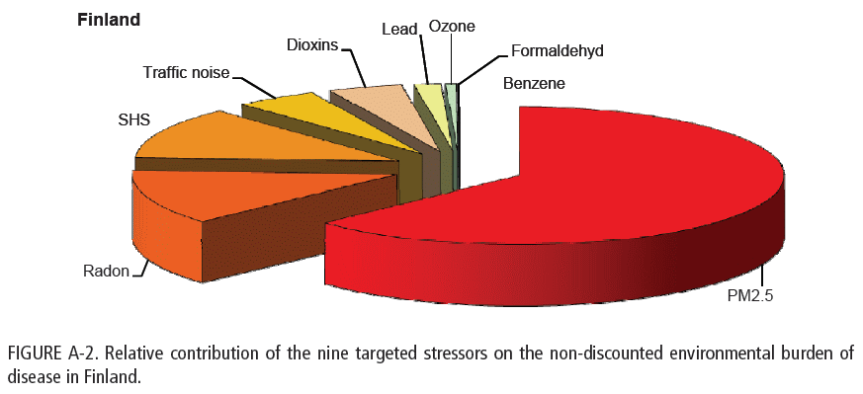
So what can we do to
Prevent environmental health risks?
Looking especially at the leading causes of EBD:
PM_{2.5} (and PM₁₀)
Radon (how about smoking?)
Second hand smoke (and smoking?)
Traffic noise
Smoking
Hänninen & Knol, 2011

Slide 35
So what can we do to
Prevent environmental health risks?
Juho Kutvonen (2014-02-11):
Value efficiency of selected approaches to reduce PM2.5, SHS and radon exposures
Jouni Tuomisto (2014-04-29) : Radon and smoking
Isabell Rumrich (2014-05-20):
Reduction scenarios for asthma risk factors
(life table approach)

Slide 36
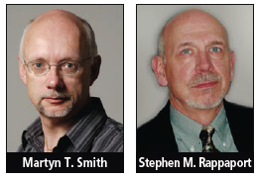

Determinants of health
For the discussion
Exposome
Genome
Pollution
Diet
Etiology of disease
Smith & Rappaport, 2009, EHP
Medication
Radiation
Infections
Accidents
Genome sequencing
explained (much) less
than 10% of the risk of
major diseases
Lifestyle
Behaviour
Stress
Education
Health
Exposome-concept:
Wild, 2005, Cancer Epidemiology, Biomarkers & Prevention 2005;14(8):1847-1850
Notes:
Human Genome project achieved a significant step in 2003. The project was run with a great enthusiasm about understanding determinants of health, however producing a slight disappointment: as a result many interesting genes were identified, explaining individual diseases. But as whole, understanding of the whole of health did not take such a major step forward that could have been perhaps expected.

Slide 37
So what can we do to
Prevent environmental health risks?
For the discussion
Wider context: Environmental vs. genetic impacts
It seems likely that we may be able to improve health better, when we consider
    besides environmental pollution also
    safety (injuries)
    physical activity, tobacco,alcohol, drugs,…
    motivation for behavioral choices (social)
    …
Remote participation in discussion right now:
call +358-(0)400 673 207

Slide 38

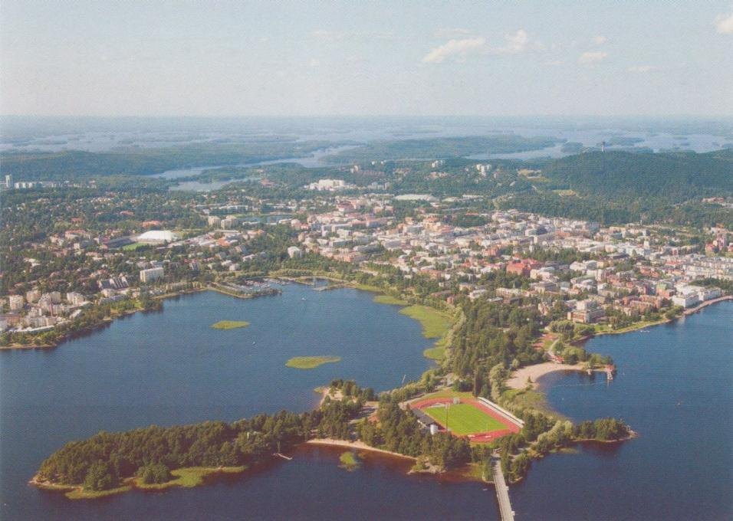
www.thl.fi
Department of Environmental Health
Kuopio, Finland

Slide 39
Burden of disease metric
disability adjusted life year (DALY)
BoD= YLD + YLL
YLD = years lived with disability
(because of a disease)
YLL = years of life lost
(because of premature mortality)

Slide 40
Years lived with disability (YLD)
Corresponding burden of disease is calculated as
DALY = duration x severity of the disease
  (mean) duration is a medical fact
  severity is a value parameter determined by expert panels based on predefined criteria; subject to different valuations, cultural differences etc.

Slide 41
Disability weight (severity weight)
WHO Definition
“A disability weight is a weight factor that reflects the severity of the disease on a scale from 0 (perfect health) to 1 (equivalent to death). Years Lost due to Disability (YLD) are calculated by multiplying the incident cases by duration and disability weight for the condition.“

Slide 42
The concept of DALYs
Disability-adjusted life years
serious annoyance
pneumonia
progressive cardio-pulmonary disease
disability
leukaemia
weight
healthy life years
0
'health' loss
population
1
10
20
30
40
50
60
70
80
age
de Hollander et al., 1999

Slide 43
Ympäristö ja Terveys 3/2010
http://www.ymparistojaterveys.fi/www/ytlehti/sisallot/vuosi-2010/
SETURI Teemanumero
(MMM)

Slide 44






Environmental Burden of Disease in Europe
Finland
Netherlands
Belgium
Germany
France
Italy
http://en.opasnet.org/w/Ebode
http://www.thl.fi/thl-client/pdfs/b75f6999-e7c4-4550-a939-3bccb19e41c1
Notes:
Health effects of particulate matter has been estimated in several major projects including World Health Report, WHO Environmental Burden of Disease, Clean Air For Europe (CAFE) –programme. As a recent example I will summarize the findings of a study coordinated by the applicant.

Slide 45
Few environmental factors are responsible for most of the environmental burden of disease in Europe
Hänninen & Knol, 2011
A small number of key stressors contribute most of the EBoD in Europe.
Only SHS exposures are currently effectively reduced. Dioxin and benzene exposures are also declining. The others are steady or increasing.
Burden of disease from chemicals other than those present in particles is not conclusive in this study, but appears not to be dominating.

Slide 46
Environmental Burden of Disease in Six European Countries
Environment contributes to BoD also in Europe.
EBoDE-project, estimates that 3-6% (discounted) of the total NBoD in the six participating countries is caused by nine environmental stressors
In absolute numbers Finland had the largest BoD & smallest EBoD in contrast to Italy with the lowest BoD and highest EBoD
Discounted, age-weighed values
Hänninen & Knol, 2011

Slide 47
EBD per million in Europe
Non-discounted values
Certainty of the assessment
High Medium Low
High
Medium
Low
Particulate
air pollution
(4500-10 000)
Second hand
smoke
(600-1200)
Traffic noise
(400-1500)
Public health impact
Lead
(100-900)*
Dioxins
(200-600)
Radon
(450-1100)
Ozone
(30-140)
Benzene
(2-4)
Formaldehyde
(0-2)*
Numerical values indicate non-discounted DALYs per million people in the six participating countries.
* a numerical model has been used to estimate threshold exceedances.
Hänninen & Knol, 2011

Slide 48
Health impact estimates associated with ventilation
methods and results presented in more detail in a THL report printed last week:
Available online:
http://urn.fi/URN:ISBN:978-952-245-822-3
Hänninen & Asikainen (eds.)
THL Report #2/2013

Slide 49
Baseline burden (2010) and reducible component in EU26

Slide 50

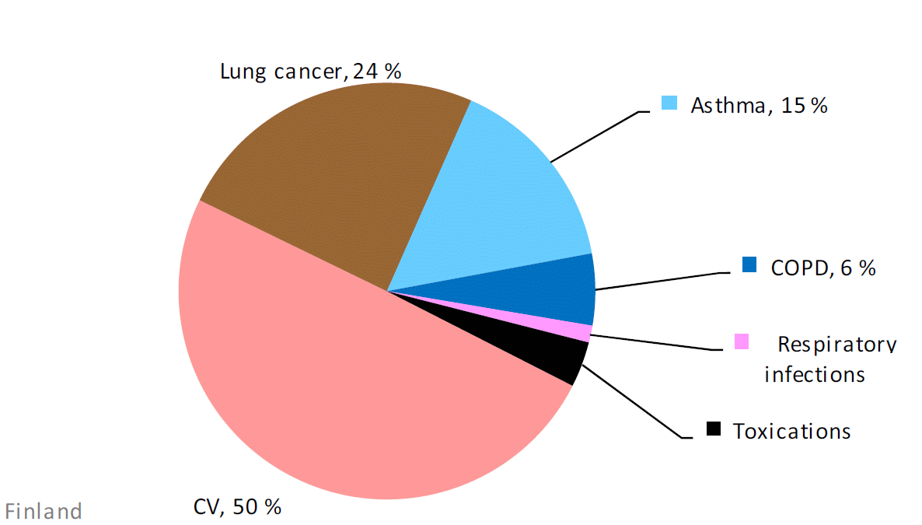
Healthvent estimate
BoD from indoor exposures in Finland
By disease
Total 13 000 DALY/a
Source: Hänninen & Asikainen 2013

Slide 51
National burden from indoor exposures

Slide 52
Prevention:
Dilution by ventilation?

Slide 53
Three approaches to control the burden
1
2
3

Slide 54
GBD 2010
Burden of disease in Finland
22 cause groups
Total burden 1.4 MDALY in 2010
Top three groups
  cardiovascular disorders (19%)
  cancers (14%)
  musculoskeletal disorders (15%)

Slide 55
GBD 2010
Attributable risks
Total observed 288 k
Sum of attributed 665k
Cardiovascular risks are attributed to risk factors by 230%, i.e. more than double counting the control options
Actual reductcion potential remains unclear
Same multiple counting may affect other end points, but seems to be substantially less severe

Slide 56
GBD 2010
Back to burden by disease
Respiratory
communicable
non-communicable
Cardiovascular (CV) causes lead
followed by cancer, muscelosceletal and mental conditions
Thus CV and cancer remain the promising targets for environmental risk reduction interventions

Slide 57
So what can we do to
Prevent environmental health risks?
    Overall burden rankings
      SETURI DALY Update
      Fine PM
      Traffic noise
      Radon
      Second hand smoke
      UV-radiation
      Dampness and mould
      Methylmercury in fish
      Lead
      Ozone
      Carbon monoxide
      Formaldehyde
      Fluoride in drinking water
      EBoDE
      Fine PM
      Radon
      Second hand smoke
      Traffic noise
      Dioxins
      Lead
      Ozone
      Formaldehyde
      Benzene

