Slide 1
Modeling environmental burden of disease of asthma: Protective factors and control options
as part of the TEKAISU project
Isabell Rumrich
National Institute for Health and Welfare (THL)
Kuopio, Finland
Master Thesis in the ToxEn program
University of Eastern Finland, Department of Environmental Science

Slide 2
Outline
Introduction
Background data
Associated Factors
Control Policies
Discussion
2

Slide 3
Asthma
Chronic inflammatory disease
Prevalence as high as 9.4 % (2007)
Currently only symptomatic treatment
Pathology is characterized by miss-regulation of immune responses
Various factors have been proposed to be associated with onset or symptoms:
anthropogenic and natural environmental factors, lifestyle related stressors, pharmaceutical stressors, internal factors, genetic susceptibility and co-morbidities
3
Notes:
Pathological featues:
- Changes in the airway wall
- Airway wall thickeing die to inflammation
- Vascular dilatation and angiogenesis
- Increased vascular permeability
- Airway edemma
Airway hyperresonsiveness
Factors:
-mostly studied for onset or prevalence and specific age of exposure and response → often a matter of study deisgn whether onset or symptoms are studied -→ no evidence that stressor only affect one of both
anthropogenic: formaldehyde, phthalates, prenatal bisphenol A, SHS, air pollutants
Environmental: fungi, mold and dampness, airway infection (bacteria and virus), allergens in sensitized individuals, farm environment (protection, hygiene hypothesis)
Lifestyle: active smoking, breastfeeding (controversial risk vs protection), diet (antioxidants, vitamines, omega-3 fatty acids, nonrefined carbohydrates) (but no evidence), socioeconimic status (might be biased by exposure to pollutants and diet etc)
Pharmaceuticals: 5 – 10 % of asthmatics symptoms after nonsterioidal anti-inflammatory drugs (eoicosanoid production → provoake asthma symptoms), antibiotics (especially in early childhood)
Genetic suscepibility: mostly genes coding for proteins associated with immune response, airway development and remodeling → mostly connected to allergy because of study design (candidate gene association studies)
ADAM33 expressed in smooth muscle cells; locus 17q21 suggest that it might be involved in pithelial cell remodelling
- co-morbidities: co-occurence of asthma and gastroesophageal reflux, stress (controversial), gender (female more prone to have persistent asthma, males develop it more often in early childhood), gut microbiota, fetal growth and weight gain pattern, obesity (low chronic inflammatory level), Vitamin D (regulation of immune system Treg cells), nocturnal dyspnea,

Slide 4
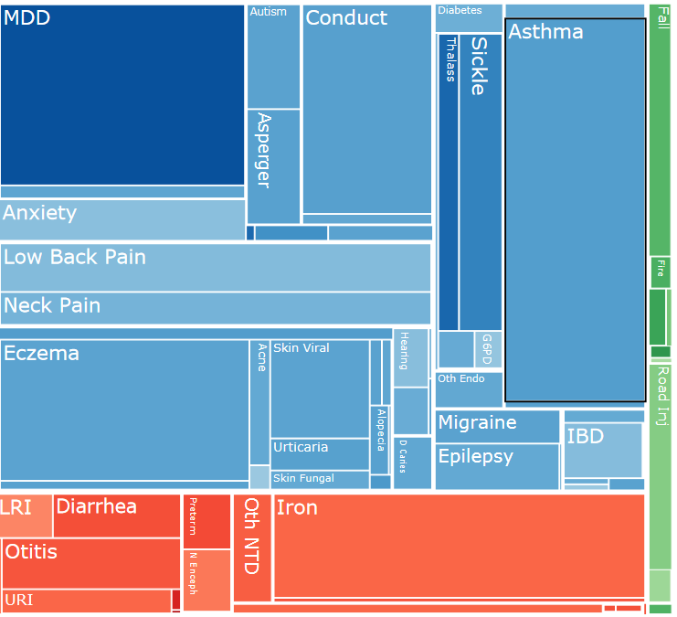
IHME estimates of BoD (YLDs) in 2010
Asthma:
2% of total YLDs in 1990 and
2010
Maximum for 5-9y old (2010)
→ 13% of total YLDs
→ biggest contribution to
total YLD
http://viz.healthmetricsandevaluation.org/gbd-compare/
4
Notes:
IHME: Institute for Health Metrics and Evaluation (University of Washington)

Slide 5
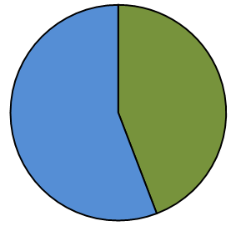
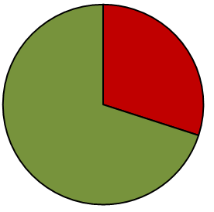
From the Model to Control Policies
Asthma BoD
Attributable
Risk Ratio
Can not be changed
Attributable
Exposure
Can be changed
Reducible Fraction
Genes
Lifestyle
Other factors
Environmental Factors
Exposure can be changed by relatively easy measures
Already existing policies
Development of hypothetical policies
→ Modelling of effect of exposure change
Co-morbidities

Slide 6
Selection of exposure factors
Literature Search
Review Table
Lack of evidence;
Duplication of
factors
Model
Policies
Lack of data;
Lack of significance
Impact on
asthma burden
235 articles
35 factors
15 factors
6 factors
Databases: PubMed, Scopus, Web of Science – WoS (ISI),
SpringerLink and Science Direct (Elsevier).
Search queries: asthma; asthma AND environment*; asthma AND risk; asthma AND environment* NOT atopy; asthma AND risk NOT atopy; asthma AND mechanism; asthma AND risk NOT occupation*; asthma AND environment* NOT occupation*
6

Slide 7
Outline
Introduction
Background data
Associated Factors
Control Policies
Discussion
Attributable
Attributable
Reducible Fraction
Asthma BoD
7

Slide 8
Life Table (1986-2040) and Age Distribution

Slide 9
Incidence & Prevalence
Incidence: number of new cases in a specific period of time
→ number of new individuals entitled to reimburse expenses for asthma medication during one year
Prevalence: number of all cases at a specific time point
→ total number of individuals entitled to reimburse expenses for asthma medication at the end of a year
Data provided by KELA statistics

Slide 10
Incidence and Prevalence – Total number of cases
10

Slide 11
Background Rates at Baseline (2011)

Slide 12
Burden of Disease - YLD
Years Lived with Disability (YLD)
a) Incidence based:
$$YLD_{I}=I×D×DW;D=15y (WHO)$$
b) Prevalence based:
$$YLD_{P}=P×D×DW;D=1y$$
YLD_{I} = YLD_{P}
P x DW = I x D x DW
D = $\frac{P}{I}$
I = Incidence; DW = Disability Weight; D = Duration; P = Prevalence
Notes:
DW (Disability Weight): 0 (perfect health) – 1 (equivalent to death)

Slide 13
Years Lived with Disability – Total number of years

Slide 14
Duration estimation
Notes:
Assuming that Duration = Prevalence / Incidence → unrealistic high duration in older age groups → duration longer than age specific life expectancy

Slide 15
Outline
Introduction
Background data
Associated Factors
Risk Factors
Protective Factors
Control Policies
Discussion
Attributable
Reducible Fraction
Attributable
Asthma BoD
15

Slide 16
Overview Risk Factors
Factor | Exposed Population [%] | RR/OR | Target Age [Years]
Dampness and Mold | 15 | 1,34 | 0-99
NO₂ | 100 | 1,077 | 0-99
Underweight | 3 | 3,14 | 6
PM_{2.5} | 100 | 1,16 | 0-99
SHS (child) | 4 | 1,32 | 0-13
SHS (adult) | 14 | 1,97 | 21-99
Cat Allergy | 7 | 1,67 | 7-8
Dampness and Mold | 15 | 1,37 | 0-99
Dog Allergy | 7 | 2,78 | 21-99
Formaldehyde | 2 | 1,02 | 0-2
16
Notes:
- Since NO₂ and PM_{2.5} are both ambient air pollutants, it is assumed that the whole population is exposed to them.
- It is thought that a small fraction of all newborns have a smaller length-to-weight ratio than the 85th percentile. The estimation for this is 3 % of all infants.
- The exposure estimate for cat and dog allergens where derived from Haahtela et al.’s (2008) estimate of 15 % of prevalence of allergies to animals in Finland. It was assumed, that only a small fraction (1 %) was to other animals than cat and dog and therefore the prevalence of sensitization to cat and dog was assumed to be 7 % for each animal. The exposure of the general population to cat and dog was obtained from Hugg et al (2008). For cat it is 21 % and for dog 26 %. It was assumed, that the population, which is regularly exposed to either of the animals resembles the general population and therefore that the allergy prevalence is 7 % in this sub-population. Merging this assumptions, the exposure estimate for cat is 1.5 % and for dog 1.8 %.

Slide 17
Attributable incident cases and residual at baseline (2011)
Smoking; 0%

Slide 18
Overview Protective Factors
Factor | Exposed Population [%] | RR/OR | Target Age [Years]
Cat | 20 | 0,47 | 7-16
Dog | 24 | 0,57 | 7-16
Breastfeeding | 35 | 0,48 | 4-6
Eurotium | 4 | 0,57 | 6-12
Penicillium | 4 | 0,57 | 6-12

Slide 19
Prevented cases at baseline (2011) and background

Slide 20
Outline
Introduction
Background data
Associated Factors
Control Policies
Tobacco Smoke
PM_{2.5}
Dampness and Mould
Pets
Discussion
Attributable
Reducible Fraction
Attributable
Asthma BoD
20

Slide 21
Summary Risk & Protective Factors
Residual;
7922
8 000
Protective Factors

Slide 22
Control Policies
Policy | Factor | Reference
Tobacco | SHS | Kutvonen (2014); Savuton Suomi 2040
 | Smoking
PM_{2.5} | PM_{2.5} | Kutvonen (2014)
Dampness and Mould | Dampness and Mould | HealthVent study
Pets | Cat
 | Dog

Slide 23
Control Policies – Tobacco
Policy | Exposure in 2013 | Change in Exposure | Explanation
Ban | SHS: 4% Children 9% Adults Smoking: 15% (15-24y) 19% (25-44y) 29% (45-64y) 8% (65-84y) | Total ban → 100% reduction | From 2015 onwards no exposure at all
50% Reduction |  | 50% Reduction | In 2015 50% reduction and then constant exposure
10% Reduction |  | 10% Reduction | From Exposure 2014 annually 10% reduction
23

Slide 24
Tobacco Exposure trends

Slide 25
Impact of Tobacco Control Policy
Smoking
Smoking

Slide 26
Control Policies – PM2.5
Policy | Exposure in 2013 | Change in Exposure | Explanation
Ban of Small Scale Wood Combustion (SSWC) in Urban Areas | Total: 8mg/m³ and 0,6 mg/m³ due to SSWC | Total ban→ 100% Reduction | Annually fraction due to SSWC is deleted from total exposure
Reduction of Small Scale Wood Combustion (SSWC) in Urban Areas | Total: 8mg/m³ and 0,6 mg/m³ due to SSWC | 50% Reduction | Annually 50% of fraction due to SSWC is deleted from total exposure
Speed Limit of 35km/h in Urban Areas | Total: 8mg/m³ and 0,7 mg/m³ due to resuspension | 40% Reduction | Annually 40% of fraction due to resuspension is deleted
26
Notes:
Urban area: 200 inhabitants / km2

Slide 27
Impact of PM2.5 Control Policy
Small Scale Wood Combustion

Slide 28
Control Policies – Dampness and Mould
Policy | Exposure in 2013 | Change of Exposure | Explanation
D&M | 15% of total population | 50% Reduction | In 2015 50% reduction to 7,5% and then constant exposure
28

Slide 29
Impact of Dampness and Mold Control Policy

Slide 30
Control Policies – Pets
Policy | Exposure in 2013 |  | Change in Exposure | Explanation
Cat Risk | 20% of total Population | 7% atopic → 1,5% | 50% increase | Increase in 2015, after that constant at 3,5%
Cat Protection |  | 93% non-atopic → 18,5% |  | Increase in 2015, after that constant at 46,5 %
Dog Risk | 24% of total Population | 7% atopic → 1,8% |  | Increase in 2015, after that constant at 3,5%
Dog Protection |  | 93% non-atopic → 22,2% |  | Increase in 2015, after that constant at 46,5%
30

Slide 31
Impact of Pet Control Policy

Slide 32
Reduction Potential of Control Policies
Tobacco
Wood Combustion
Dampness

Slide 33
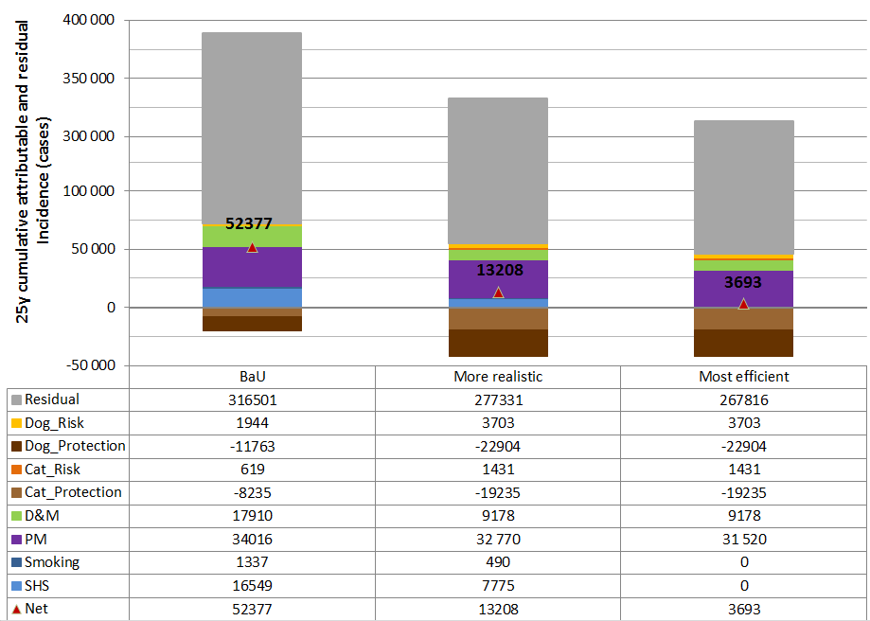
Impact of combined Control Policies

Slide 34
Reducible Fraction of the total 25y cumulative Incidence
More realistic
Most efficient

Slide 35
Efficiency Control Scenarios - Incidence

Slide 36
Efficiency Control Scenarios - Prevalence

Slide 37
Efficiency Control Scenarios – combined Incidence & Prevalence

Slide 38
Outline
Introduction
Background data
Associated Factors
Control Policies
Discussion
38

Slide 39
Limitations
Population Life Table
Neglecting of (Im-)migration
Use of YLD instead of DALY
Each year a very low number of death due to asthma → neglected
Discounting
Discounting decreases estimates for future years compared to non-discounted estimates
Notes:
Population Life Table
Neglecting of (Im-)migration
Use of YLD instead of DALY
Each year a very low number of death due to asthma → neglected
Trend estimations
Uncertainty about the future trends in asthma and exposures
Discounting
Discounting decreases estimates for future years compared to non-discounted estimates
Evidence
Overall very weak (association with atopy)
PM source has impact on toxicological profile
Duration
Duration has impact on incidence based YLD estimate → longer duration increases YLD estimate
Multicausality – Impact of exposure to one Factor
Constantly exposure to many factors
Study endpoint
Are specific factors associated with only onset or aggravation?
Target Age
How long does the effect last (of causing or preventing?)
Comparison Onset against Aggravation
Due to lack of data on duration it is not possible to compare efficiency of preventing onset or aggravation

Slide 40
Uncertainties
Trend estimations
Uncertainty about the future trends in asthma and exposures
Evidence
Overall very weak (association with atopy)
PM source has impact on toxicological profile
Duration
Duration has impact on incidence based YLD estimate → longer duration increases YLD estimate

Slide 41
Conclusion
Accumulation of prevalent cases in older age groups
Asthma duration is increasing and age dependent
About half of the total BoD can be theoretically explained
BoD can be reduced (up to 20%) by reducing exposure to risk factors

Slide 42
Thank you for your attention!

Slide 43
Life Table (1986 – 2040)

Slide 44
Age groups
Age Group | Start | End | Absolute 1986 | % 1986 | Absolute 2011 | % 2011 | Absolute 2040 | % 2040
Infant | 0 | 0 | 67 221 | 1,3 | 60 074 | 1,1 | 72 314 | 1,3
Toddler | 1 | 3 | 211 339 | 4,2 | 183 099 | 3,4 | 214 476 | 3,8
Preschool Child | 4 | 6 | 209 640 | 4,1 | 178 890 | 3,3 | 210 889 | 3,7
Child | 7 | 12 | 441 028 | 8,7 | 348 265 | 6,4 | 410 752 | 7,2
Teen | 13 | 19 | 468 675 | 9,3 | 446 420 | 8,3 | 460 318 | 8,1
Young Adult | 20 | 25 | 465 347 | 9,2 | 398 035 | 7,4 | 378 248 | 6,7
Working Age | 26 | 65 | 2 591 580 | 51,2 | 2 885 081 | 53,4 | 2 485 483 | 43,6
Pensioner | 66 | 80 | 480 214 | 9,5 | 670 736 | 12,4 | 891 563 | 15,6
Elderly | 80 | 99 | 152 366 | 3,0 | 230 003 | 4,3 | 571 632 | 10,0
Total | 0 | 99 | 5 058 012 | 99,9 | 5 400 603 | 99,9 | 5 695 675 | 99,9
Absolute | 0 | >100 | 5 058 119 |  | 5 401 267 |  | 5 700 200

Slide 45
Disability Weights
Leukemia
Liver
neoplasm
Meningitis
Cretinism
Asthma
0
1
Perfect
Health
0,1
0,2
0,3
0,4
0,5
0,6
0,7
0,8
0,9
Death
Dental caries
Severe
Depressive
Episode
1st stroke ever
Acute mycardial
infarction
Notes:
Cretinism is a condition of severely stunted physical and mental growth due to untreated congenital deficiency of thyroid hormones (congenital hypothyroidism) usually due to maternal hypothyroidism. Cretinism arises from a diet deficient in iodine.

Slide 46
Estimation $Duration = \frac{Prevalence}{Incidence}$

Slide 47
Comparison YLD_I and YLD_P
1986
2011

Slide 48
2015
2040

Slide 49
Attributable YLD_I & attributable YLD_P – Comparison I
Baseline (2011)
49

Slide 50
Attributable YLD_I & attributable YLD_P – Comparison
1986
2006
Notes:
1986: biggest difference
2006: smallest difference

Slide 51
Comparison studies – Methods
 | WHO | IHME | EBoDE | SETURI | HealthVent | Thesis
Target year | 2004 | 2010 | 2004 | 2006 | 2010 | 2011
YLD estimate | YLD_I | YLD_P | YLD_I | YLD_I | YLD_I | YLD_I YLD_P
Disability Weight | 0,04 | 0,009-0,132 | 0,04 | 0,04 | 0,04 | 0,04
Duration | 15 years | - | 15 years | 15 years | 15 years | 15 years -
Discounting | Yes | No | Yes No | No | Yes | No
Source Asthma Data | WHO | ? | WHO | WHO | WHO | KELA statistics

Slide 52
Comparison with other studies
Study | Year | Factor | Estimate (YLD) | Thesis (YLD)
WHO | 2002 | Asthma | 9 526 | 8 974
WHO | 2004 | Asthma | 9 000 | 8 191
HealthVent | 2010 | Asthma ª | 2 023* | 2 037
HealthVent | 2010 | PM2.5 ^{1,a} | 8 653* | 1 049
HealthVent | 2010 | SHS ^{2,a} | 278* | 591
HealthVent | 2010 | Dampness & Mould ^{3,a} | 340* | 397
EBoDE | 2010 | SHS | 692 | 604
EBoDE | 2010 | Formaldehyde | 9 | 0
* In DALYs
ª Includes only attributable to poor indoor air quality
¹ includes asthma, lung cancer, CV-diseases, COPD
² includes lung cancer, ischemic heart disease, asthma
³ includes respiratory infections, asthma
Notes:
Target Country: Finland

Slide 53
Risk estimates for stressors
Risk estimates for stressor were available for short window of time
linear regression used for extrapolation for longer period of time
53
Notes:
It seems unlikely that a stressors only presents risk at very short time window to cause asthma onset or symptoms → more a matter of study design
The data points at 6 and 8 years were the original OR of the study
Increase in risk associated with underweight in infancy from birth to 6 years, and then decrease to the age of 21 years again
extrapolation between 6 and 8 years, too

Slide 54
Tobacco Statistics Finland

Slide 55
PM Exposure trends

Slide 56
From change in Incidence to change in Prevalence
Year
2015
2016
2017
2018
2019
2020
BaU Inc
Control Inc
Control 1
Preventing Inc
-x%
-x%
-x%
-x%
-x%
+a1-x%
+a2-x%
+a3-x%
+a4-x%
+a5-x%
Control 1 Prev
BaUPrev
+a1
+a2
+a3
+a4
+a5
Control 2
Preventing Prev
-y%
-y%
-y%
-y%
-y%
Control 2 Prev

Slide 57
Summary I
How much of the burden of asthma can be explained by known environmental risk factors? Which are the ones with the most impact?
25-50% with PM_{2.5} and SHS having the biggest impact
Are there any protection factors capable of preventing a significant fraction of onset or symptoms of asthma?
→ Yes, but very weak evidence
57

Slide 58
Summary II
Are the two different modeling approaches comparable? Are differences in the burden of disease estimates due to changes in the incidence or prevalence rate?
→ Incidence based has bigger focus on younger age groups and prevalence based estimates have bigger focus on older age groups
Does the reduction of environmental exposures lead theoretically to a reduction of burden of disease?
→ 10% of total BoD and 30% of attributable BoD

Slide 59
Summary III
Which control policies approach has theoretically a bigger impact on DALYs?
→ Ban of Tobacco (SHS) and Increase of Pets
Can any causality between onset and aggravation regarding environmental factors be identified?
→ No
Does it make a difference to use a constant duration of disease or an age-dependent estimate?
→ Yes (assumed that duration is equal to Prev/Inc)
59

Slide 60
Conclusion
”Essentially, all models are wrong, but some are useful”
(George Box)
Many uncertainties, but nevertheless, the model gives an overview over the order of magnitude of impact of exposures on asthma
→ Results can be used as support for decision making in public health policies

