Slide 1
Endocrine Disruptors
Where Do We Go From Here?
Linda S. Birnbaum, Ph.D., D.A.B.T., A.T.S.
Director
National Institute of Environmental Health Sciences
National Toxicology Program
32nd International Symposium on
Halogenated Persistent Organic Pollutants
Monday, August 27, 2012
Notes:
Good Afternoon. Thank you for inviting me to DIOXIN 2012. It’s an honor to be here with you in Australia.

Slide 2
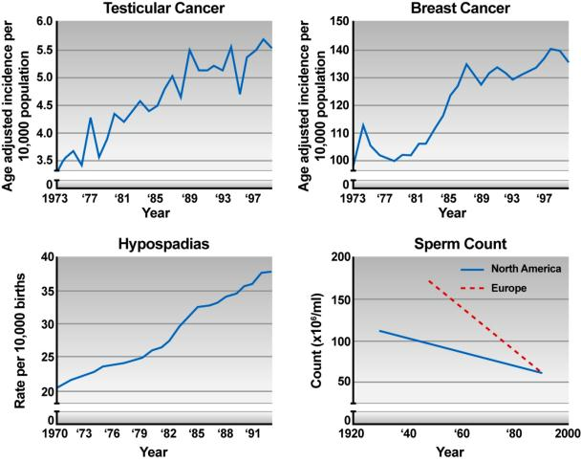
Should We Be Concerned?
Sharpe and Irvine, 2004
Notes:
Over the past fifty years, we’ve seen increases in health problems such as breast and prostate cancer, ectopic pregnancies, undescended testicles, and a 42% decrease in sperm count.
These findings, along with observations of abnormal sexual development in frogs and fish, and the widespread detection of endocrine disrupting chemicals in our bodies, led NIEHS to increase its research on the effects of these chemicals on human health.

Slide 3
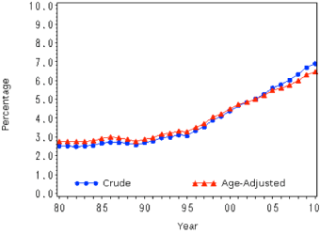
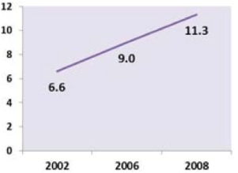
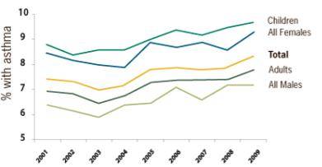
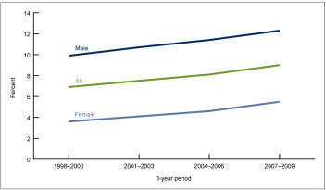
Should We Be Concerned?
Increase in Diabetes (1980-2010)
Increase in Autism Prevalence
Increase in Asthma
Increase in ADHD
Data from CDC / National Center for Health Statistics

Slide 4
Gene-Environment and Disease
Why have some diseases increased in incidence over the past 40 years?
Genes have not changed over that time
Recent “epidemics” of diabetes, asthma, ADHD, obesity due to environmental, dietary and behavioral changes
We will never understand the etiology of diseases without an understanding of the role of “environment
Notes:
Why are these focus areas important?
We know that some diseases like obesity, diabetes, autism, ADHD and asthma have increased significantly over the past 40 years.
What explains this increase?
We know the human genome hasn’t changed over that time, so a genetic cause is unlikely.
Some have pointed to dietary and behavioral changes to explain the obesity epidemic as well as ADHD and asthma among other things. But the environment figures significantly in this matrix; as such, we have to understand the role of the environment in this increase.
First, we need to begin by defining the “environment”, which of course includes chemicals, but also diet and nutrition, drugs (both prescription and over-the-counter as well as illicit drugs), stress, climate, and even infections. Although most people may only assume that chemicals are the focus of the environment, we have to remember that the environment encompasses a wide range of potential factors.
But the key is *how* the environment interacts with our genes, leading to the field of epigenetics.

Slide 5

“ENVIRONMENT” Includes:
Industrial chemicals
Agricultural chemicals
Physical agents
(heat, radiation)
By-products of combustion and industrial processes
(dioxin)
Infectious agents
Microbiome (gut flora)
Foods and nutrients
Prescription drugs
Lifestyle choices and
substance abuse
Social and
economic factors
Notes:
Environmental Health is a very broad topic, but I would like to just mention what I mean when I say “Environment.” Of course, most people think about chemicals and substances found in pollution, but the environment also includes the food we eat, the drugs we take, and social and economic factors like stress.
What’s interesting to note is that each of these things can be related to adverse health outcomes.

Slide 6

Diseases with a Known or Suspected Environmental Component Include:
Cancers
Birth defects (cleft palate, cardiac malformations)
Reproductive dysfunction (infertility)
Lung dysfunction (asthma, asbestosis)
Neurodegenerative diseases (Parkinson’s)
Neurodevelopmental disorders (autism)
Notes:
Each of the diseases listed here are either known or suspected to have environmental causes. Cancers, birth defects, lung diseases, and reproductive problems such as infertility.
We know that the environment is a factor in these conditions. And we’re supporting research to try to understand this connection better.
The main point here is that death or cancer are NOT the only endpoints that are important when considering environmental health. Reproductive function, brain development, lung function and other physiological properties rely on proper development in order to maintain health, and environmental stressors can affect each of these functions.

Slide 7
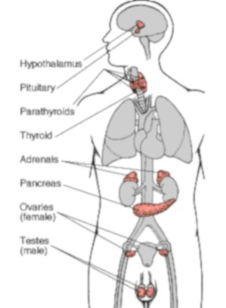
The Endocrine System
Complex system of hormones and receptors
  Multiple receptors (cellular/nuclear)
  Multiple cofactors
  Receptor cross-talk
  Hormones active at pM-nM concentrations
  SERMs
Multiple modes of action over a wide dose response
  Non-monotonic dose responses
  High doses do not predict low dose effects
  High doses cause negative feedback
Doses examined must be in the range of agent binding to receptor system
Highly conserved across species

Slide 8
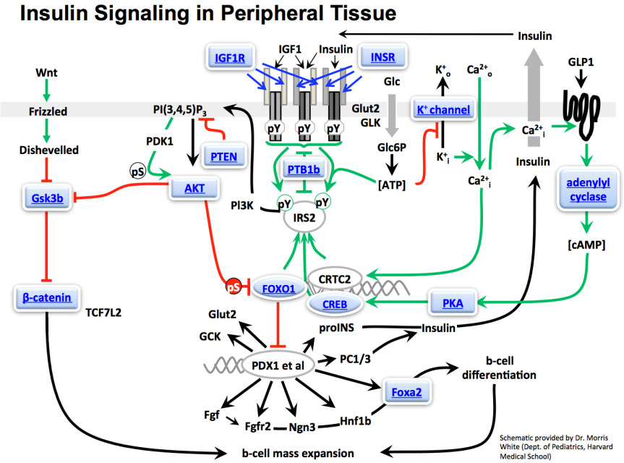
Notes:
This diagram is just here to show you how complex the endocrine system is – this is a schematic of the effects of insulin in your tissues. You can obviously see that there are many, many points of regulation and control in this system, and this is because your body needs to be able to finely tune the use of insulin, or any hormone. You can also imagine how the endocrine system can go haywire when any one of these control points is out of whack.

Slide 9
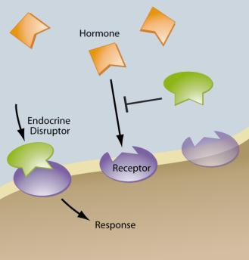
Some Chemicals Disrupt the Endocrine System
“Endocrine Disruptors”
Exogenous agents that interfere with the production, release, transport, metabolism, binding, action, or elimination of the natural hormones in the body responsible for the maintenance of homeostasis and the regulation of developmental processes
EPA definition modified from Crisp et al, “Environmental Endocrine Disruption: An Effects Assessment and Analysis,” EHP 1998.

Slide 10
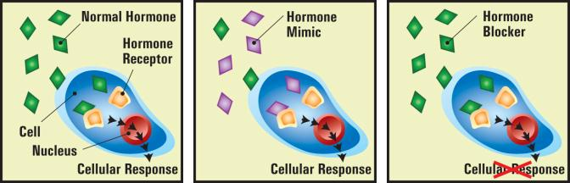
Why We Study Endocrine Disrupting Chemicals
Low doses can have big effects
Wide range of effects on our health
Early life exposures can have persistent effects
Endocrine disrupting chemicals are ubiquitous
Effects seen in wildlife, laboratory animals, and people

Slide 11
Endocrine Disrupting Chemicals
HERBICIDES
2,4,-D
2,4,5,-T
Alachlor
Amitrole
Atrazine
Linuron
Metribuzin
Nitrofen
Trifluralin
FUNGICIDES
Benomyl
Ethylene thiourea
Fenarimol
Hexachlorobenzene
Mancozeb
Maneb
Metiram - complex
Tri-butyl-tin
Vinclozolin
Zineb
METALS
INSECTICIDES
Aldicarb
beta-HCH
Carbaryl
Chlordane
Chlordecone
DBCP
Dicofol
Dieldrin
DDT and metabolites
Endosulfan
Heptachlor / H-epoxide
Lindane (gamma-HCH)
Malathion
Methomyl
Methoxychlor
Oxychlordane
Parathion
Synthetic pyrethroids
Transnonachlor
Toxaphene
INDUSTRIAL CHEMICALS
Bisphenol - A
Polycarbonates
Butylhydroxyanisole (BHA)
Cadmium
Chloro- & Bromo-diphenyl
Dioxins
Furans
Lead
Manganese
Methyl mercury
Nonylphenol
Octylphenol
PBDEs
PCBs
Pentachlorophenol
Penta- to Nonylphenols
Perchlorate
PFOA
p-tert-Pentylphenol
Phthalates
Styrene
Testosterone synthesis inhibitor Estrogen receptor agonist
Thyroid hormone disruptor Androgen receptor antagonist

Slide 12

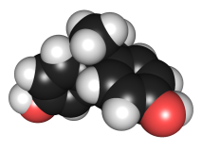
Low Dose
Our endocrine system: tiny amounts
of hormones with profound effects on
development and normal health
Chemical exposures, even at low doses,
can disrupt delicate endocrine system
and create a mechanism for disease
For some endocrine disruptors, biological changes can be seen at low doses, but not at high doses
For example: BPA, atrazine, DDT, DES, dioxin (TCDD), genistein, nicotine, parathion, PBDE-99, PCB mixtures, perchlorate, sodium fluoride, triclosan, and others
Notes:
LOW DOSE
Our endocrine system works on tiny amounts of hormones that have profound effects on development and normal health.
As a result, chemical exposures, even at low doses, can disrupt the body’s delicate endocrine system and create a mechanism for disease.
For some endocrine disrupting chemicals, biological changes can be seen at low doses, but not at high doses.
This is different from the usual dose-response curve which shows continually increasing responses with increases in dose.
As an example, low doses of BPA, an endocrine disruptor, change brain structure, function, and behavior in rats and mice exposed during critical periods of development.

Slide 13
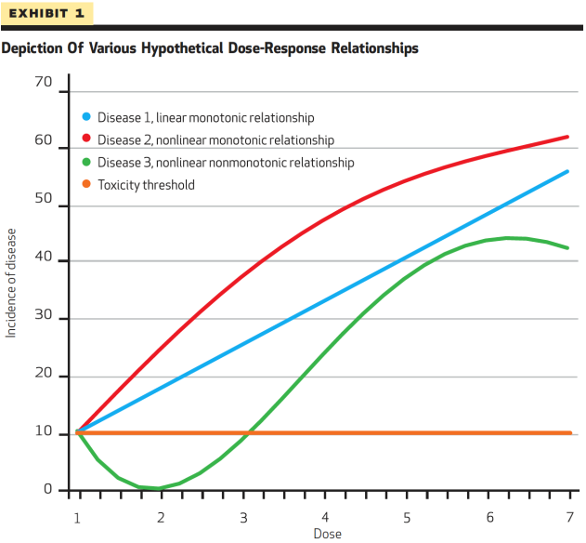
Non-Monotonic Dose-Response Curves
Notes:
What exactly is a non-monotonic dose-response curve?
[Figure is from Health Affairs article]
Modern science around toxicology has moved beyond the simple dichotomy of toxic versus nontoxic, which implies that all substances can be harmful at high doses and at some lower dose, no harm is done. We now know that agents also create effects at low doses too, and these effects still have a substantial impact on our health. In other words, some chemicals may have beneficial effects at certain doses and deleterious effects at others. This modern understanding of chemical effects is critical to understanding the behavior of chemical agents and how resulting health effects may differ based on various exposures.
The shift to our current understanding is best explained through the dose-response relationship. The classic assumption of toxicity assumes that dose response relationships are monotonic, meaning that the biological effect moves in one direction, either positive or negative, in response to an increase in the dose. The “monotonic linear” blue line in this graph shows an example of the simplest kind of monotonic relationship: as the dose increases on the horizontal axis, the biological effect also increases linearly on the vertical axis. And as the dose increases, at some point along this line, the effect is considered toxic.
A nonlinear monotonic relationship depicts a more complicated interaction between an agent and a biological effect. Under this relationship, an increase in dose is always met with an effect in the same direction—increasing or decreasing—but, in contrast to the linear relationship, the size of the effect can vary according to the level of the dose (shown here in red). For example, at low doses, a one-unit increase in the dose might result in larger increases in disease incidence than it would at higher doses.
A nonmonotonic relationship allows for decreases in the effect at some doses and increases at others, shown in green. One can easily see these contrasting relationships in this graph.

Slide 14
Non-Monotonic Dose-Response Curves
NMDRCs in hormones
  Cortisol
  Estradiol
  Progesterone
  Insulin
  Growth Hormone
  Prolactin
  Testosterone
  Thyroid Hormone
  TSH
NMDRCs in Endocrine Disruptors
  Atrazine
  Bisphenol A (BPA)
  Chlorpyrifos
  DDT
  DES
  Dioxin (TCDD)
  PBDE-99
  PCB 180 and PCB Mixtures
  Perchlorate
  Sodium fluoride
  Tributylin oxide
  Triclosan
  And others…

Slide 15
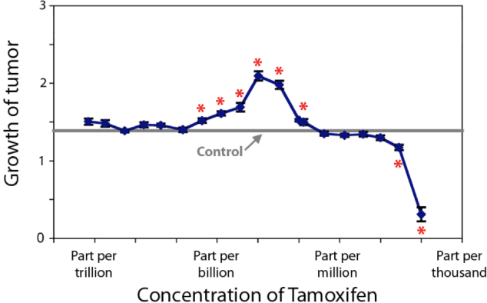
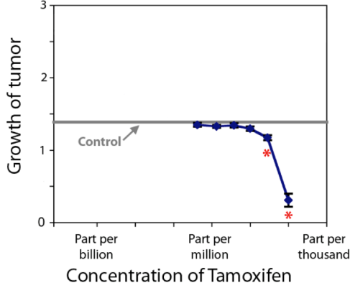
A Practical Example: Tamoxifen Flare
True
NOAEL
“Flare”
NOAEL
SAFE
SAFE
Modified from Vandenberg et al, “Hormones and EDCs: Low-Dose Effects and Nonmonotonic Dose Responses,” Endocrine Reviews 2012.

Slide 16
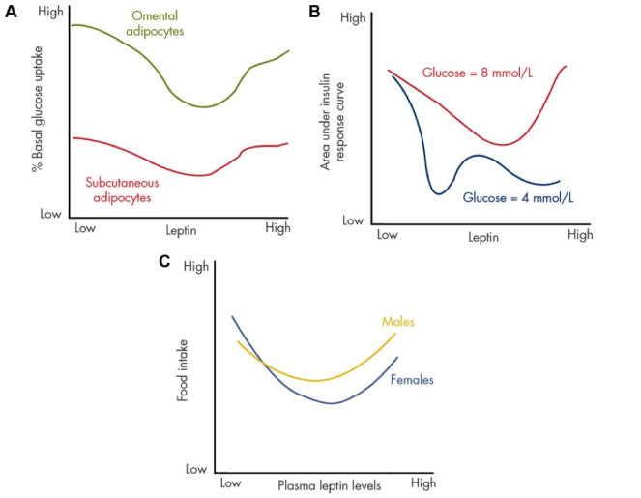
Example: Leptin
Modified from Vandenberg et al, “Hormones and EDCs: Low-Dose Effects and Nonmonotonic Dose Responses,” Endocrine Reviews 2012.
Notes:
Leptin as an example of a NMDRC. Several studies report NMDRCs in response to leptin treatments. A, NMDRCs are observed in cultured primary adipocytes after leptin exposure. This graph illustrates the relationship between administered leptin dose and glucose uptake in two types of adipocytes, those isolated from omental tissue (green) and others from sc fat (purple) (schematic was made from data in Ref. 559). These data are on a log-linear plot. B, Ex vivo rat pancreas was treated with leptin and various doses of glucose, and the insulin response curves were examined. Area under the curve is a measure of the ability of the pancreas to bring glucose levels under control. Different dose-response curves were observed depending on the amount of glucose administered: a U-shaped curve when 8 mmol/liter was included (pink) or a multiphasic curve with 4 mmol/liter (blue) (schematic made from data in Ref. 560). These data are on a linear-linear plot. C, U-shaped NMDRCs were also observed when food intake was compared with leptin levels in the blood of rats administered the hormone. This response was similar in males (orange) and females (cyan) (schematic made from data in Ref. 562). These data are on a linear-linear plot.

Slide 17

Wide Range of Health Effects
Endocrine signals govern every organ
& process in body
When chemicals interfere, effects can
be seen in many different conditions
and diseases
Recent work on endocrine disruption shows potential health effects including immune function, metabolism, brain development and behavior. Animal studies identified exposure to environmental endocrine disruptors can cause weight gain later in life. Endocrine Disruptors have also been linked to cancers, altered behavior, diabetes, immune dysfunction, reproductive dysfunction, and cardiovascular disease
Notes:
WIDE RANGE OF HEALTH EFFECTS
Endocrine signals govern every organ and process in the body.
This means that when chemicals interfere with endocrine signaling, the effects can be seen in many different conditions and diseases.
Early work on endocrine disruption focused mostly on health problems such as reproductive cancers that were known to be hormonally sensitive.
More recently, the universe of potential health effects has grown to include immune function, metabolism, brain development and behavior.
Animal studies have identified how exposure to environmental endocrine disruptors, such as tributyltin, genistein and diethylstilbestrol, can cause weight gain later in life.
Endocrine Disruptors have also been linked to cancers, altered behavior, diabetes, immune dysfunction, reproductive dysfunction, and cardiovascular disease.

Slide 18
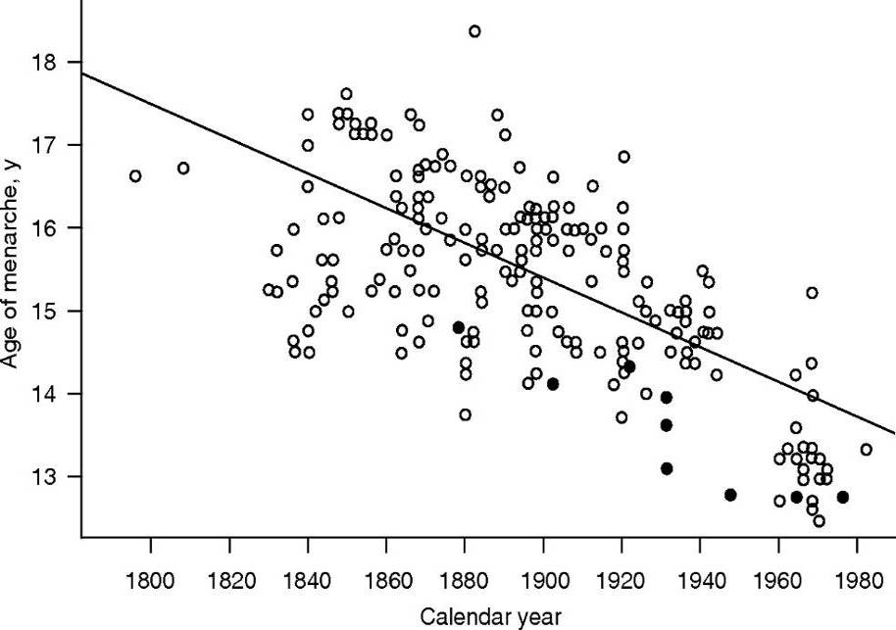
Decreasing Age of Puberty
US expert panel concluded:
Earlier breast development and onset of menarche
“Suggest … endocrine-disrupting chemicals …and body fat are important factors associated” with the change
African American and Mexican American girls enter puberty earlier than white girls
Age of Menarche in Europe and the US
from 1790 to 1980
Euling et al. Pediatrics 2008.
Notes:
A U.S. consensus panel, that included scientists from EPA and NIEHS, published its findings in 2008. There was general agreement, given the science that’s already out there, that the age of puberty has decreased, specifically breast development and onset of menarche.
There was also agreement that the studies suggest that endocrine-disrupting chemicals and body fact are associated with this altered timing of puberty.

Slide 19
Decreasing Age of Puberty
The proportion of white girls in the Breast Cancer and the Environment Research Consortium who attained breast stage >2 at age 7 years significantly greater than reported in Pediatric Research in Office Settings (PROS) network in 1997.
  White girls: 10.4% vs 5.0% (z = 3.72, P = .001)
  Black non-Hispanic girls: 23.4% vs 15.4% (not significant)
The proportion of white girls at breast stage >2 at age 8 also significantly greater than PROS.
  White girls: 17.9% vs 10.5% (z = 3.77, P < .0002)
  Black non-Hispanic girls: 37.0% vs 36.6% (not significant)
  Biro et al, Pediatrics 2010.
Notes:
A recent paper by Frank Biro and colleagues showed that a significantly greater proportion of white girls studied at the Breast Cancer and the Environment Research Centers (BCERC) had reached breast development stage >2 by age 7 and at year 8. This is compared with prior studies of girls through the Pediatric Research in Office Settings (PROS) network.
So clearly, the phenomenon of early onset of puberty continues.

Slide 20
Decreasing Age of Puberty
Exposure to three chemical classes (phenols, phthalates, and phytoestrogens) in multiethnic longitudinal study of 1,151 girls:
  High-molecular-weight phthalate metabolites and triclosan weakly associated with pubic hair development
  Daidzein with breast stage
  Low-molecular-weight phthalate biomarkers associated with breast and pubic hair development
  Enterolactone attenuated BMI associations with breast development
Weak, hormonally active xenobiotic agents had small associations with pubertal development, mainly agents detected at highest concentrations.
Wolff et al, EHP 2010
Notes:
Another recent paper by Mary Wolff and her colleagues showed that urinary measures of three chemical classes of phenols, phthalates, and phytoestrogens had associations with pubertal development, mainly those detected at highest concentrations.
Chemicals in Wolff's study include triclosan, high- and low-molecular weight phthalate metabolites, daidzein, and enterolactone. Measurements included pubic hair development, breast stage, the BMI-breast development association.
It is clear that hormonally active agents are playing a role in the timing of development.

Slide 21
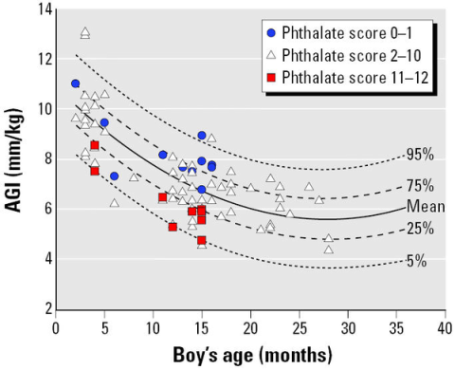
Phthalates and Anogenital Distance
Higher exposure to phthalates
(phthalate score) results in lower
anogenital index (AGI) in boys.
Association between AGI and
phthalate exposure consistent
with phthalate-related syndrome
reported in prenatally exposed
rodents.
Data support hypothesis that
prenatal phthalate exposure
at environmental levels adversely
affects male reproductive development.
  Swann et al, 2005. EHP;113(8):1056–1061
Notes:
Swan SH, Main KM, Liu F, Stewart SL, Kruse RL, Calafat AM, et al. the Study for Future Families Research Team 2005. Decrease in Anogenital Distance among Male Infants with Prenatal Phthalate Exposure. Environ Health Perspect 113:1056-1061.
Shorter Anogenital Distance Predicts Poorer Semen Quality in Young Men in Rochester, New York Jaime Mendiola, Richard W Stahlhut, Niels Jørgensen, Fan Liu, Shanna H Swan Shanna H Swan ... -9182. Fax: (585) 276-2171. E-mail: shanna_swan@urmc ... 1 2 Richard W. Stahlhut 1 Niels Jørgensen 3 Fan Liu 1 Shanna H. Swan 1 4 1 Department of Obstetrics and Gynecology Research Article, published 04 Mar 2011 | doi:10.1289/ehp.1103421

Slide 22
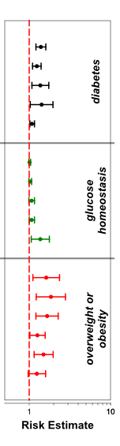
Bisphenol A & Diabetes / Obesity (Human Studies)
BPA and Diabetes, Glucose Homeostatis, Obesity
  NTP Review of 8 Studies
  Studies range from 2008 – 2011
  Risk Estimates show:
    All Odds Ratios > 1.00 for diabetes
    All OR > 1.00 for glucose homeostatis
    All OR > 1.00 for overweight & obesity
    No pooled OR available yet

Slide 23

Persistence of Biological Effects
Health effects of exposure to endocrine
disruptors can be observed long after
the actual exposure has stopped
This is especially true when exposures
occur during growth and development,
processes that are very sensitive to endocrine regulation
Epigenetics: the study of changes in DNA expression that are independent of the DNA sequence.
A person’s DNA base sequence doesn’t change, but expression of DNA is affected by changes in DNA “packaging.”
Environment is critical factor in DNA expression; we’re born with genes, but environment affects epigenetic changes.
Notes:
PERSISTENCE OF BIOLOGICAL EFFECTS
We are finding that the health effects of exposure to endocrine disruptors can be observed long after the actual exposure has stopped. This is especially true when exposures occur during growth and development, processes that are very sensitive to endocrine regulation.
Exposure to Endocrine Disruptors during development can result in profound changes in later life.
Animal researchers recently discovered that Endocrine Disruptors can produce these latent effects by subtly altering the structure of the DNA molecules and chromosomes.
These changes can potentially affect gene expression for several generations. This is the relatively new science of “epigenetics.”
Our understanding of chemical toxicity has been challenged by the new science of epigenetics, which is the study of changes to the packaging of the DNA molecules that influence the expression of genes, and hence the risks of diseases and altered development. Studies indicate that exposures that cause epigenetic changes can affect several generations. This new understanding heightens the need to protect people at critical times in their development when they are most vulnerable to this kind of toxicity.
Epigenetics is the study of changes in DNA expression that are independent of the DNA sequence itself. Although a person’s DNA base sequence doesn’t change, the expression of that DNA into a person’s phenotype can be altered by methylation of cytosine residues in DNA, modification of the histones which package the DNA into chromatin, and control of chromatin structure via microRNAs.
This has significant implications for the cause and heritability of disease.

Slide 24
Windows of Susceptibility
Early Prenatal Mid-Late Prenatal Postnatal
Central nervous system (3 wks - 20 yrs)
Ear (4-20 wks)
Kidneys (4-40 wks)
Heart (3-8 wks)
Limbs (4-8 wks)
Immune system (8-40 wks; competence & memory birth-10 yrs)
Skeleton (1-12 wks)
Lungs (3-40 wks; alveoli birth-10 yrs)
Reproductive system (7-40 wks; maturation in puberty)
Week 1-16 Week 17-40 Birth – 25 years
Source: Altshuler, K; Berg, M et al. Critical Periods in Development, OCHP Paper Series on Children's Health and the Environment, February 2003.
Notes:
We know that there are different stages of development, from the first week of the embryo to the postnatal years, even through puberty.
And the standard biomedical paradigm has been that exposures during development will affect the organ system in question.
The key point to recognize is that there are “windows of susceptibility” throughout all stages of development.

Slide 25
Examples of Developmental Origins of
Health and Disease (DOHAD)
Developmental Exposures
Learning Differences/Behavior
Asthma
Increased Sensitivity to Infections
Testicular Dysgenesis Syndrome
Atherosclerosis
Cardiovascular Disease
Infertility
Breast Cancer
Obesity
Prostate Cancer
Alzheimer's
Parkinson's
Altered Puberty
Fibroids
Premature Menopause
AGE
2 12 25 40 60 70

Slide 26
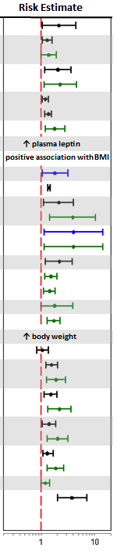
Windows of Susceptibility: Tobacco
Maternal Smoking & Children’s Obesity
  NTP Review of 23 Studies
  Studies range from 2001 – 2010
  Pooled data show:
    OR=1.5 for obesity (95%CI=1.35-1.65)
    OR=1.6 for overweight (95%CI=1.42-1.90)
Notes:
This is some interesting data presented at a recent Workshop that our National Toxicology Program held on the Role of Environmental Chemicals in the Development of Diabetes and Obesity. This is a summary of 23 studies relating smoking in pregnant mothers to later development of obesity and diabetes in their children.
The forest plot on the right side shows the risk estimate; the red line is the baseline risk, the blue lines show the risk for diabetes, the green lines obesity, and the black lines show the risk for being overweight. In other words, if the lines are entirely on the right side of the red line, that means the study showed an increase in risk for those conditions in children whose mom smoked.
Clearly this shows that multiple studies show a relationship between maternal smoking, diabetes, and obesity.
We used to think that maternal smoking was bad for the mother, and bad for the baby, primarily because of the risk of low birthweight. This data shows that the negative effects of smoking can carry into the child’s adulthood in the form of obesity and diabetes.

Slide 27


Ubiquitous Exposure
Chemicals with endocrine disrupting activity are widely dispersed in our environment
Endocrine disruptors often dispersed at biologically effective levels, and exposure to humans is common
CDC’s Report Card
All of us exposed to many different chemicals, and other environmental stressors, at the same time
Synergism
Given exposures can alter the body’s response to later exposures
The “exposome” is the totality of exposures that a person is subjected to from the environment (“EWAS”)
Notes:
UBIQUITOUS EXPOSURE
Because of widespread use as drugs and components of consumer products, chemicals with endocrine disrupting activity are widely dispersed in our environment.
Often, endocrine disruptors are present at biologically effective levels, and exposure to humans is common. This is well documented by the CDC’s National Exposure Report.
As an example of what types of research we’re conducting to address this issues, the National Toxicology Program is conducting a study of triclosan, an antimicrobial found in soaps, toothpaste, and even in clothing; triclosan is one of the most frequently detected water contaminants.

Slide 28

Summary: Where We Go From Here
Need to better characterize:
  Low dose / nonmonotonic effects
  Early life exposures may not show effects until later in life
  Modes of action change across dose response
  Wide range of biological effects
  Assessment of new endocrine related
  endpoints may be needed
Individual vs. public health risks
  Environmental health assessments
  are at individual level
  Population effects can be much larger
Regulatory issues

Slide 29




Thank you!
NIEHS Strategic Plan Website
http://www.niehs.nih.gov/strategicplan

