Slide 1
Homework 9: Participate in an Assessment
Climate change policies in Helsinki
Anni, Michael and Mari

Slide 2
Introduction
Objective was to contribute to making an assessment
Finding data about building stock in Helsinki
  Energy demand by use type
  Changes in energy efficiency of different energy sinks
Used for modeling
  Help in decision making process
  Help in identifying the most favorable ways to cut GHG emissions
  The model has not been created yet

Slide 3
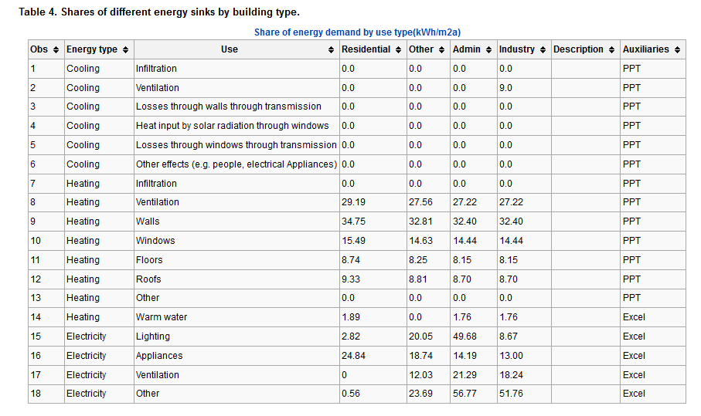

Slide 4
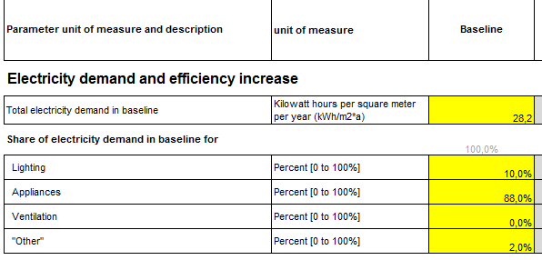
We used Copenhagen data
  Used total energy demand and percentages of different sections e.g. electricity, heating
  → kWh/m2a
  For appliances:
  28,2kWh/m2a*88,0%
  =24,8kWh/m2a
Floor area from Helsinki needed to calculate energy demand
Some data are still missing e.g. cooling

Slide 5
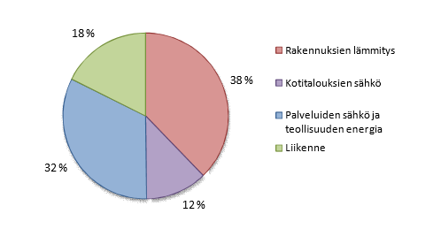
Estimated 2 % of energy for housing goes to cooling
We made an estimate about the annual energy demand of housing using total energy demand in Helsinki (14332 GWh/a)
  Took out the share of traffic (18%)
Total estimated amount of energy needed for cooling 23504480 kWh/a
http://www.stadinilmasto.fi/files/2013/04/PEK-raportti.pdf, http://www.energiatehokashelsinki.fi/energiankulutus/Helsinki, http://www.korjaustieto.fi/pientalot/pientalojen-energiatehokkuus/energiatehokkuus-pientaloissa/pientalon-energiankulutus-ja-paastot.html

Slide 6
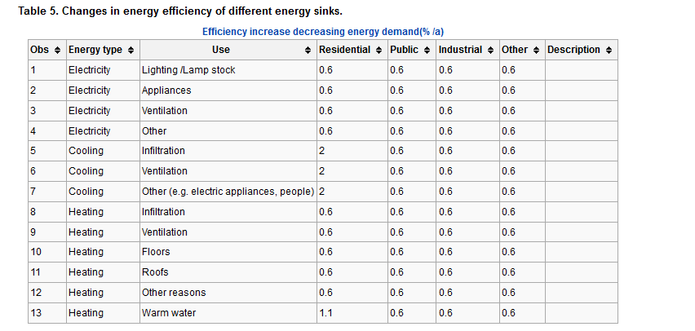

Slide 7
Some values could be found from Copenhagen data
For other sections we estimated
  Assumption: 3 % of houses renovated/year
    Same as in Kuopio
  20 % increase in energy efficiency when renovated*
  0,6 % increase in energy efficiency
  *http://www.hel.fi/static/rakvv/ohjeet/energiatehokkuus_korjaamisessa.pdf

Slide 8
Conclusions
Finding the correct data was difficult
  Using data from different sources
  Estimations can be made to fill in the gaps
    It is important to tell what the estimations are based on
Collected data is important for the assessment and will be incorporated in the bigger picture
Other data is still needed in order to utilize the information

Slide 9
Thank you for the attention!

