Slide 1
Application of toxicological risk assessment in the society
Jouni Tuomisto, THL, Kuopio
http://en.opasnet.org/w/File:Use_of_risk_assessment_in_the_society.ppt

Slide 2
The take-home message
Information in
  risk assessment and
  risk management
should be openly available for
  reading,
  criticism, and
  further use.
The main problems of risk assessment are actually problems of the decision making to use existing information (information need pull)

Slide 3
Outline
Four different assessment methods as examples:
  Red Book risk assessment (1983)
  Reach chemical risk assessment
  Environmental impact assessment (EIA, YVA)
  Open assessment
Group work on a real-life case study: how do the assessment methods see the case?
Evaluation of assessment drafts
Lessons learned and discussion

Slide 4
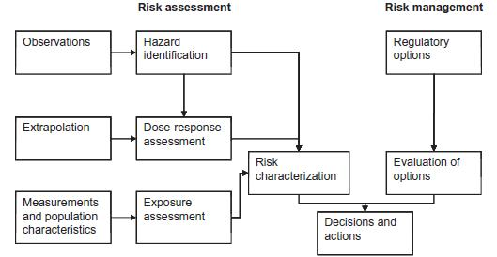
Red Book risk assessment (1983)

Slide 5
REACH – EU Chemical safety
Information: available vs. required/needed
▪ Substance intrinsic properties
▪ Manufacture, use, tonnage, exposure, risk management
Hazard assessment
▪ Hazard identification
▪ Classification & labeling
▪ Derivation of threshold levels
▪ PBT/vPvB assessment
Exposure assessment
▪ Exposure scenarios building
▪ Exposure estimation
Iteration
no
Dangerous or PBT/vPvB
yes
Risk characterisation
yes
no
Chemical safety report
Risk controlled
ECHA 2008. Guidance on Information Requirements and Chemical Safety Assessment. Guidance for the Implementation of REACH.

Slide 6
YVA - regulatory EIA in Finland
Phase 1
Phase 2
Evaluation program
Statements of the ministry of employment and economy about the report
Participation
Opinions and statements about the program
Opinions and statements about the report
Participation
Pohjola et al. State of the art in benefit-risk analysis: Environmental health. Food Chem Toxicol 2012.
Statements of the ministry of employment and economy about the evaluation
Assessment
Evaluation report

Slide 7
Open policy practice: participants and roles
Mikko V Pohjola and Jouni T Tuomisto. Environmental Health 2011, 10: 58 doi
Notes:
Original file: http://en.opasnet.org/w/File:Information_flow_within_open_policy_practice.svg (converted to wmf by CloudConvert for compatibility with PowerPoint [a nuisance])

Slide 8
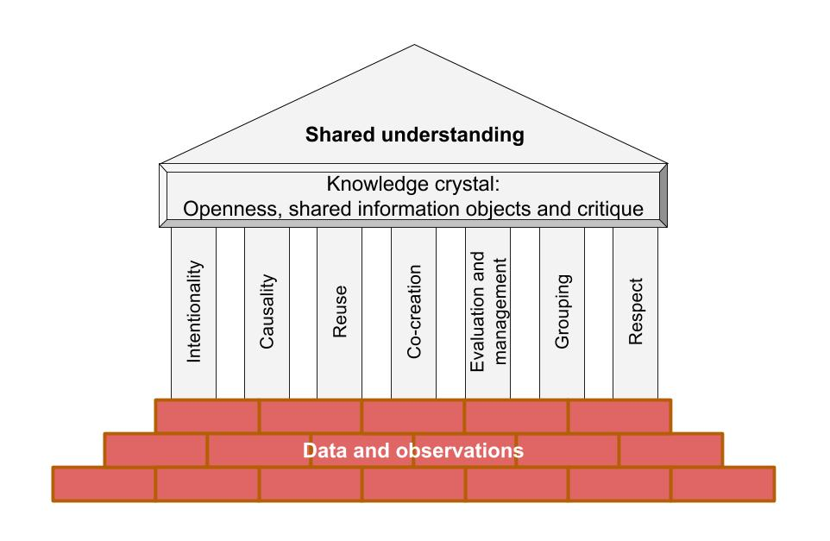
Open policy practice

Slide 9
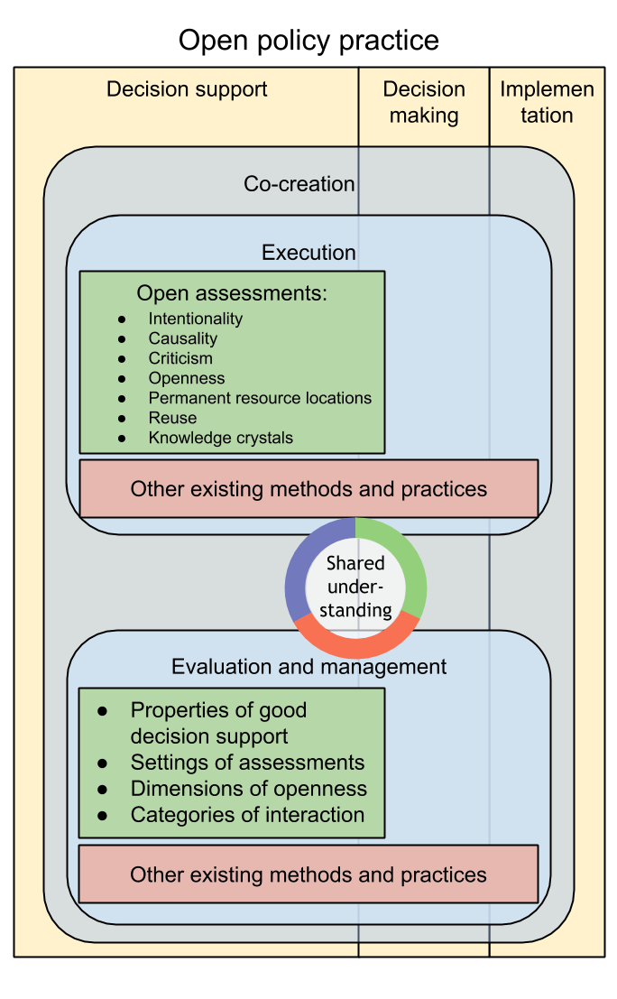
Open policy practice: parts
Shared understanding
Execution
Evaluation and management
Co-creation

Slide 10
Ympäristöhyvinvointia tietokiteillä
Jouni Tuomisto
Notes:
Esitys on tehty Etenen kokoukseen 30.1.2019. Alkuperäinen tiedosto: https://docs.google.com/presentation/d/1B86so0HAcL1WQrbGkY43xpV7jhrPeRXyqdwcqN82mUE/
Valtakunnaallinen sosiaali- ja terveydenhuollon eettinen neuvottelukunta ETENE haluaa seuraavalla 4-vuotiskaudellaan kehitellä ”kokonaisvaltaista (ympäristö)hyvinvointimallia”. Työ aloitetaan tutustumalla jo olemassa oleviin malleihin, ensin ympäristöä koskeviin, sitten terveyden edistämisen malleihin ja myöhemmin väestön terveyttä/hyvinvointia koskeviin malleihin.
Ohessa lainaus toimintasuunnitelmaluonnoksesta, joka ehkä auttaa hahmottamaan mitä ajamme takaa:
”Tavoitteeksi esitettiin luoda holistinen ympäristöhyvinvoinnin kokonaismalli. Lähtökohtana on, että paikallinen toiminta on myös globaalia ja että maailmanlaajat vaikutukset ulottuvat myös paikallistasolle. Ympäristöhyvinvointi kattaa laajasti maan, veden, ilman, mutta myös sosiaaliset-, kulttuuriset- ja teknologiset ympäristöt.
Tavoitteena on, että Etenen luo suuntaviivat kokonaisvaltaiselle hyvinvointikonseptille. Se edellyttää uudenlaista tarkastelutapaa. Tärkeä, tarkastelussa mukana pidettävä näkökohta on eksistentiaalinen hyvinvointi, merkityksellinen elämä. ”
Avainteemoja ovat: hyvä arki, kestävä kehitys, kokonaisvaltainen hyvinvointi, ekologisuus, kestävä yhdyskuntasuunnittelu, yhteisö, tulevaisuuteen katsominen
Etsin nyt olemassa olevia malleja ja asiantuntijaa ensiksi ympäristö teemoista (sisältäen asumisen ekologisesti tulevaisuudessa).

Slide 11
Operational principles of the city of Helsinki
openness +
participation +
digital solutions
=> Open policy practice
Notes:
Suomenkieliset tekstikalvot on käännetty englanniksi.

Slide 12
”Helsinki develops digital solutions that facilitate the following of and participation to interesting issues and activities irrespective of whether they are produced by the city or someone else.”

Slide 13
”Helsinki cherises as open and transparent practices as possible. Helsinki will become the leading city in opening and utilisation of public data.”

Slide 14
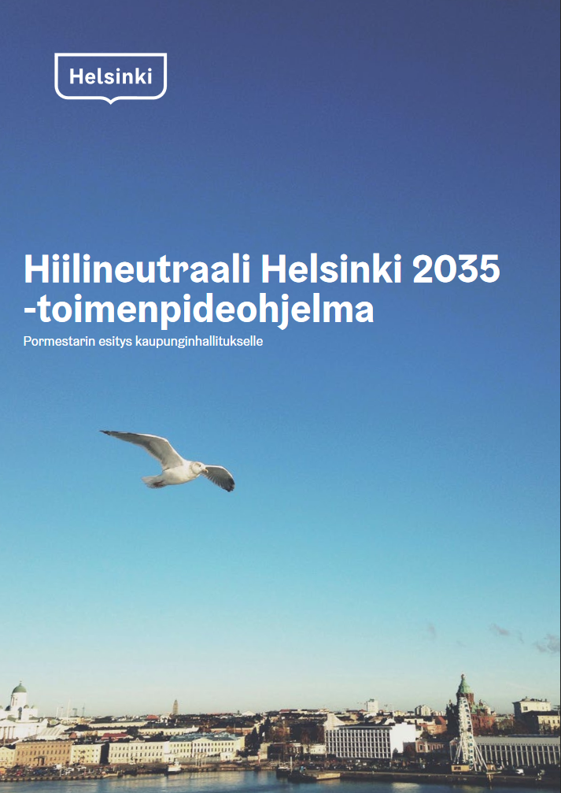
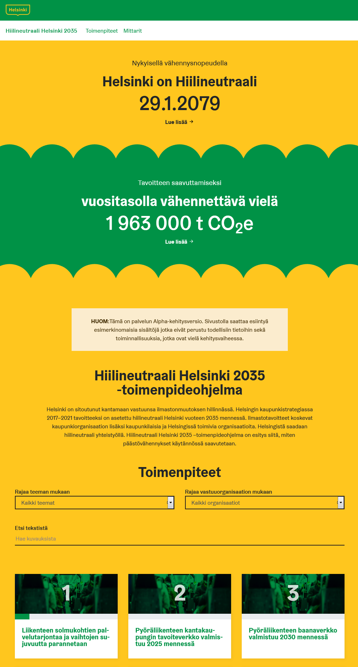

Slide 15
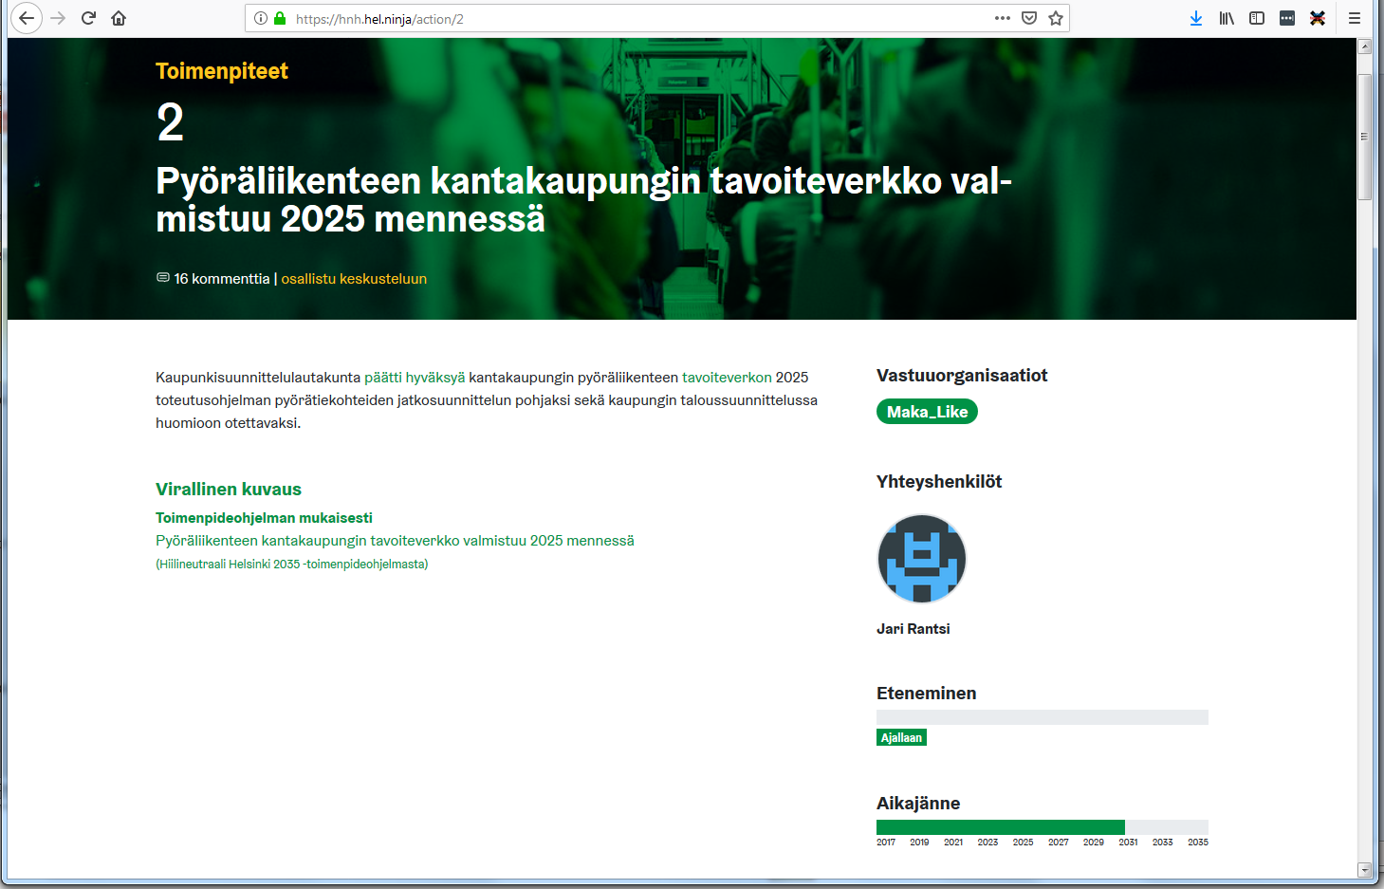
https://hnh.hel.ninja

Slide 16
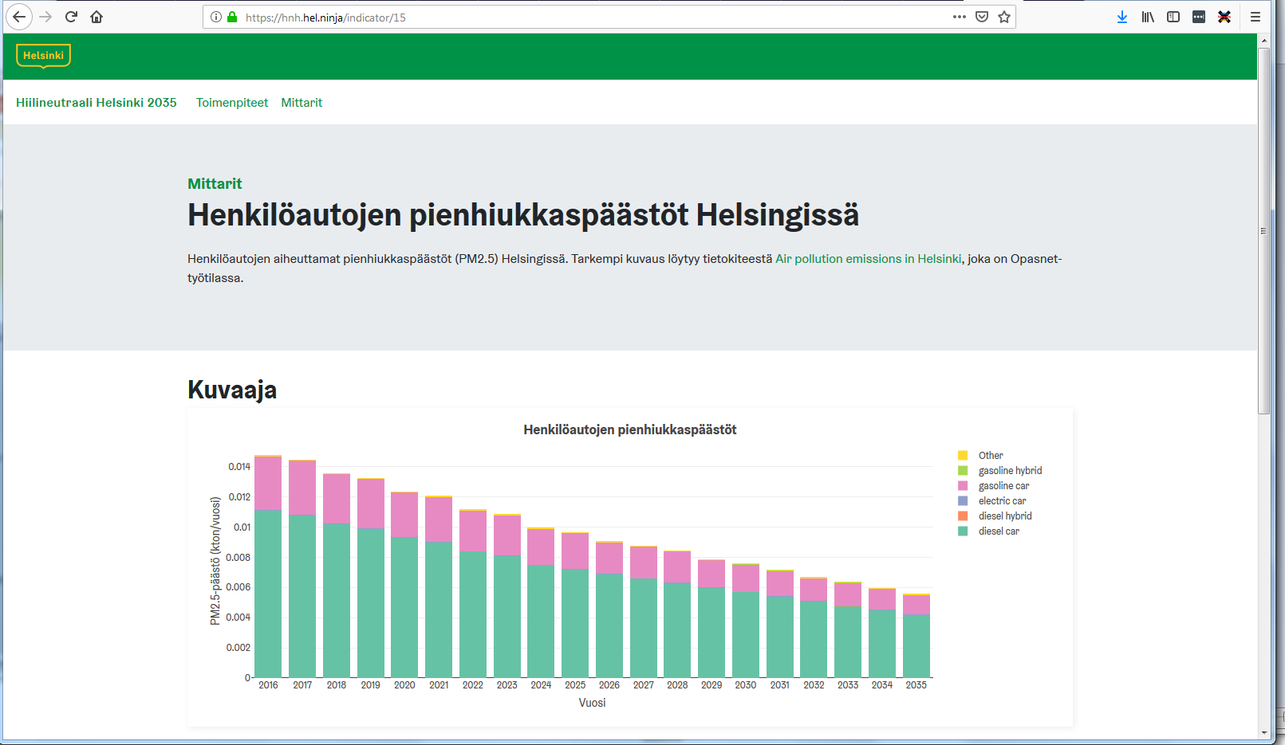

Slide 17
Knowledge crystal
Knowledge crystal is a web page that
answers a specific research question,
offers all information and participation openly to everyone,
uses substantial critique to reject poor answers,
offers the current best answer(s) via a permanent link in a format that is
  understandable to humans and
  machine readable (this enables applications built on top of it)

Slide 18
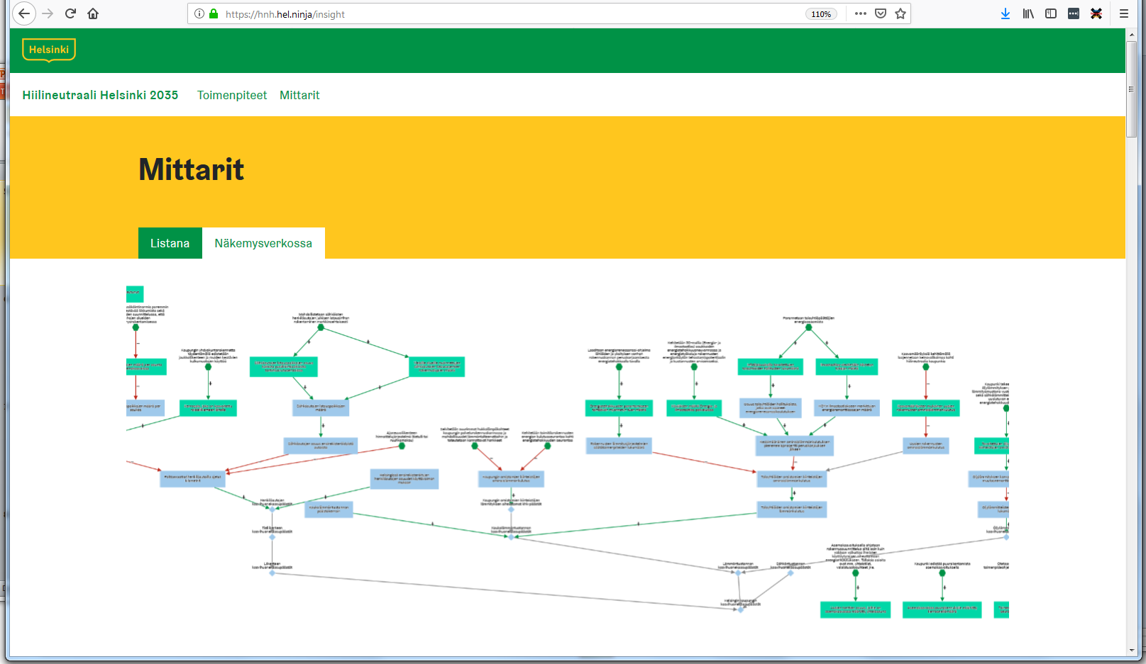

Slide 19
Guiding principles
All information is visible and available for everyone all the time.
Everyone’s comments and critique about implementation, achievements, and information is welcome.
The objective is not to find a best answer or action but rather to reject wrong answers and poor actions from further use.
A purpose is to produce shared understanding about what issues are important, what is known about them, what are the agreements and disagreements and why.

Slide 20
New opportunities
Knowledge crystals and insight networks enable new forms of collaboration
  between research and decision making
  between experts and citizens
  for fact checking
  for developing and motivating new actions
  for promoting objectives that are not the main purpose of an action (equity, health etc)
What practical things you can do yourself?

Slide 21
Case study: Pahtavaara mine
Citizen worries about asbestos from mine landfill
Health concerns
Legal obligations

Slide 22
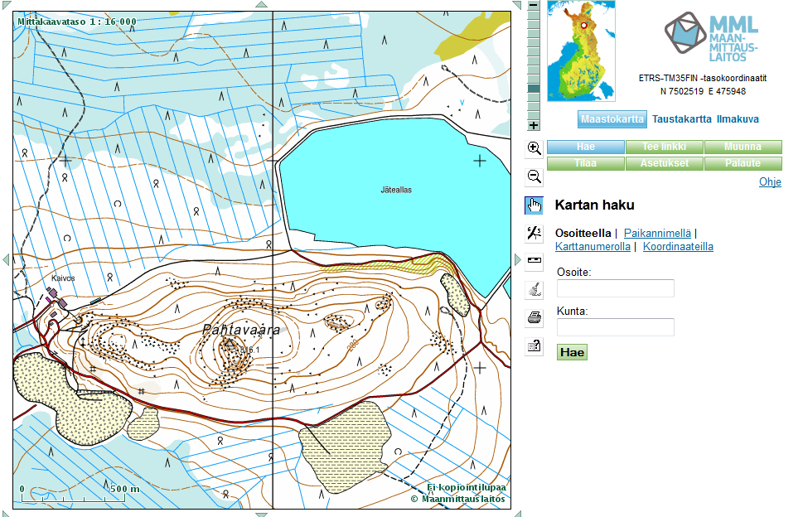
Pahtavaara mine
http://fi.opasnet.org/fi/Pahtavaaran_kaivos

Slide 23
Case study: Isomäki recreational area in Pori
Objectives: To assess environmental health and other impacts of the current use and develop the area towards
  Increasing the value of Isomäki area
  User safety
  Overall functionality
  Accessibility
  Sustainable development
More info: http://fi.opasnet.org/fi/Pori

Slide 24
Work in pairs
Based on what you heard about the case, make a draft of an assessment plan.
  Impacts to look at
  Scenarios to look at
  Main approaches to work: how to do it in practice
  What assessment methods to use
  Who to be involved in the assessment and how
  Is toxicology needed? For what?

Slide 25
Evaluation of the assessment plan 1/2
Intentionality: Do we have explicit objectives from the decision makers? Is the assessment answering to those?
Shared info objects: do we have and use them?
Causality: are decisions and outcomes linked in our assessment?
Criticism: Have we successfully included all criticism presented? Has there been a fair possibility to criticise anything?
Reuse: Can our results be reused? Are we efficiently using existing information?
Openness: How open is our approach?

Slide 26
Evaluation of the assessment plan 2/2
Quality of content: How do we best ensure that the quality of our assessment will be good?
Applicability: How do we ensure that our assessment can be effectively applied?
Efficiency: How can we make the best use of existing resources?
Evaluation criteria: see http://en.opasnet.org/w/OPP

Slide 27
Framework for knowledge-based policy
(Knowledge) practices
Policy making
Assessment
Question
Implementation
Outcomes
Answer
Interpretation
Process
Product
Use
Interaction
Design
Execution
Follow-up
Evaluation &
management
Notes:
Guidance of action both now and in future.
Design: purposes, execution plan, evaluation measures
Execution: evaluation of implementation, evaluation of design, evaluation of means
Follow-up: overall evaluation (including all previous + outcomes)

Slide 28
Shared understanding: definition
There is shared understanding about a topic within a group, if everyone is able to explain what thoughts and reasonings there are about the topic.
  There is no need to know all thoughts on individual level.
  There is no need to agree on things (just to agree on what the disagreements are about and why they exist).
  Descriptions are written down so that those who were not involved in discussions can learn.

Slide 29
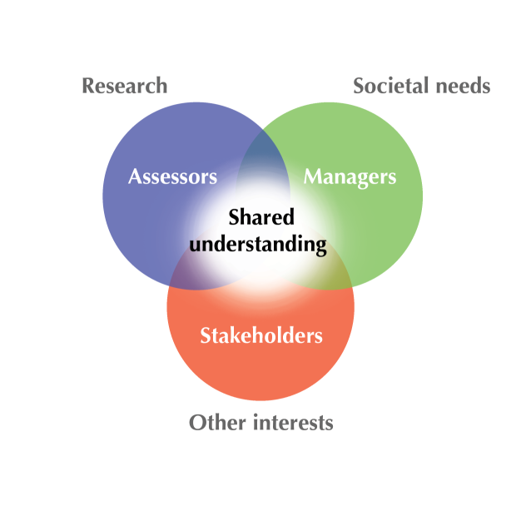
Shared understanding: graph
Pohjola MV et al: Food and Chemical Toxicology. 2012.

Slide 30
Problems perceived about open participation
It is unclear who decides about the content.
Expertise is not given proper weight.
Strong lobbying groups will hijack the process.
Random people are too uneducated to contribute meaningfully.
The discussion disperses and does not focus.
Those who are now in a favourable position in the assessment or decision-making business don’t want to change things.
The existing practices, tools, and software are perceived good enough.
There is not enough staff to keep this running.
People don’t participate: not seen useful, no time, no skills.
People want to hide what they know (and publish it in a scientific journal).

Slide 31
Problems observed about open participation
People want to hide what they know (and publish it in a scientific journal).
People don’t participate: not seen useful, no time, no skills.
The existing practices, tools, and software are perceived good enough.
There is not enough staff to keep this running.
Those who are now in a favourable position in the assessment or decision-making business don’t want to change things.
The discussion disperses and does not focus.
It is unclear who decides about the content.
Expertise is not given proper weight.
Strong lobbying groups will hijack the process.
Random people are too uneducated to contribute meaningfully.

Slide 32
Main rules in open assessment (1)
Each main topic should have its own page.
  Sub-topics are moved to own pages as necessary.
Each topic has the same structure:
  Question (a research question passing the clairvoyant test)
  Answer (the best current hypotheses as answers to the question)
  Rationale (evidence and arguments to support, attack, and falsify hypotheses and arguments)
ALL topics are open to discussion at all times by anyone.
  Including things like ”what is open assessment”

Slide 33
Main rules in open assessment (2)
Discussions are organised around a statement.
A statement is either about facts (what is?) or moral values (what should be?)
All statements are valid unless they are invalidated, i.e. attacked with a valid argument [sword].
The main types of attacks are to show that the statement is
  irrelevant in its context,
  illogical, or
  inconsistent with observations or expressed values.
Statements can have defending arguments [shield].

Slide 34
Main rules in open assessment (3)
Uncertainties are expressed as subjective probabilities.
A priori, opinions of each person are given equal weight.
A priori, all conflicting statements are considered equally likely.

Slide 35
SOTA in EHA (Pohjola et al., 2012)
Interaction:
  Trickle-down: Assessor's responsibility ends at publication of results. Good results are assumed to be taken up by users without additional efforts.
  Transfer and translate: One-way transfer and adaptation of results to meet assumed needs and capabilities of assumed users.
  Participation: Individual or small-group level engagement on specific topics or issues. Participants have some power to define assessment problems.
  Integration: Organization-level engagement. Shared agendas, aims and problem definition among assessors and users.
  Negotiation: Strong engagement on different levels, interaction an ongoing process. Assessment information as one of the inputs to guide action.
  Learning: Strong engagement on different levels, interaction an ongoing process. Assessors and users share learning experiences and implement them in their respective contexts. Learning in itself a valued goal.
A continuum of increasing engagement and power sharing
Notes:
Pohjola MV, Leino O, Kollanus V, Tuomisto JT, Gunnlaugsdóttir H, Holm F, Kalogeras N, Luteijn JM, Magnússon SH, Odekerken G, Tijhuis MJ, Ueland O, White BC, Verhagen H. State of the art in benefit-risk analysis: Environmental health. Food Chem Toxicol. (2012) 50: 1: 40-55. [23]

Slide 36
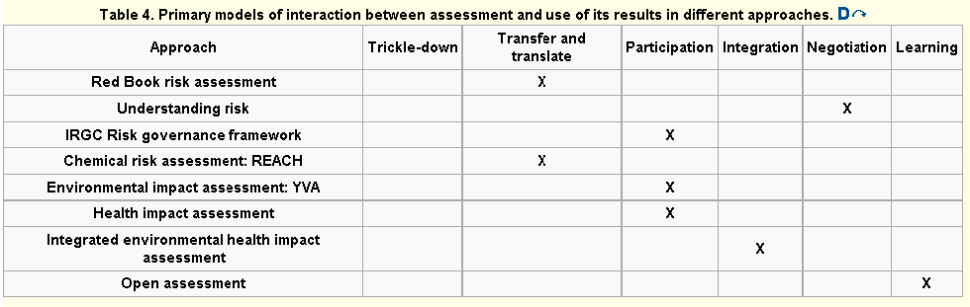
Assessment – management interaction

Slide 37
Why do we need risk assessment?

Slide 38
Thesis 1: Idea ”RA and RM must be separated” is false
Idea is based on an unrealistic mechanistic model of risk assessment and risk management being linked by an information product (i.e., a risk assessment report) that is independent of its making and its use.

Slide 39
Thesis 2: Practices have diverged from needs
The false assumption in thesis 1 makes it possible to falsely interpret risk assessment, risk management, and risk communication as well as stakeholder / public involvement as genuinely separate entities causing their practices to diverge from real needs.

Slide 40
Thesis 3: ”Risk” is a false focus
Focusing on risk as the central issue of interest often diverts attention to irrelevant aspects in the decision making problems the assessment is supposed to inform.

Slide 41
Thesis 4: RA is collective knowledge creation
Instead, the relationship between systematic analysis and informed practice should be interpreted as collective knowledge creation (production of well-founded and reasoned mutual understanding).

Slide 42
Thesis 5: RA making = communication
In this view making and using of assessment are inherently intertwined and the interaction between different actors IS communication throughout and on all levels.

Slide 43
Thesis 6: Foundations must be rebuilt
Limitations of the currently prevailing and broadly accepted ”traditional risk assessment idea” can not be overcome by tweaking and fine-tuning the current model and system, but only by reconstructing the foundations.

Slide 44
Food for thought
What is the role of collaboration in your work?
What is the role of information sharing?
What is the role of the end user of the information?
What is the role of the scientific method?

Slide 45
State of the art in benefit-risk analysis: environmental health
Notes:
Pohjola MV, Leino O, Kollanus V, Tuomisto JT, Gunnlaugsdóttir H, Holm F, Kalogeras N, Luteijn JM, Magnússon SH, Odekerken G, Tijhuis MJ, Ueland O, White BC, Verhagen H. State of the art in benefit-risk analysis: Environmental health. Food Chem Toxicol. (2012) 50: 1: 40-55. [23]

Slide 46
Analysis framework
Purpose: What need(s) does an assessment address?
Problem owner: Who has the intent or responsibility to conduct the assessment?
Question: What are the questions addressed in the assessment? Which issues are considered?
Answer: What kind of information is produced to answer the questions?
Process: What is characteristic to the assessment process?
Use: What are the results used for? Who are the users?
Interaction: What is the primary model of interaction between assessment and using its products?
Performance: What is the basis for evaluating the goodness of the assessment and its outcomes?
Establishment: Is the approach well recognized? Is it influential? Is it broadly applied?

Slide 47
Main findings (1/3)
Purpose: All state to aim to support societal decision making
Question, answer, process: Quite different operationalization of the (stated) aims
Question, answer: Huge differences in scopes
Process, interaction: Mostly expert activity in institutional settings
Performance: Societal outcomes hardly ever considered

Slide 48
Main findings (2/3)
The key issues in benefit-risk analysis in environmental health are not so much related to the technical details of performing the analysis, but rather:
  i) the level of integration (cf. Scope)
  ii) the perspective to consider the relationship between assessment and use of its outcomes in different assessment approaches
    “Assessment push” or “needs pull”
The means of aggregation are basically the same as in other fields
  e.g. DALY, QALY, willingness-to-pay (WTP)

Slide 49
Main findings (3/3)
In EHA there are tendencies towards:
  a) increased engagement between assessors, decision makers, and stakeholders
  b) more pragmatic problem-oriented framing of assessments
  c) integration of multiple benefits and risks from multiple domains
  d) inclusion of values, alongside scientific facts, in explicit consideration in assessment
Indicative of the incapability of the common contemporary approaches to address the complexity of EHA?
Does not necessarily show much (yet) in practice

Slide 50
Implications to RM?
RM more or less included in the approaches
  E.g. YVA & REACH are actually RM approaches that include assessment
  Purpose, use, interaction, … all (somewhat) acknowledge RM and the broader societal context
  RM finds questions -> assessments find answers -> RM implements

Slide 52
Open assessment
Participant’s knowledge
Participant’s updated knowledge
Participant’s knowledge
Contribution
Perception
Participant’s updated knowledge
Decision making
Perception
Assessment
Updated assessment
Decision
Contribution
Participant’s knowledge
Pohjola et al. State of the art in benefit-risk analysis: Environmental health. Food and Chemical Toxicology 2012.

Slide 53
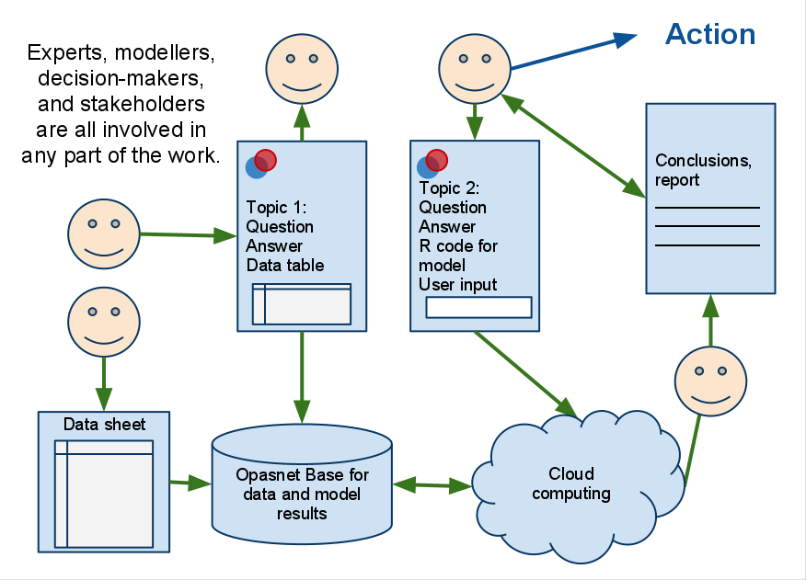
How web workspaces can help in assessments (example Opasnet)
https://docs.google.com/drawings/d/1f1s1drjo8qMJ-vWR3BQgsfRbH2DO0E43Xb01eRddWcg/edit?hl=en_GB&authkey=CN_oqbYK&pli=1

Slide 54
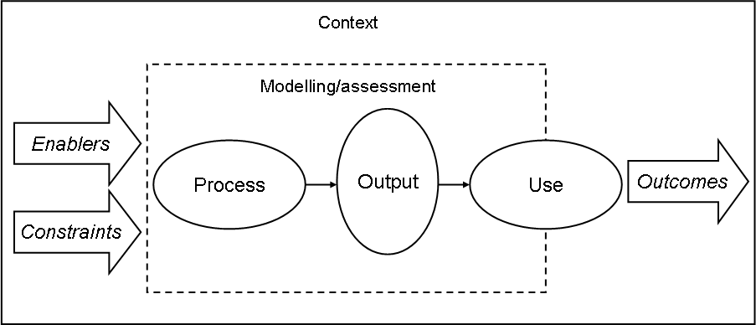
Assessment in its societal context
Pohjola MV, Tuomisto JT, and Tainio M: The properties of good assessment - addressing use as the essential link from outputs to outcomes. Manuscript.

Slide 55
Purposes for participation
Other factors
Outcome
Assessment
Decision making
Participation

Slide 56
Outline
I will argue that we could do most of our scientific work online using shared information systems and web workspaces (such as Opasnet).
These tools exist and are functional.
The work would be quicker and better.
There are major obstacles of new practices:
  Lack of awareness.
  Lack of practical knowledge to use tools.
  Current practices incentives are against sharing.
  Legislaton and practices prevent the opening of patient data.

Slide 57
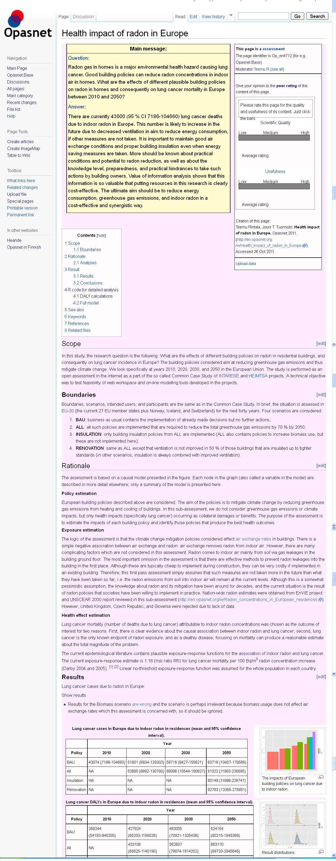
An example of an open assessment
Health impact of radon in Europe

Slide 58
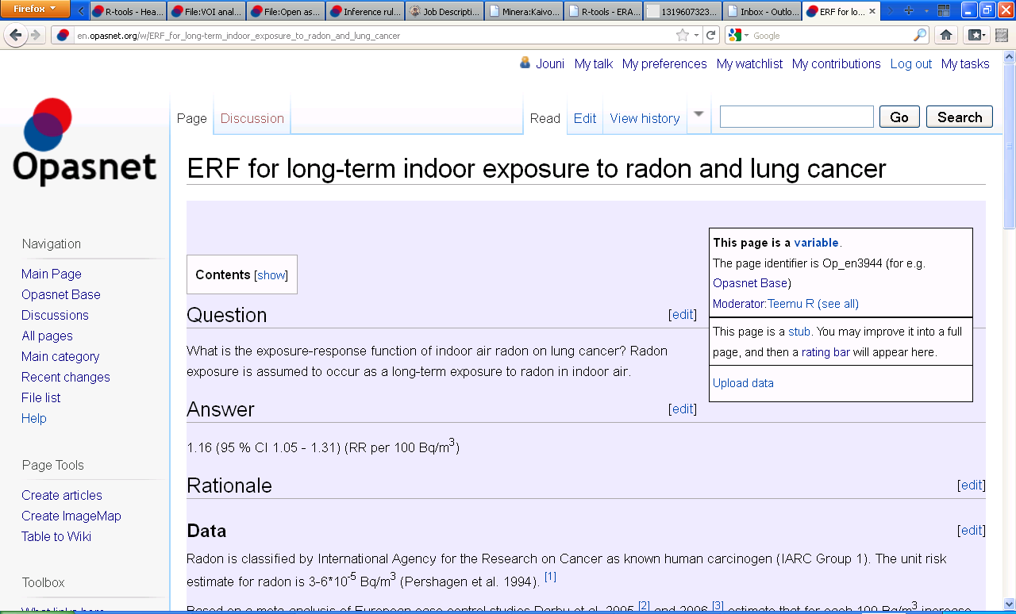
An example of a variable in a model

Slide 59
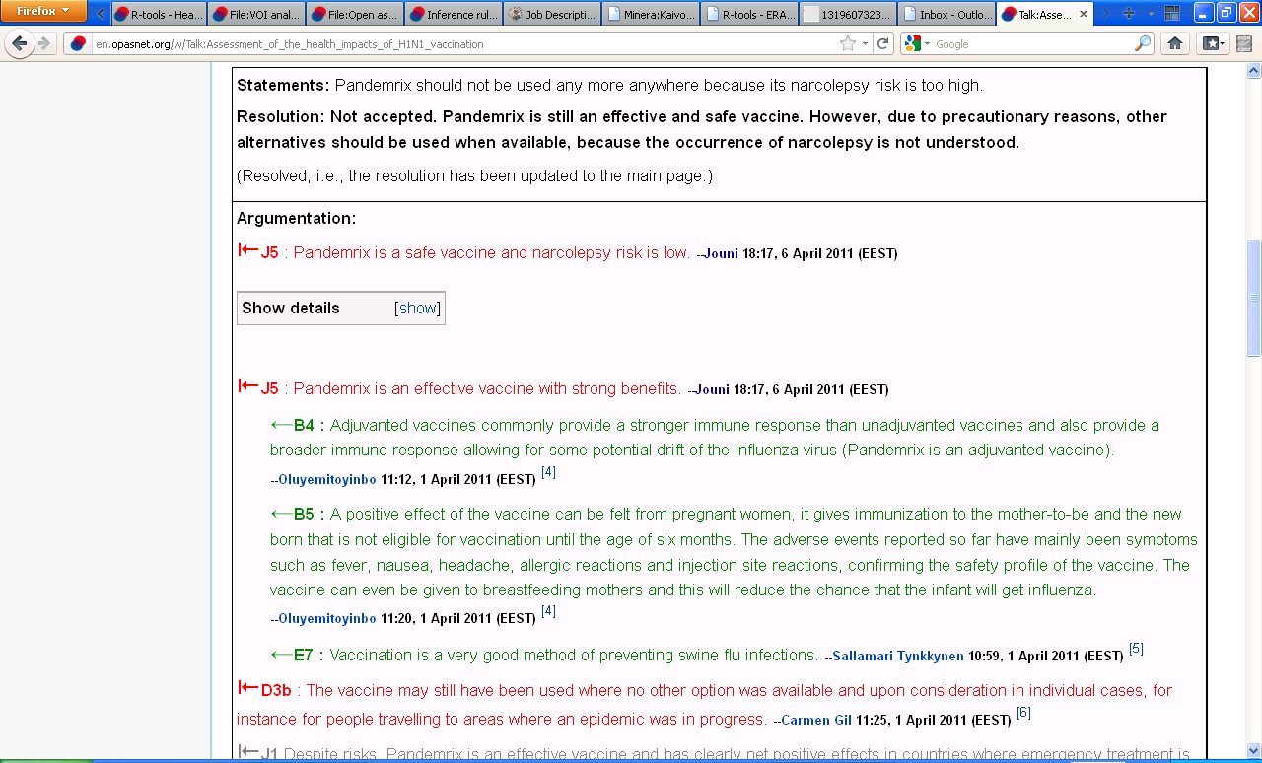
An example of a statement and resolution of a discussion
Is Pandemrix a safe vaccine?

Slide 60
What are open assessment and Opasnet?
Open assessment
  How can scientific information and value judgements be organised for informing societal decision making in a situation where open participation is allowed?
  [Previous names: open risk assessment, pyrkilo]
Opasnet
  What is a web workspace that contains all functionalities needed when performing open assessments, based on open source software only?

Slide 61
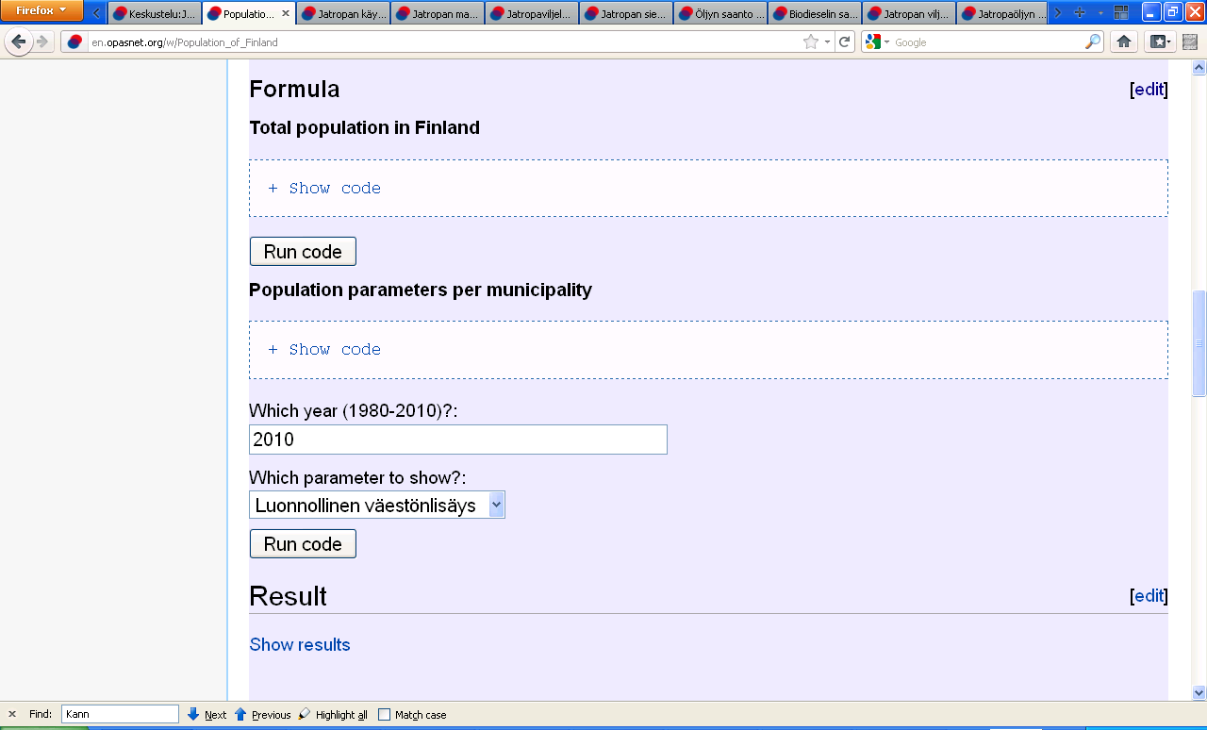
Application of soRvi in Opasnet

Slide 62
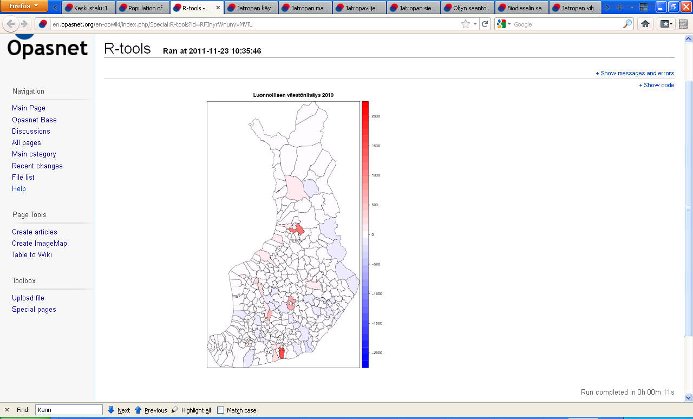
Results from soRvi

Slide 63
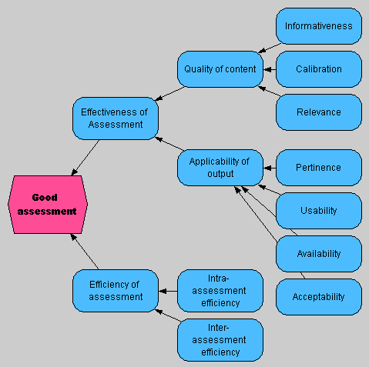
Properties of good assessment

Slide 64
Participation and openness
Lessons for RM?
  Participation, assessment, policy making inseparable
  If not, participation also vehicle for changing power and decision making structures
  In an open process the role of DM’s (same goes for assessors as well) becomes quite different
    From the center of the process to the outset
      Coordination, organization, and feeding of an open social knowledge process
    Many existing practices (of participation, assessment, policy making) remain useful, but the foundation changes
  How to enable collaborative knowledge processes?

