Slide 1
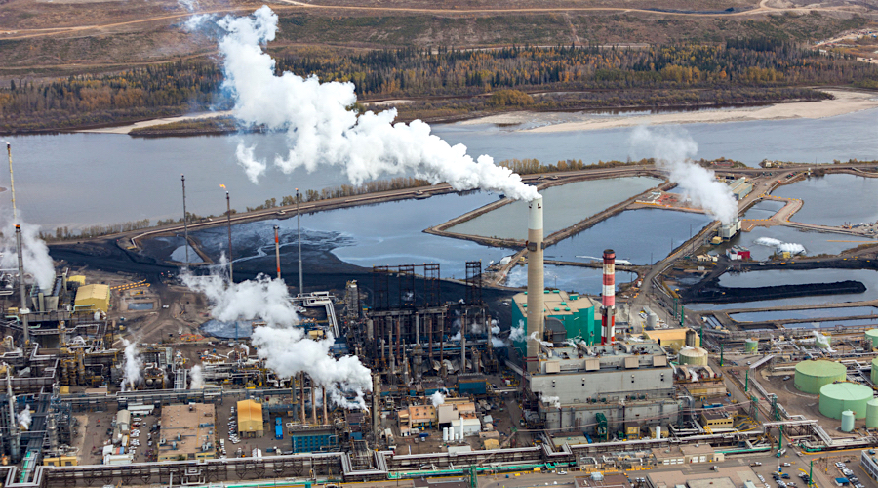
ASSOCIATION BETWEEN LONG TERM EXPOSURE TO PM POLLUTION WITH THE RISK OF LUNG CANCER AND COPD: COHORT STUDY FROM A MINING CITY Zahra Shirani, Margaret Taiye Arogunyo, Nze Michael Isiozor, Krasnova Ekaterina

Slide 2
Introduction
In the past 100 years, lung cancer has been transformed from a rare disease into a global problem.
Air pollution has been found to be associated with a risk of lung cancer and development of COPDs
Chronic exposure to ambient PM2.5 poses serious health risks in form of various diseases such as COPD (Chronic Obstructive Pulmonary Diseases), IHD (Ischemic Heart Diseases), stroke and LC (Lung Cancer) for adults and ALRI (Acute Lower Respiratory Infection) for children, eventually leading to premature death

Slide 3
Aims
To study if there is association between exposure to PM and risk of lung cancer
To study if there is association between exposure to PM and risk of COPD
To explore possible association between the diseases and the distance from the mining area.
Specifically to study association between PM2.5 and the risk of lung cancer and COPD among middle-aged men.

Slide 4
Study design
Study area (mining city)
Cohort retrospective study
With a period of 30 years follow up
Sampling of study population , 10 years interval
The area is divided into four distinct sections regarding to its distance from the polluting source
Apparently healthy middle-aged men (35 to 55years)

Slide 5
Exposure assessment:
Assessing exposure data from meterological registers
Satelite data

Slide 6
Outcome
COPD (Chronic Obstructive Pulmonary Diseases),
LC (Lung Cancer)

Slide 7
Analyses
Relative risks and correlation analysis
Confounders:
smokings
other air pollutants e.g CO, NO2
Effect modifier:
Gender: primarily men work more in the mining area
Lifestyle: doing more outdoor activities e.g cycling, walking
Personal characteristics: Genetic

Slide 8
Strengths
Study Design:
Retrospective cohort study has reliable resource data e.g meterological data, health register data
Study population:
Men are more prone to lung cancer than women
Variable:
PM2.5 is chosen to be studied due to studies showing its chronic exposure to the riskof lung cancer and COPD

Slide 9
Weaknesses:
Women were not included in the study.
The younger aged individuals including children have not been considered in the study.
Possibility of confounders such as smoking and other air pollutants can affect the results.

Slide 10
Dissemination
Public information
radio channels, Internet, TV, newspapers, leaflets
Direct information
(leaflets) to schools and hospitals
Policies ( both from the government policies and mining company)
Councilor

Slide 11
Possible solutions
Relocating residential areas far from mining areas
Adding filters to the exhaust of the mining area
Workers/residents living near the polluted areas should adapt protective measures such as wearing face masks.
Adapting new technology that will help to reduce PM2.5 emissions from the mining area.

Slide 12
References
American Cancer Society Cancer Facts and Figures 2012 Atlanta, GA: 2012. Available at: http://www.cancer.org/acs/groups/content/@epidemiologysurveilance/documents/document/acspc-031941.pdf
S.C. Anenberg, L.W. Horowitz, D.Q. Tong, J.J. West, An estimate of the global burden of anthropogenic ozone and fine particulate matter on premature human mortality using atmospheric modeling, Environ. Health Perspect., 118 (2010), pp. 1189–1195
J. Lelieveld, J.S. Evans, M. Fnais, D. Giannadaki, A. Pozzer, The Contribution of Outdoor Air Pollution Sources to Premature Mortality on a Global Scale, (2015)
Jain, Vaishali, Sagnik Dey, and Sourangsu Chowdhury. "Ambient PM 2.5 exposure and premature mortality burden in the holy city Varanasi, India." Environmental Pollution 226 (2017): 182-189.

Slide 13
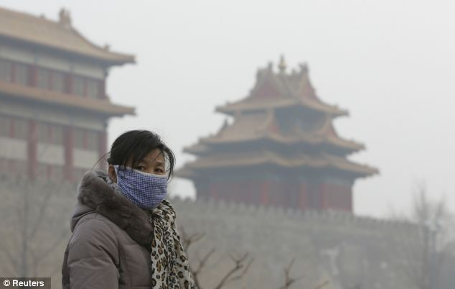
Thank you!

