Slide 1
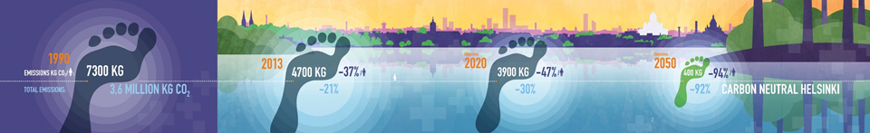
Helsinki’s Climate Work and the Benefits of Open Assessment
Sonja-Maria Ignatius
City of Helsinki Environment Centre

Slide 2
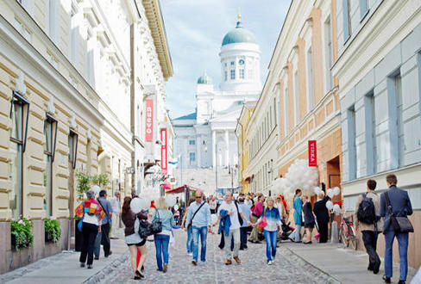
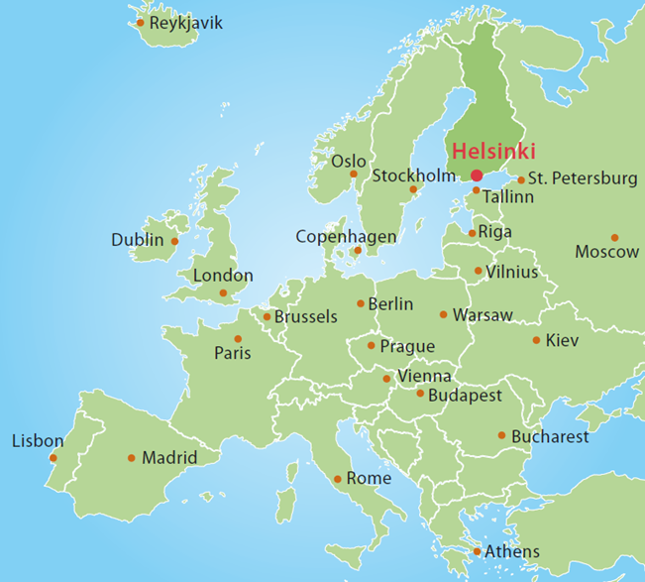
City of Helsinki
Notes:
620 000 inhabitants
860 000 inhabitants in 2050
400 000 jobs
The emissions of Helsinki are about x % of the total emissions of Finland
40 000 employees

Slide 3
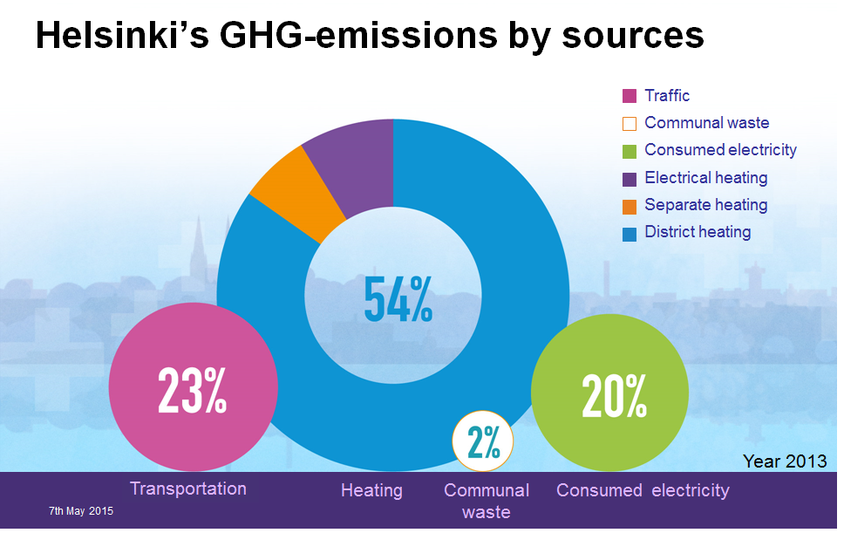
Transportation

Slide 4
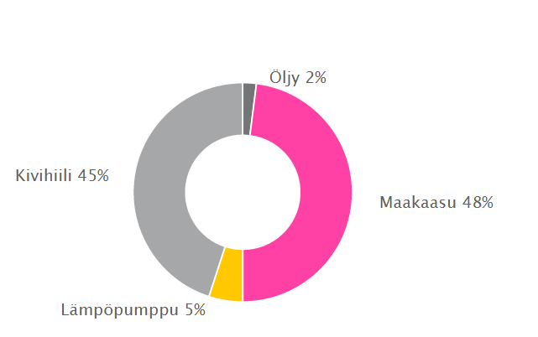
District heating
Oil 2 %
Coal 45 %
Natural gas 48 %
Heat pumps 5 %
https://www.helen.fi/kotitalouksille/neuvoa-ja-tietoa/tietoa-meista/energiantuotanto/energian-alkupera/

Slide 5
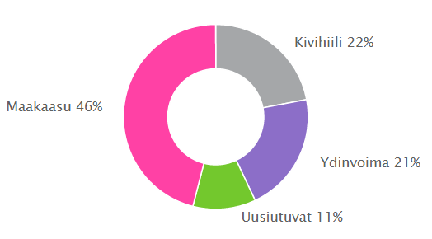
Electricity
Coal 22 %
Natural gas 46 %
Nuclear 21 %
Renewables 11 %
https://www.helen.fi/kotitalouksille/neuvoa-ja-tietoa/tietoa-meista/energiantuotanto/energian-alkupera/

Slide 6

Climate objectives
Carbon neutral Helsinki by 2050
  Emissions from the city area -30 % (1990-2020)
Carbon neutral energy production by 2050
  Emissions from energy production -20 % (1990-2020)
Adaptation will be integrated into all of the City’s operations in order to minimise risks.
Notes:
•Helsinki has various climate objectives for the reduction of the emissions, for increasing the share of renewables in energy production as well as for saving energy. There are also objectives for the adaptation to climate change.
•The main target is to be carbon neutral by 2050.
•This means a reduction of total emissions from the city area by more than 90 % from 1990 to 2050.
•Of the remaining emissions half will be compensated by carbon offsetting or by using CCS ((carbon capture and storage), if the technology is evolved sufficiently by then) and the other half will be bound by the vegetation in the city.
•First milestone is to cut the emissions by 30 % by 2020.
•Energy production will be carbon neutral by 2050.
•Emissions will be cut by 20 % from 1990 to 2020.
•The share of renewables will be at least 20 % in 2020.
•Energy will be saved 20 % per resident from 2005 to 2020.
•Energy will be saved 9 % in the City´s own operations (2008-2016)
•Reduction of emissions caused by energy consumption by 20% (1990-2020) in the City’s impact area
•Adaptation
Climate change adaptation will be integrated into all of the City’s operations in order to minimise risks. The effects of climate change and the measures that can be taken to prepare for it will be communicated to municipal residents and companies.
Built and urban environment adaptation to the changing climate (Helsinki Metropolitan Area Adaptation Strategy)
Ilmastotavoitteet tukevat monia kaupungin muita strategian tavoitteita.

Slide 7
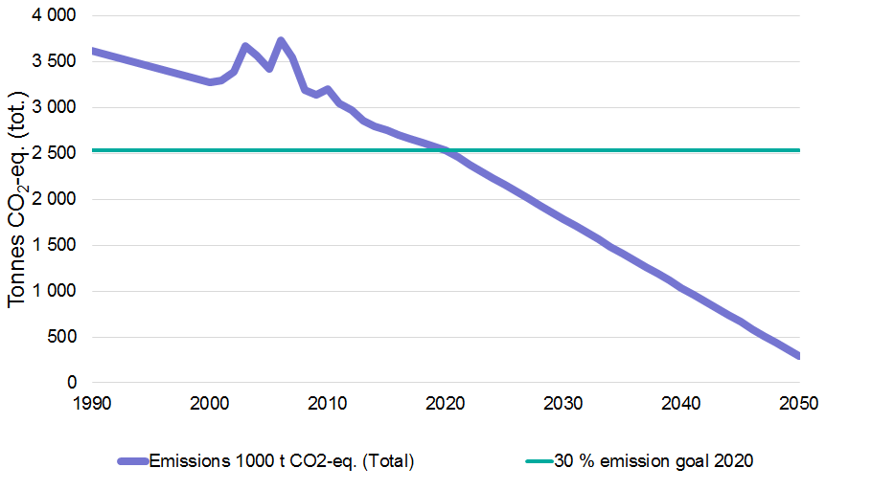
Reduction of emissions
1000

Slide 8
How to achieve these objectives?
The sources of energy
Efficiency of the energy production
Energy saving in housing
Means of transportation
Dense urban structure
Consumption habits

Slide 9
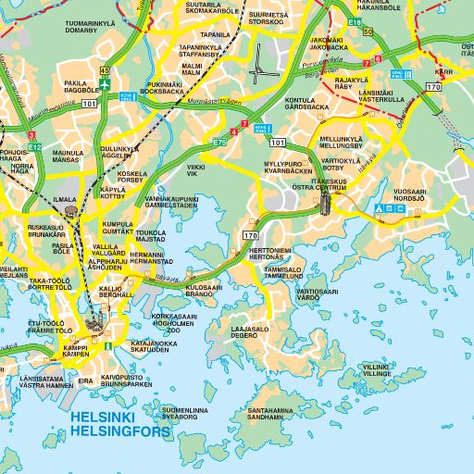
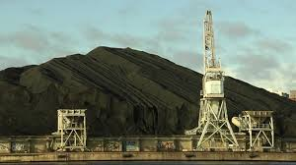
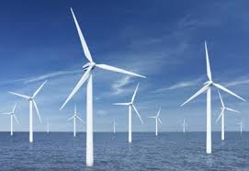
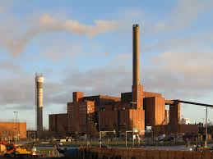
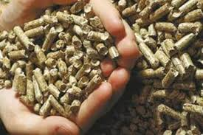
Energy production in Helsinki: what are the important aspects for you? Why?

Slide 10
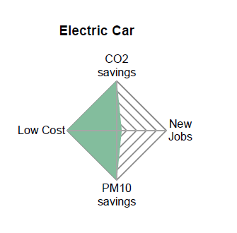
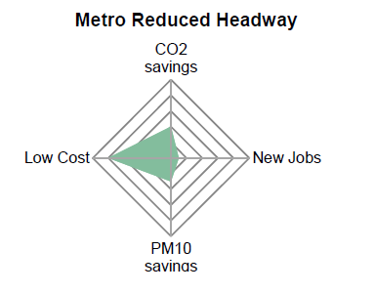
The most cost-efficient technologies?
Increase of wall insulation by 7 %
Decrease of warm water usage by 5 %
Notes:
Energy efficiency and potential of renewables in Helsinki

Slide 11
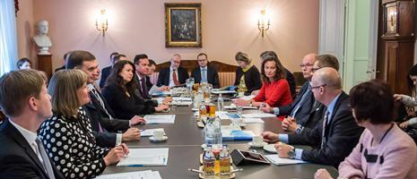
How I met Jouni

Slide 12
Better processes and outcomes
expert
understanding of the subject
facilitator
understanding of the process

Slide 13

Involvement of people
Technical solutions are not enough.
How to get people contribute to the transition into a carbon neutral society?
Benefits!

Slide 14
The benefits of open assessment
More holistic assessments.
Transparency of the criteria.
Shared understanding.
Commitment.
Acceptability of decisions.
Notes:
Traceability
Where does the data go???

Slide 15
The obstacles of open assessment
Slowing down the process?
More costs?
Technical difficulties?
Uncertainties.
Traditions.
Knowledge is power.

Slide 16

Thank you!
sonjamaria.ignatius@hel.fi

Slide 17
Helsingin ilmastotiekartta
Helsingin ilmastotyön esittely havainnollisesti ja kiinnostavasti
Vuoropuhelu kaupungin ja muiden tahojen välillä
Eri tahojen roolit ja vaikutusmahdollisuudet

Slide 18
emissions of CO₂
safety of the workers of the power plant
price of the energy for the customers
security of the energy supply
Finnish employment
emissions of SO₂, NO_{x} and PM
small requirement of space in the city area
communal tax rate
storability of the fuel
possibility to produce both heat and electricity
building and operating costs for the city
safety of the power plant for the surroundings
image of the city of Helsinki

Slide 19
city mayor of Helsinki
35-year-old teacher, three children
an active member of FANC
an engineering student living next to the power plant
a worker at the power plant
CEO of a pulp mill in Kouvola
city planner in the city of Helsinki
a physician working in a public hospital in Helsinki
Timo Soini, a member of the Finnish Parliament (party: Perussuomalaiset / True Finns)
city mayor of Kuopio Petteri Paronen
representative of Brazil in the UN climate conference in December
Vladimir Putin
a Polish coal mine worker

