Slide 1




Experiences in developing risk analysis tools for oil spills in the Gulf of Finland – how to create learning modelling systems?
Sakari Kuikka & Inari Helle, Annukka Lehikoinen, Mika Rahikainen, Jarno Vanhatalo, Samu Mäntyniemi and Maria Hänninen
Head of Fisheries and Environmental Management group (FEM), Department of Environmental Sciences, University of Helsinki, Finland, Email: sakari.kuikka@helsinki.fi
STECF member (EU main advisory body)
Focal point of International Ocean Institute in Finland

Slide 2
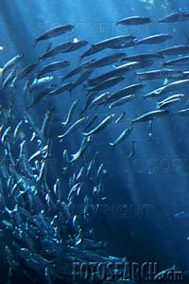
FEM group at the University of Helsinki
2 professors, 4 senior scientists, 2 postdoctoral researchers, 7 postgraduate researchers
Research interests:
Applications in fisheries and oil spill risk analysis
Decision analysis of renewable resources
Integrating different sources of data and knowledge: Bayesian analysis
Identification and quantification of risks in the use of natural resources
Management of natural resources in the face of risks and uncertainty in the information
=> User of information in an essential role
www.helsinki.fi/science/fem/index.html

Slide 3
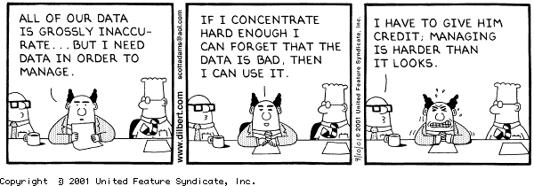
Decision making and poor knowledge ☺

Slide 4
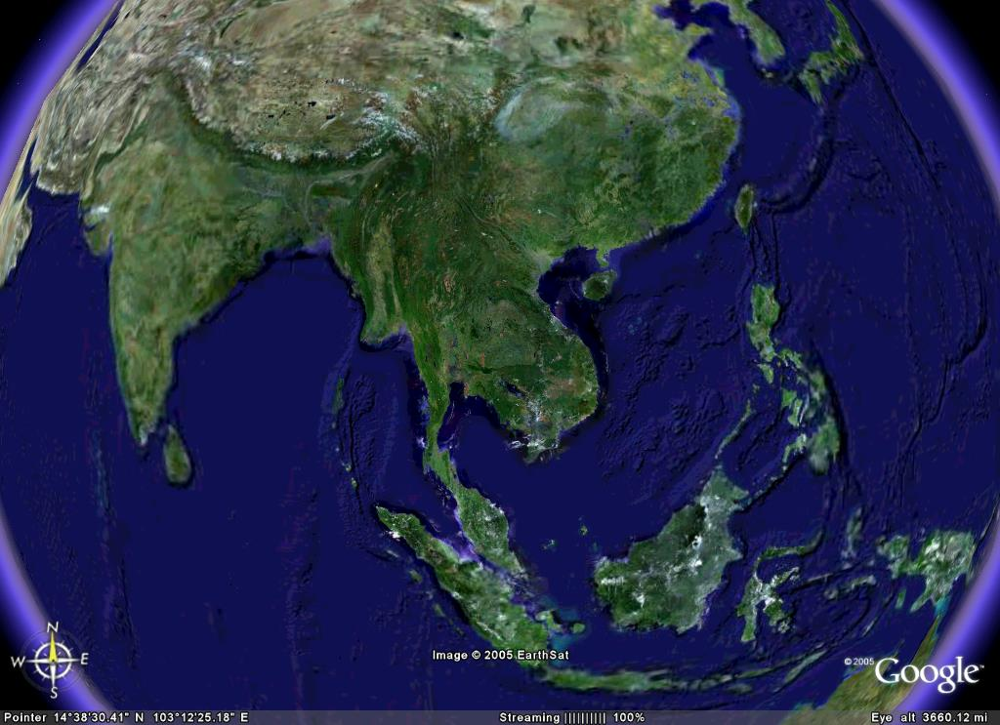

2.1 mb/d
5.3 mb/d
15.3 mb/d
5.5 mb/d
2.2 mb/d
11.0 mb/d
Energy Shipping Lane and Strategic Passages in Asia Pacific

Slide 5
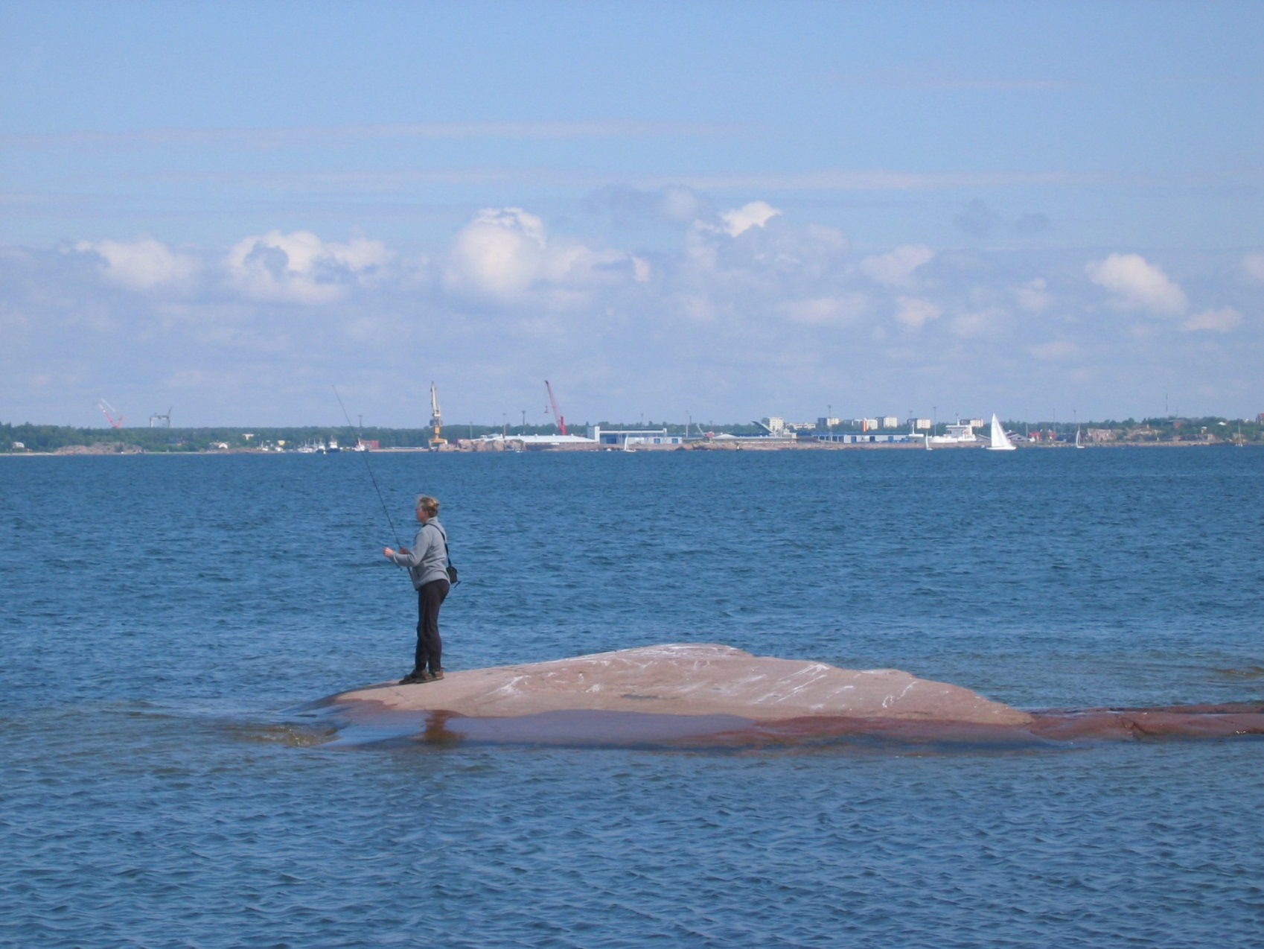
There are multiple uses for sea and archipelago areas:
Transportation
Fisheries (mosaic of islands provides good reproduction areas)
Recreationa use
Environment of 70 IUCN classified threatened species

Slide 6
Outline of the talk 1) Published papers by FEM group 2) Oil spills: basic models 3) Why Bayesian inference? 4) Concluding slides, including learning systems

Slide 7
Published papers on oil spills
Klemola, E., Kuronen, J., Kalli, J., Arola, T., Hänninen, M., Lehikoinen, A., Kuikka, S., Kujala, P. and Tapaninen, U. 2009. A cross-disciplinary approach to minimising the risks of maritime transport in the Gulf of Finland. World Review of Intermodal Transportation Research 2(4): 343–363.
Kokkonen, T., Ihaksi, T., Jolma, A. and Kuikka, S. 2010. Dynamic mapping of nature values to support prioritization of coastal oil combating. Environmental Modelling & Software, 25 (2010) 248–257.
Helle, I., Lecklin, T., Jolma, A. & Kuikka S. 2011. Modeling the effectiveness of oil combating from an ecological perspective - A Bayesian network for the Gulf of Finland; the Baltic Sea. Journal of Hazardous Materials 185(1):182-192.
Lecklin, T., Ryömä, R. and Kuikka, S. 2011. A Bayesian network for analyzing biological acute and long-term impacts of an oil spill in the Gulf of Finland. Marine Pollution Bulletin 62 (2011) 2822-2835.
Ihaksi,T., Kokkonen, T., Helle, I., Jolma, A.,Lecklin, T. and Kuikka, S. 2011. Combining conservation value, vulnerability, and effectiveness of mitigation actions in spatial conservation decisions: an application to coastal oil spill combating. Environmental Management. 47: 802–813.

Slide 8
Published papers on oil spills II
Lehikoinen, A., Luoma, E., Mäntyniemi, S. and Kuikka, S. (2013) Optimizing the Recovery Efficiency of Finnish Oil Combating Vessels in the Gulf of Finland Using Bayesian Networks. Environmental Science and Technology, 47(4):1792-1799.[Link]
Jolma, A., Lehikoinen, A., Helle, I. and Venesjärvi, R. (2014). A software system for assessing the spatially distributed ecological risk posed by oil shipping. Environmental Modelling & Software, 61:1-11. [Link]
Lehikoinen,A., Hänninen, M. Jenni Storgård, Emilia Luoma, Samu Mäntyniemi & Sakari Kuikka. (n print) A Bayesian network for assessing the collision induced risk of an oil accident in the Gulf of Finland. Environmental Science and Technology
Helle, I., Ahtiainen, H., Luoma, E., Hänninen, M., Kuikka, S. Where should we invest in oil spill management? A probabilistic approach for a cost-benefit analysis under uncertainty. Accepted with minor revisions .

Slide 9
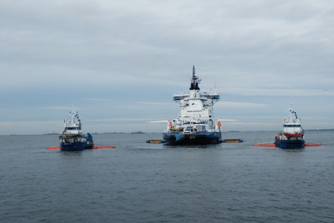
2) Oil spill and basic models: scientific description of learning

Slide 10
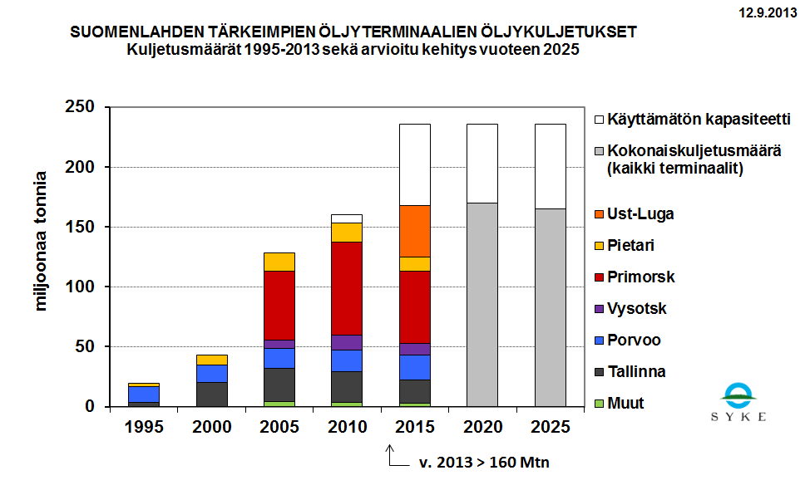
Oil transportation in the Gulf of Finland

Slide 11
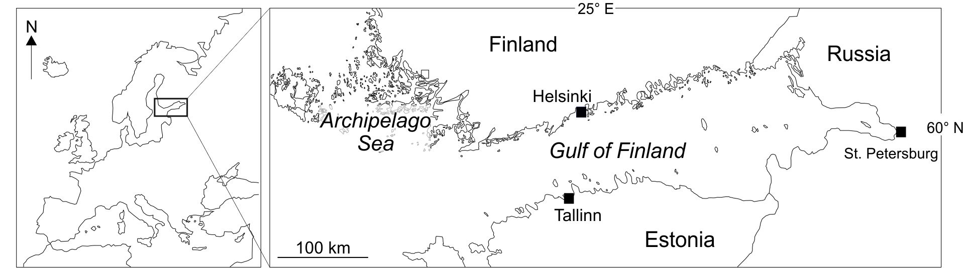
Gulf of Finland
Difficult to navigate, in winter ice covered
Surroundings countries are in different positions

Slide 12
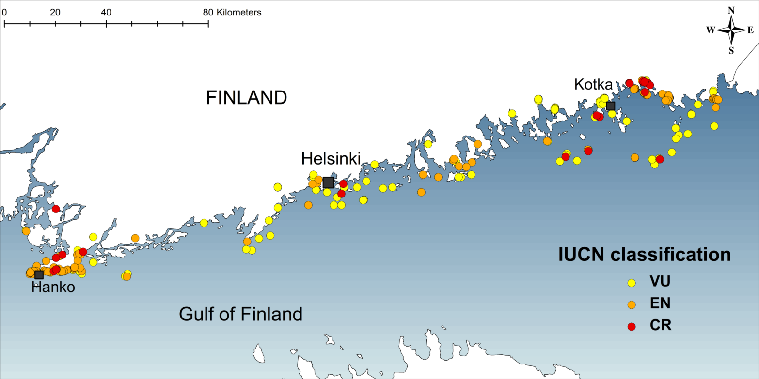
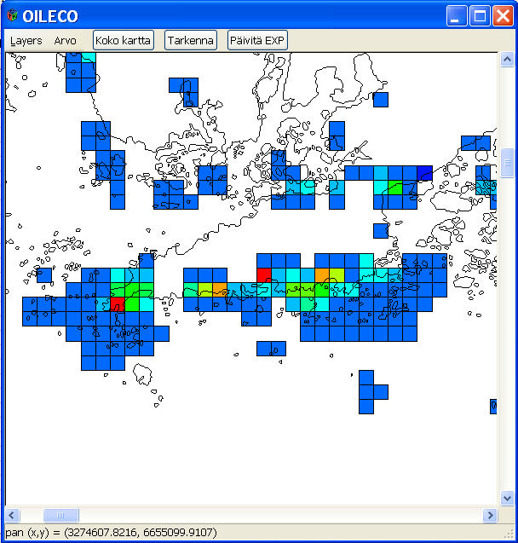
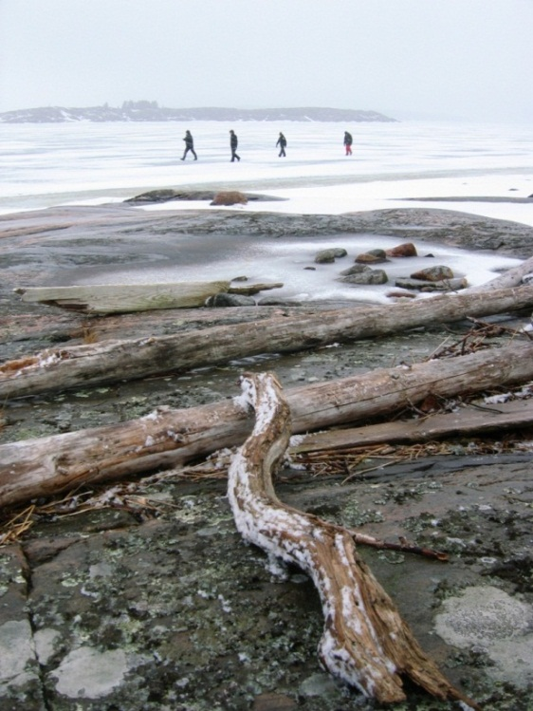
Making biodiversity data as an operational tool for firemen

Slide 13
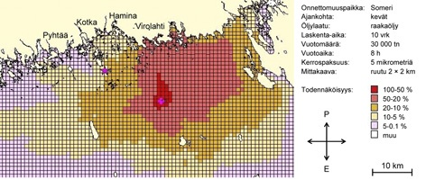
SpillMod results
Picture is from SÖKÖ project
Probabilistic maps with grids of 2*2 km
Probability to become oiled for each cell is calculated given the place of accident, type of oil, season (weather stats during last 10 years), spill size, duration of the spill and the drifting time

Slide 14
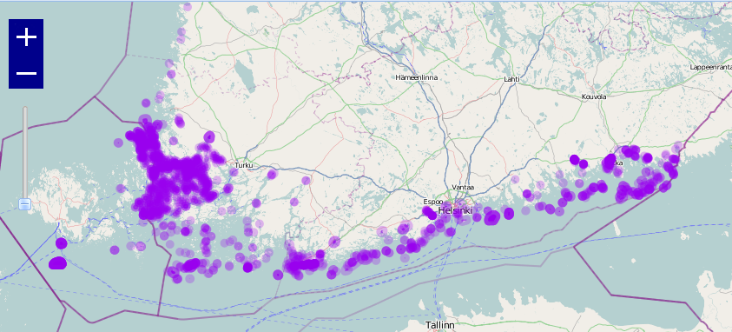
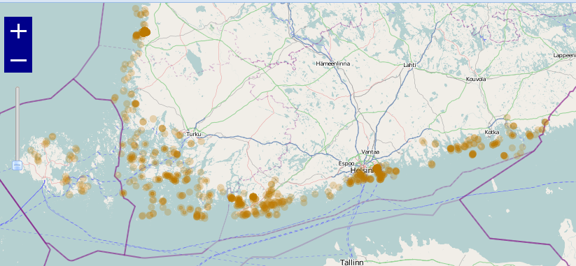
Species and habitat data
Species and habitats
Locations
Conservation value index (VAL)
IUCN ”Red List”classes:
CR – Critically Endangered
EN – Endangered
VU – Vulnerable
+ status as Directive species/habitat

Slide 15
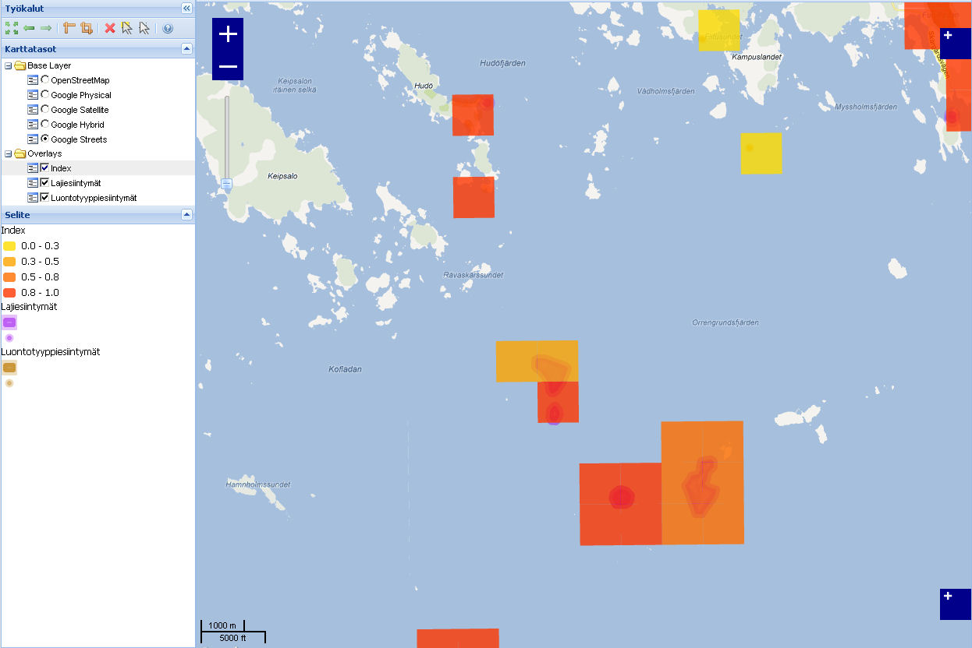
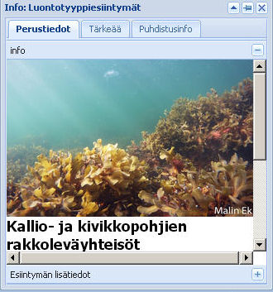
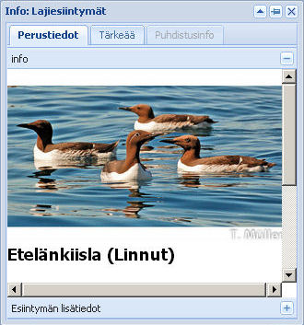

Map application

Slide 16
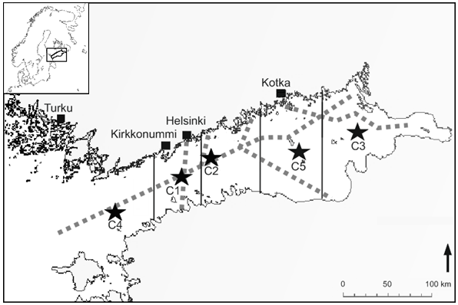
Gulf of Finland and oil
Lehikoinen et al 2013. Env. Sci. Techn. DOI: 10.1021/es303634f

Slide 17
3) Bayesian analysis

Slide 18
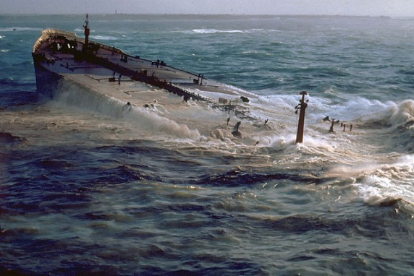
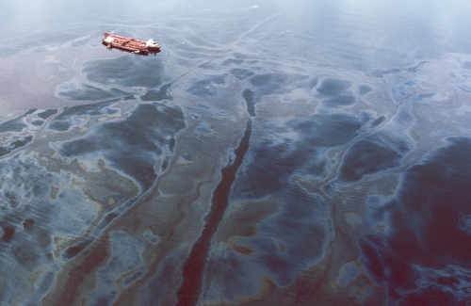
Impact of randomness on impacts
M/T Amoco Cadiz
March 1978
Bretagne
230 000 t
20 000 dead birds
M/T Exxon Valdez
March 1989
Alaska
37 000 t
250 000 dead birds
vs.
Unknown vessel
February 1976
Gotlanti
10 t
60 000 dead birds

Slide 19
Risk management

Slide 20

Sources of uncertainty
We need to use the unclear
view of future to manage
By Samu Mäntyniemi, FEM

Slide 21
Bayes rule: probabilistic dependencies
Real number
of fish (B)
Classical:
P (A|B)
Observations
(data), A
Real number
of fish (B)
Bayes:
P (B|A)
Observations
We are not interested about any possible other data sets given the data we have.
Why calculate p of classital hypothesis tests, then?

Slide 22
Posterior
Prior
Likelihood

Slide 23
Estimate of the year class t size with this data only
Bayes – inference: learning from several information sources
Estimate of the year class t size with all available information
Type of
Information
coming in
Assessment
year
t
SSB
S-R models
Accumulation of knowledge
t + 1
Environmental
data
Yolk surveys
t + 2
Survey data
t + 3
Catch data
Number of individuals
Number of individuals
Learning over time by increasing amount of information over the time, the same
Is true if we use e.g. several models that are independent way to estimate the interest
variable

Slide 24
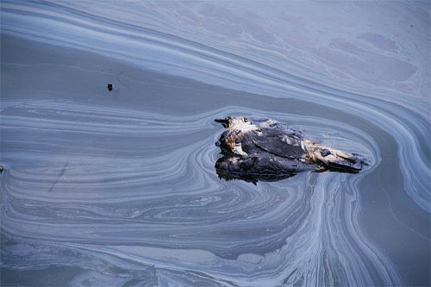
5) Conclusion, with an idea of a learning system

Slide 25
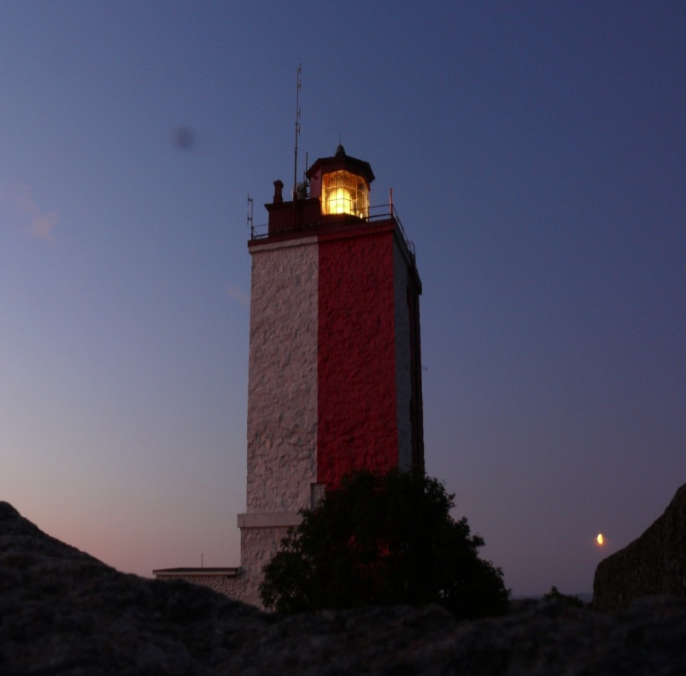
Modeling of oil spills: impacts that cannot be seen or measured
We do not want to see the data providing overall damage estimates
Even in a studied accident, we never see all impacts, even though we should be aware of them
For models we need all knowledge from field surveys, experts, publications, laboratory experiments, closeby cases

Slide 26
Yes, but..
How to transfer the knowledge from previous accidents?
Why EU legislation packages carry the names of the oil spill disasters? Do we learn only from obsered accidents, not from model estimates?
Compare to practises in flying businesses and in nuclear power management
Flying business: all have the same interest of not having an accident
Nuclear power management: an absolute trust on models and their estimates of unseen risks

Slide 27
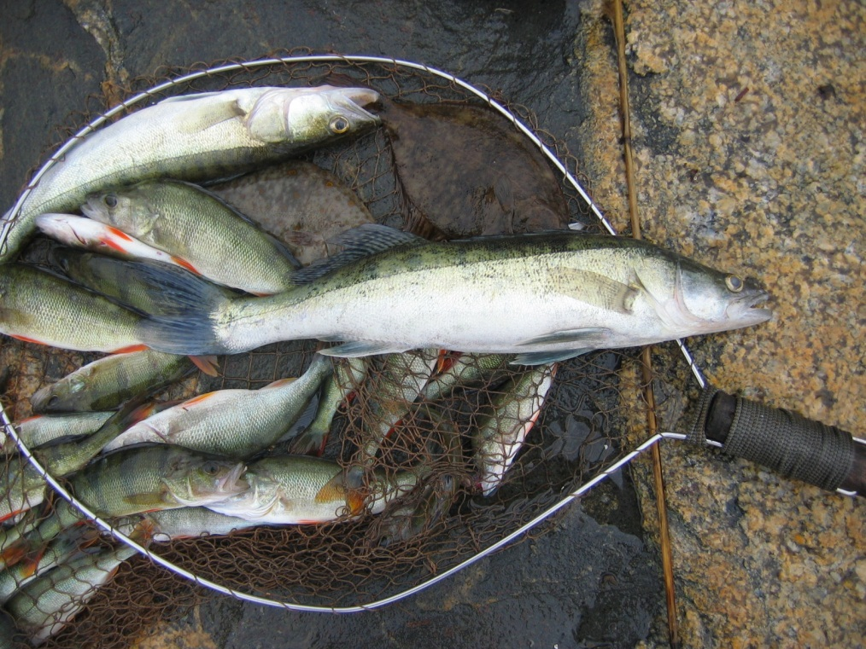
Some light in the tunnel: BAYESIAN NETWORKS: MODELLING OF UN- SEEN POTENTIAL FUTURE OIL SPILLS
1) Need to use experts
2) Need to indenfity chains
of good and cheap
control
3) Need to describe the
alternative views about
values and risk attitudes

Slide 28
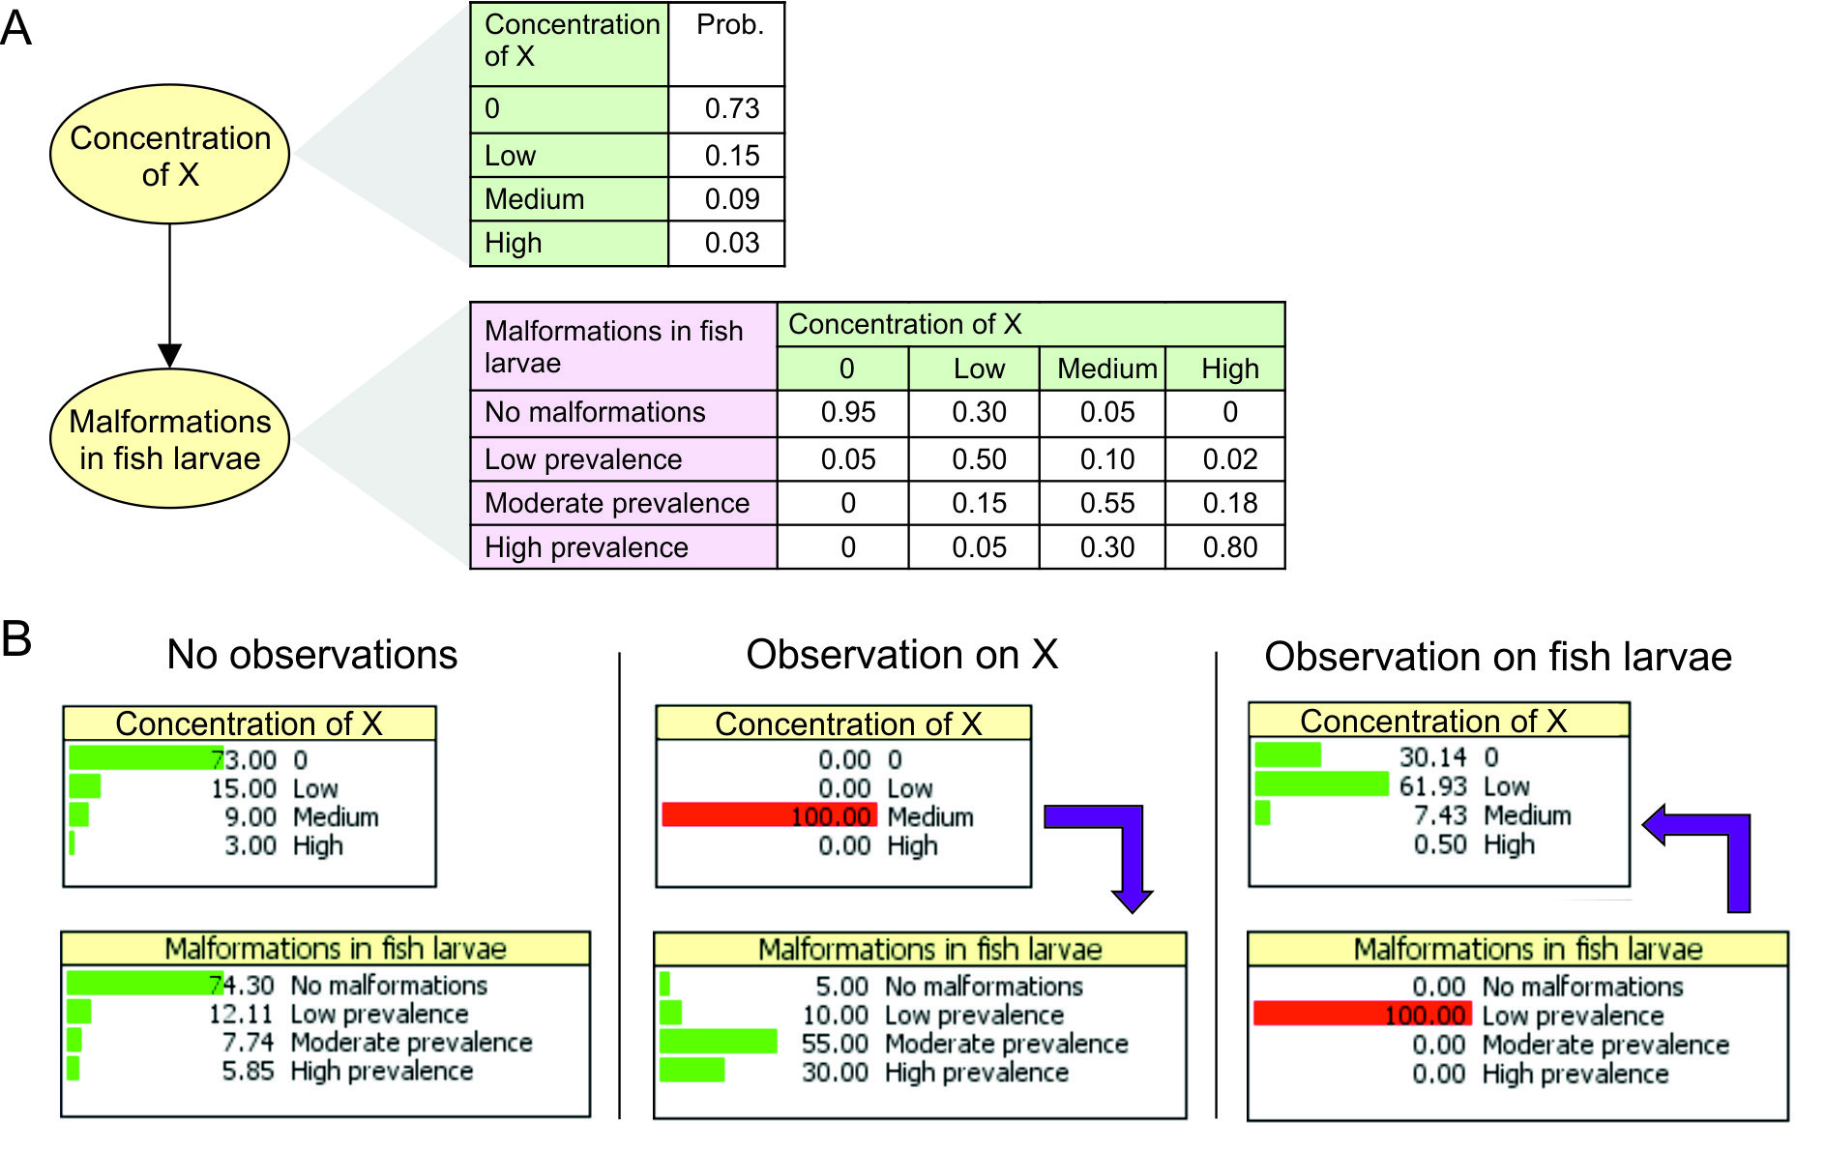
Bayesian networks

Slide 29
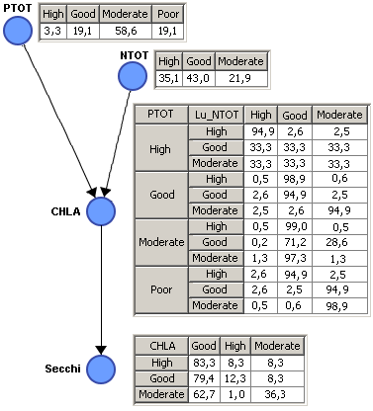
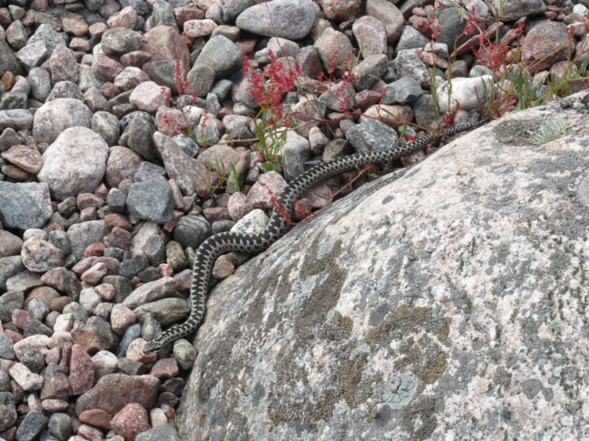
Bayesian nets in AI – a simple WFD example for GoF
Fernandez et al, 2012, Env. Sci & Tech.

Slide 30
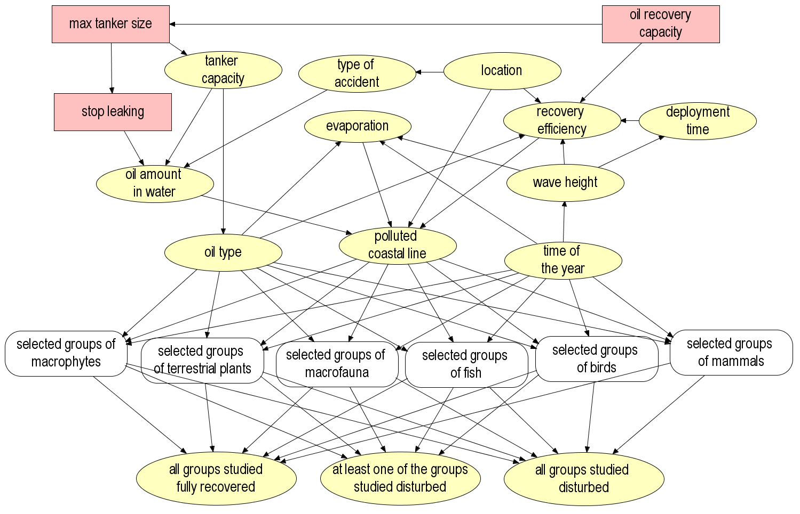
Data only
”Agent model”,
Lehikoinen et al
Physical/
theoretical
models
Data only
Expert
judgements
Lecklin, T., Ryömä, R. and Kuikka, S. 2011. A Bayesian network for analyzing biological acute and long-term impacts of an oil spill in the Gulf of Finland. Marine Pollution Bulletin 62 (2011) 2822-2835.

Slide 31
Cost benefit model of oil spill risk management
Helle et al subm.

Slide 32
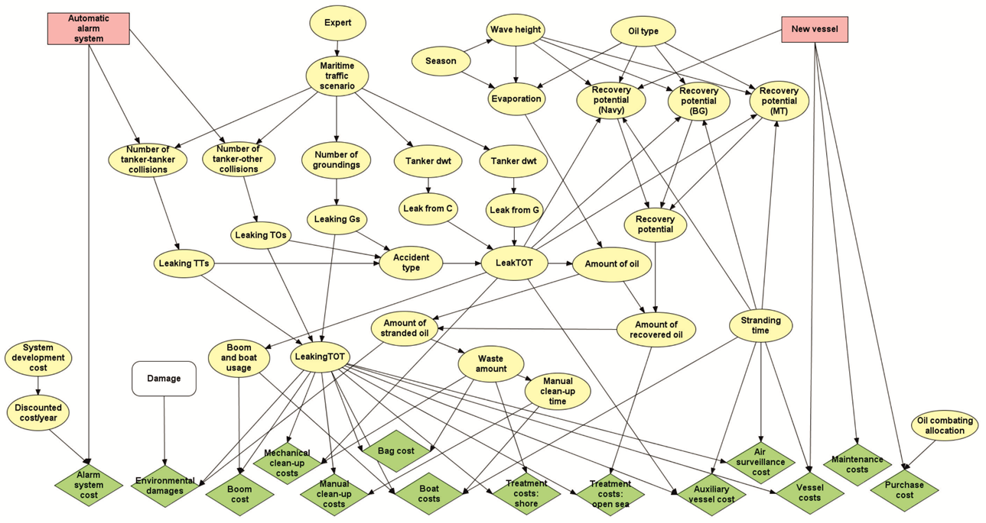
Helle et al subm.

Slide 33
Results: expected benefits – expected costs (/year)
Decision | Autom. Alarm syst. |  | New combatting vessel
State of the other option | No |  | No
Costs/Benefit | C (€) | B (€) | C (€) | B (€)
Developing alarm system | -33 234
Investment cost of vessel |  |  | -2 720 000
Running costs of vessel |  |  | -264 226
Open sea combatting |  | 1 471 | -28 837
Waste treatment (open sea) |  | 389 | -1 507
Shore line clean up |  | 5306 |  | 11575
Waste treatment (avomeri) |  | 6 750 |  | 35 706
Environmental damage |  | 230 000 |  | 1 250 000
Sum | -33 234 | 243 916 | -3 014 571 | 1 297 280
NBV (net benefit) | 210 682 |  | -1 717 290
!

Slide 34
4) Concluding slides: publication and analysis practises, and suggestion for a scientific project

Slide 35
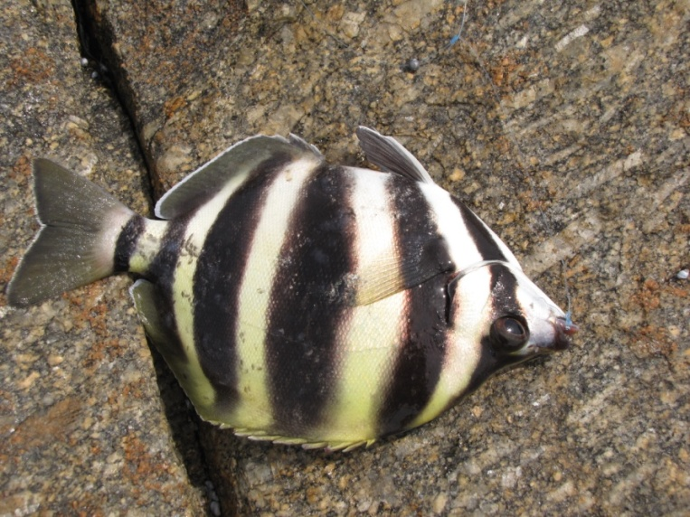

In oil spill scientific litteraturem do not use p-values as publication criteria
But we have some hope, if we learn between areas, species, environment, disciplines and cultures

Slide 36
Pre-defined interpretation of evidence
Initial knowledge
Accident 1,
Study 1
Updated evidence
New evidence
Pre-defined interpretation of evidence
Initial knowledge
Accumulation of knowledge
Accident 2,
Study 2
Updated evidence
New evidence
Pre-defined interpretation of evidence
Initial knowledge
Accident
3,
Study 3
Updated evidence
New evidence

Slide 37
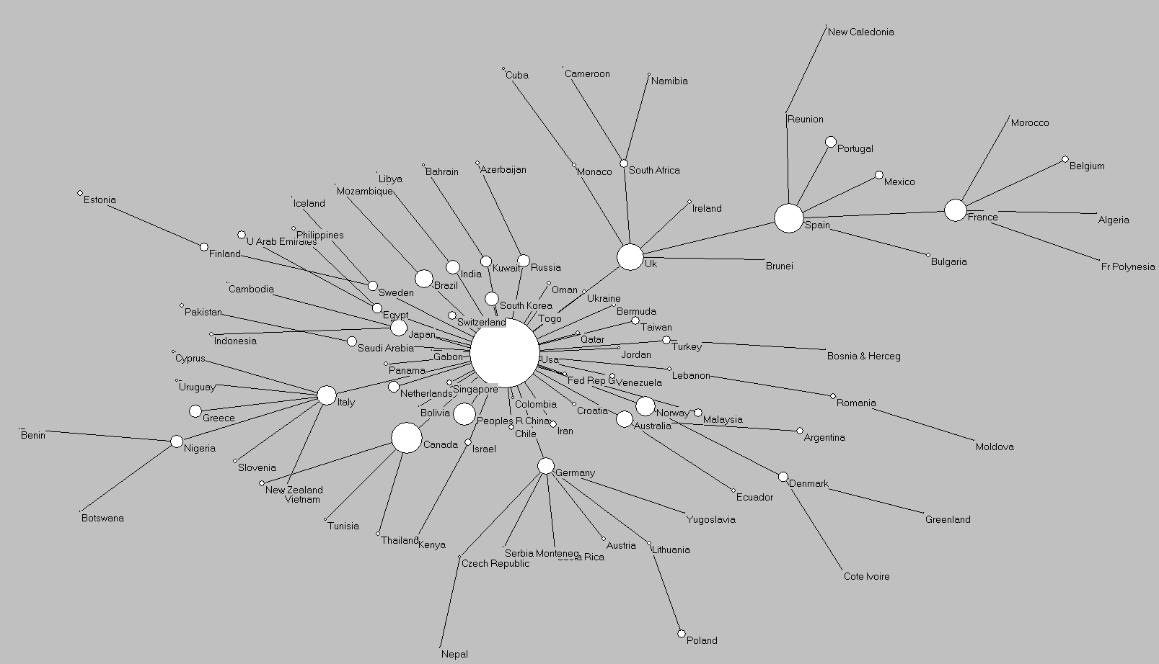
Country collaboration map
Environmental Science and Technology,

Slide 38
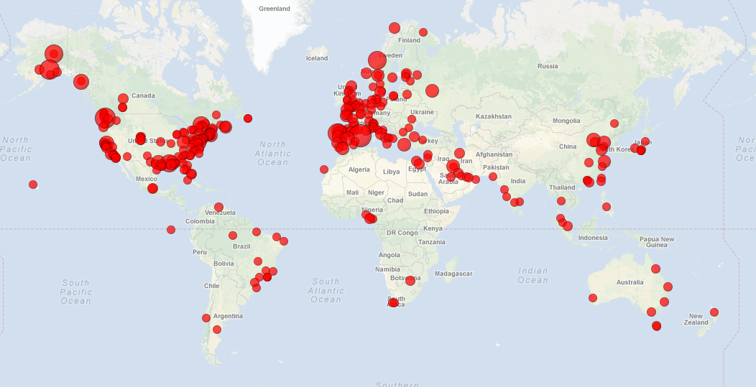
Oil spill research by city Click this zoomable Google map: http://www.gpsvisualizer.com/display/data/1359360387-25398-130.239.157.157.html

Slide 39
Improvements of governance system
For example fisheries management has strong and active advisory systems, which have power in management and in ”green labelling of the products”
These are missing from the area of oil spill risk analysis, even though the interest of society must be even higher than in fisheries
What, then, are we lacking?
We need both national and international legistlation changes !

Slide 40
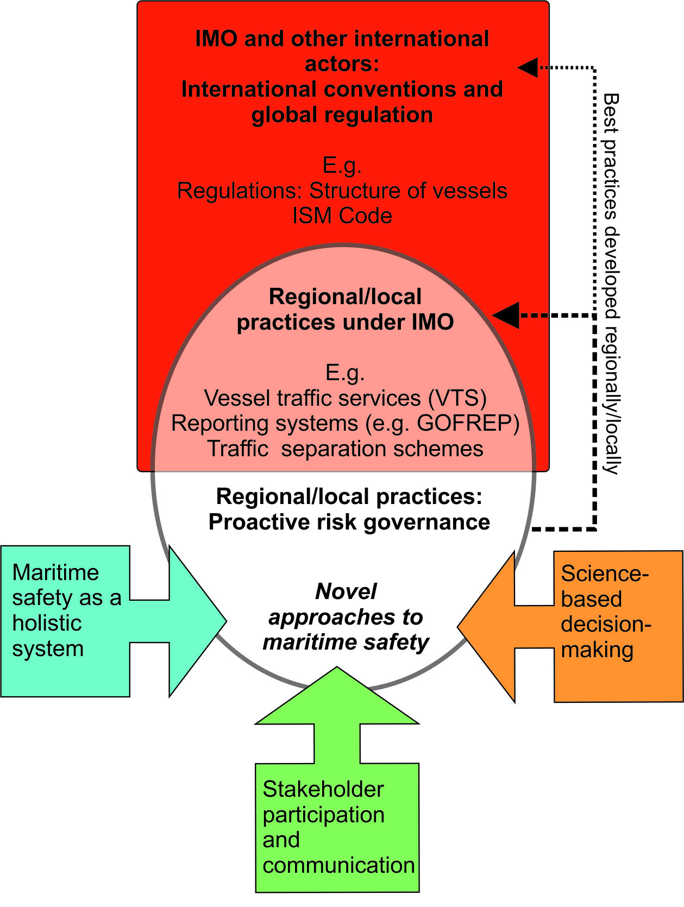
New suggested oil spill risk governance structure
Haapasaari et al, in prep.

Slide 41
How to create maximal interest to prevent an accident?
Oil companies are large, international and sell a product where are no real differences, and it is easy for customers to change the company => great interest to safeguard brand value
Estimate the potential impacts IN ADVANCE and make everyone to know what they are
Make the whole business as open as possible
Have the capacity and legislation to link each tanker load to the final seller of the products
Create on line systems to report about risks at the moment: reminder of responsibility for companies

Slide 42
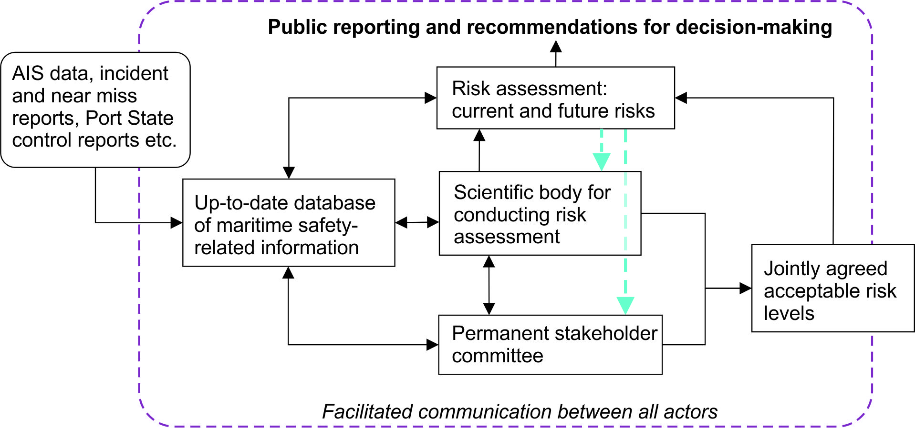
New suggested oil spill risk governance structure
Haapasaari et al, in prep.

Slide 43
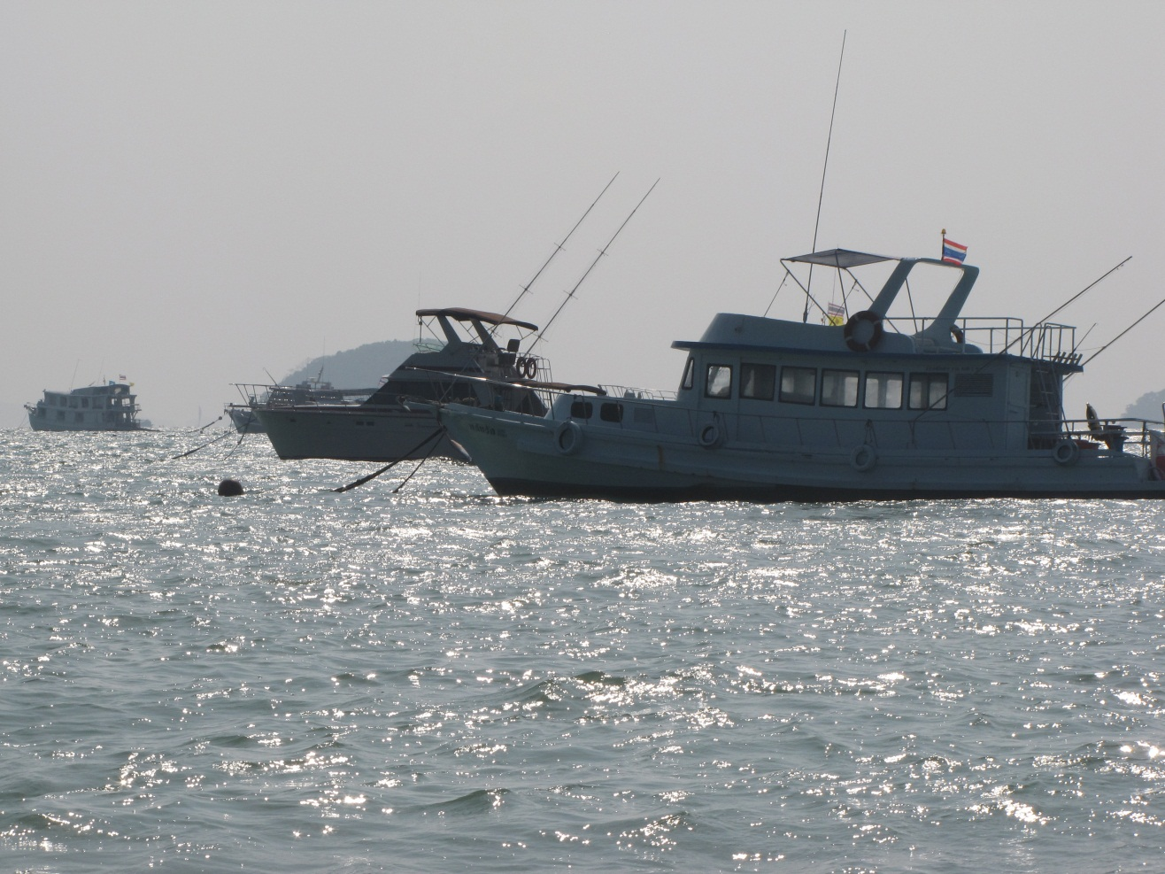
To my mind, the Strait of Malacca and surrounding waters badly need extensive risk analysis to show what we can loose. Possible funding organisation: EU research mechanisms, especially World Bank

Slide 44
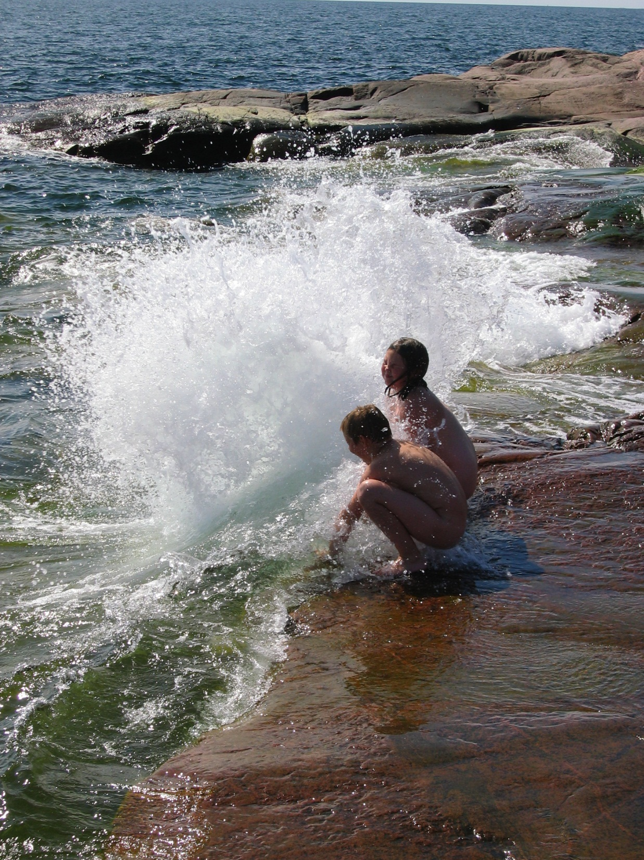
I want to
acknowledge
The
Baltic Sea
And FEM group in UH
For good
motivation !

