Slide 1
City of Rotterdam
Delta Climate adoption Environmental Assessment

Slide 2
Assessment Attributes
SCOPE
Question
ANSWER
Results
RATIONALE
Participants
Intended use and users
Conclusions
Calculations
Indices
Analyses
Dependencies
Stakeholders
Boundaries
Decisions and scenarios
Timing

Slide 3
CLIMATE PROFE DELTA CITY
Which climate change effects & problems will heat stress cause in the city? How vulnerable is Rotterdam Delta?
Will our dikes be high enough and strong enough in the future?
How well-protected from flooding are the port areas of Rotterdam?

Slide 4
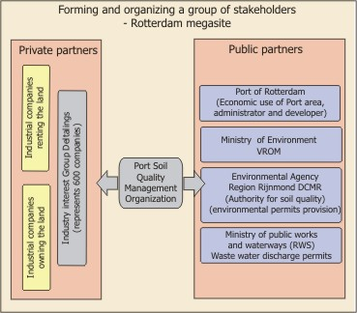
Intended users and Participants
Public sector organizations
Private sector organizations
EU Environmental execution bodies
EU Border projects
Local port Governance agencies.
CITY management
Land owners and Investors

Slide 5
Boundaries
Increase of neighboring property value
Infrastructure
Improvements in environmental quality
Protection and improvement of public health
Reduced urban sprawl
Financial resources and costs

Slide 6
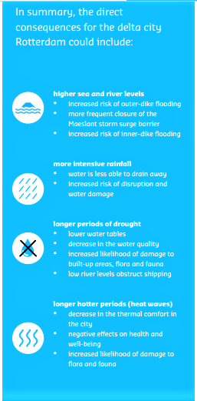
Delta Scenarios
Outer-dike flood protection
Inner-dike flood protection
Protection against extreme rainfall
Protection against drought
Protection against waves of high temperature
Decision
Area specific approach strategies based on combined additivity over time.

Slide 7
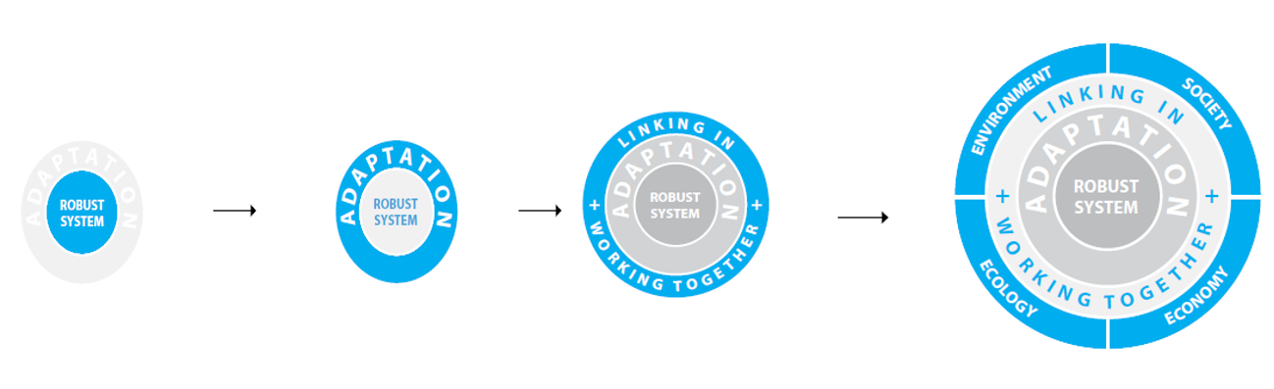
RESULTS & CONCLUSIONS

Slide 8
STAKE HOLDERS
Regulatory participants:
EU room for the river projects and altered discharge regimes at the German-Dutch border.
Delta Committee to parliament.
Regional board consisting of (municipalities, provinces, the waterboards.
‘bestuurlijke tafels’ national governmental stakeholders.
Execution Participants:
Port Rotterdam Company
Rotterdam Delta commissioner.
Deltares research institute.
Network Organisation for Quality of Environnment (NOK).
"maatschappelijke adviesgroep" (MAG)

Slide 9
DEPENDENCIES
Type of social and business activities on the delta.
Types of adoptive scenarios needed ( Clustering in Port Rotterdam)
Modeling restoration and logistics of Environmental restructure.
Assumptions on concentration and value added adoptions.

Slide 10
Analysis
Following adaptation measures are produced:
1) Dike reinforcement
2) Water storage Grevelingen
3) Room for the River measures
4) Channel deepening
5) Full closure with dams and sluices

Slide 11
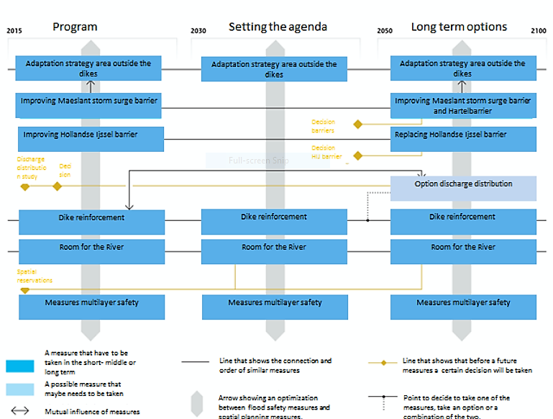
Conclusions

Slide 12
Edem’s HW4
Assessment of Irish Academy of Engineering to tackle climate changed especially green house gases effects.
Assessment is assigned to people of Ireland focusing on key infrastructural areas:
water supply.
flood alleviation.
energy infrastructure.

Slide 13
Conclusively
With recommendations made by the Irish Academy of Engineering:
Northern Ireland and the Republic of Ireland will be well equipped to adapt to the changes that will occur as a result of climate change
The changes needed to be done for this adaptation to occur will require a lot of financial commitment but it is all worth it

